Slide 1



Slide 2

Roles | Name
Chair | Jo L
E3 | Emma G
AP/ Resources for SENDCOs | Michelle D
The Waiting Well offer | Beth
Planning for next year | Jo L
If you have any questions or queries, please add to the chat.
Please press record.

Slide 3

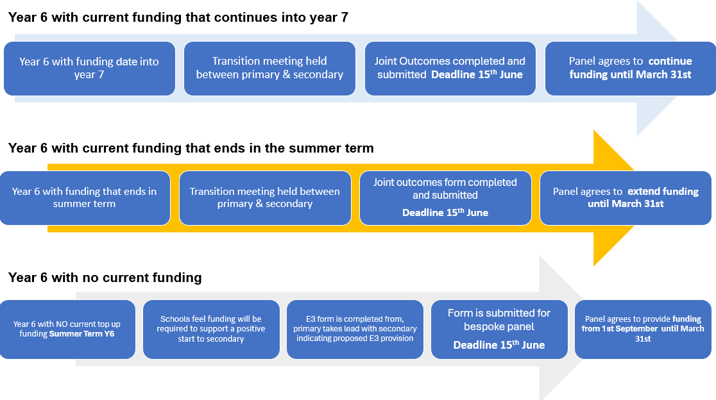
E3 top up funding
Y6/7 (deadline reminders) 15th June
Notes:
Year 6/7 - main focus
15th June – on the Extranet - add link
Add pathway arrows EG
SENIF Emergency Funding
1 year review launch from Sep. Form similar to emergency and expected to update provision and outcomes. A randomised sample of pupils will
be selected for a review visit

Slide 4
Emergency funding The Emergency funding process is now including:
B2EE (Barriers to Education and Engagement)/EBSA (Emotionally Based School Avoidance)
SENIF (SEND Inclusion Fund)
13-week funding to support the gradated approach, this could be extended in consultation with SENDSS
The SENIF emergency process has also been introduced to give settings the same 13-week support to build a graduated approach
Benefits to schools through the transition phases
This is for urgent, short-term support where needs are escalating or emerging.
E3 1-year review (2-year pilot)
From September we will be requesting a mid-point review of the provision
Paperwork is streamlined and similar in format to the emergency review document.
Within the paperwork there would be an expected outcome and provision update
Randomised sample based on pupils to complete a physical review.
Aim: to assess what’s working, what needs adjusting, and how to better support schools and pupils.

Slide 5
Alternative Provision
Part time timetable forms:
School's Extranet
The Ofsted inspection framework for Local Authority Children's Services includes a focus on children who are missing from education or who are being offered alternative provision. The LA is therefore required to have knowledge and oversight of such arrangements. This form is for schools to notify the LA about a pupil's provision when it is part-time and/or the pupil is attending alternative provision. The form should also be submitted when there is a significant change to previous details provided about a pupil's timetable.
Other support tools for AP:
https://schools.leicester.gov.uk/alternative-provision/
Draft AP Handbook
Draft AP Directory
AP/E3 Top-up Funding Application form and FAQs
Notes:
Annual review resources
E3 videos
Each of the Year 6/7 transition info
Link to be

Slide 6

Resources for SENDCOs
Area on the Extranet to support SENDCos, linked to BERA https://schools.leicester.gov.uk/sendco-additional-resources
Video resources
Annual Review School's Extranet
Year 6/7 School's Extranet
E3 applications video links School's Extranet
Notes:
Annual review resources
E3 videos
Each of the Year 6/7 transition info
Link to be

Slide 7
The Waiting Well offer - SEMH support
To support children who are awaiting special school places, and are struggling to settle to learn, we have a team within the SEMH team who can provide additional input.
This is available for primary and secondary schools.
The additional support will be bespoke. Some examples of this are:
1:1 sessional work alongside the child, including the child’s voice
Closer working with families
Support around alternative provisions
Working alongside key adults and SLTs
Circle of adult / solution circles
If you have concerns about a child who is awaiting a place at a SEMH special provision and they are struggling, please get in touch – bethan.pope@leicester.gov.uk

Slide 8
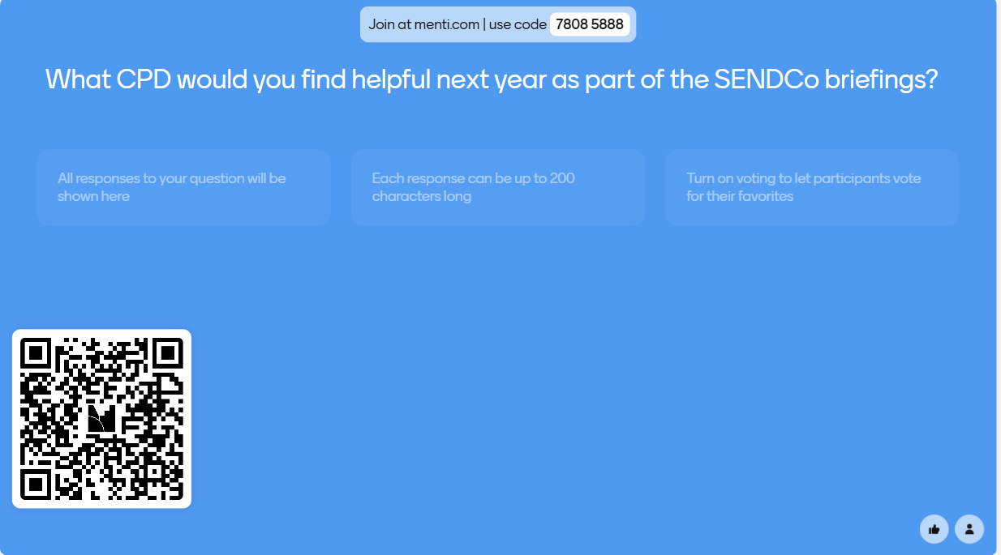

Slide 9
Question and Answer

