Slide 1


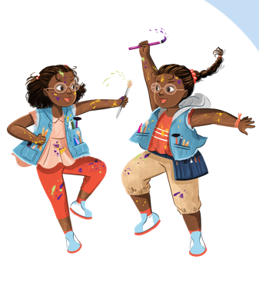


www.summerreadingchallenge.org.uk

Slide 2



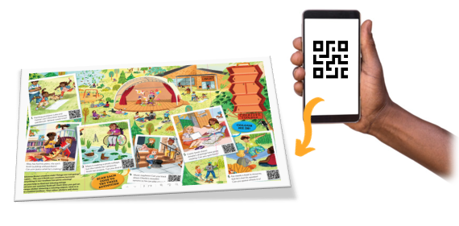

Here's how it works:
Go to your library this summer to sign up and get your Marvellous Makers collector’s foldout poster!​
Read books and collect stickers for your reading (watch out for the smelly stickers…)​
Add the stickers to your poster to complete the Challenge
Scan the QR codes on your poster to find fun 'how-to’ creative activities!
Remember, you can read ANYTHING you like. It could be a book, comic or magazine, eBook or audiobook from your library – they all count!​
Notes:
You set your reading goal, choose anything you like to read, and collect rewards for your reading. You can sign up at the library or online and it’s FREE to take part.
When you join the Summer Reading Challenge at the library, you’ll get your very own collector’s foldout poster where you can record your reading and collect special stickers.

Slide 3
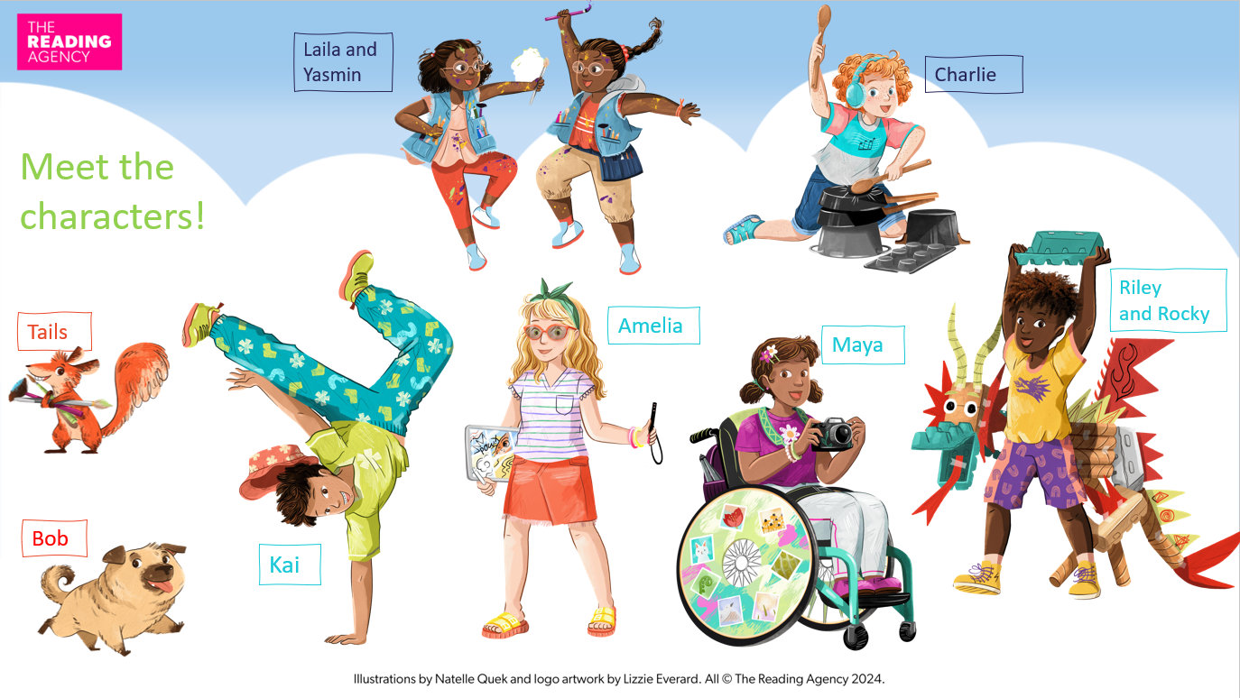
Notes:
This year’s Challenge is called Marvellous Makers, and it’s all about being creative! There’s something for everyone, from dance to drawing, creative crafting to Lego coding. We’ll help you find new reads to get your imagination buzzing, and there will be lots of activities to do in libraries all across Leicester.
Your characters are the Marvellous Makers! They're all part of a creative club. They enjoy expressing themselves through different creative hobbies and, of course, they love reading. You'll meet them inside your collector's poster and help them solve a mystery involving Tails, a cheeky squirrel who seems to be hiding things...

Slide 4

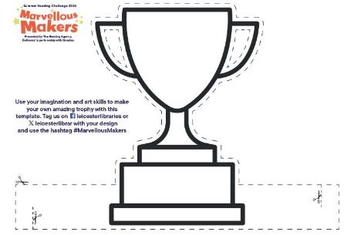
Complete the Challenge and earn your certificate of achievement!
Use the stand-up trophy template to create your own unique award for reading.
Notes:
Along with your certificate this year we have a stand-up trophy design for you to get creative with and make uniquely your own

Slide 5


Take part this summer!
The Challenge begins in Leicester on Saturday 29 June
and ends in Leicester on Sunday 15 September
Free family library events all across the city – check our webpage:
leicester.gov.uk/summerreadingchallenge

Slide 6
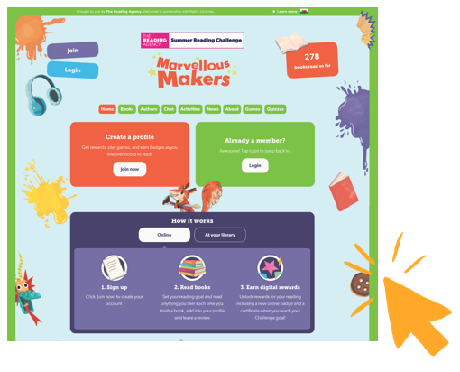
Take part online!
summerreadingchallenge.org.uk
Set your own summer reading goal
Rate and review your books to unlock badges
Play games and enter competitions
Use the Book Sorter to find books recommended by other children
Notes:
The fun continues at home too! Visit the Summer Reading Challenge website to play games, review your latest reads and enter competitions.
You can share your favourite books with other children taking part in the Challenge and unlock extra rewards for your reading and reviewing!

Slide 7

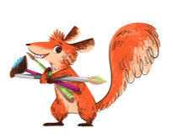
Be a winner for your school!
Be an amazing summer reader and complete the Marvellous Makers six book reading challenge to win £100 for books for your school.
The city school with the highest percentage of children completing the challenge will win!

Slide 8
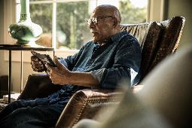
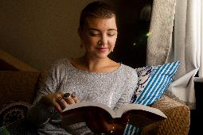
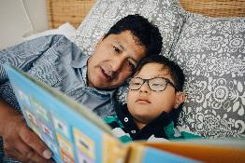
Grown-ups get reading too!
You can be a role model and support your
children by joining in and reading six books too.
Pick up a form at your local library and get reading!

Slide 9
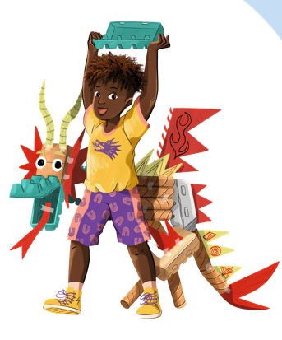
Free Family Fun days in July and August across the city!
Join in fun activities, challenges and games.
Plus, some bookable sessions for children age 6+ with our many partners, including:
Simple Science, Lego coding, National Space Centre workshops, active sessions with Inspire Together, ‘naturally creative’ sessions from the Sustainable Schools team and, of course, plenty of creative craft.
Ask at your library for details - and don’t forget to borrow a book!
Notes:
Lego coding:
15 July St Barnabas 1-2.30pm
16 July Hamilton 1-2.30pm
17 July Central 1-2.30pm
18 July Highfields 1-2.30pm
22 July New Parks 1-2.30pm
23 July Westcotes 1-2.30pm
24 July Fosse Centre 1-2.30pm
25 July Rushey Mead 1-2.30pm
Space Centre:
22 July Rushey Mead 1.30-2.30pm and 3-4pm
23 July Beaumont Leys 1.30-2.30pm and 3-4pm
24 July Belgrave 1.30-2.30pm and 3-4pm
25 July St Matthews 1.30-2.30pm and 3-4pm

Slide 10

What can you see on Summer Street?
Help us create Summer Street in your local Leicester library!
Visit a library in the first week of the holidays to borrow your first books for the summer and make a character, creature, object, plant or other feature to add to our amazing summer street scene picture in the library.

Slide 11
Play the game: Climate Change Global manager
Can you help our planet by reducing the impact of climate change?
Play the game on special arcade kiosks and find out!
Suitable for children age 8+.
Notes:
Kiosks will be at the following libraries for two weeks from these dates:
1 July Pork Pie and BRITE Centre
15 July Highfields and St Barnabas
29 July Aylestone and St Matthews
12 August Beaumont Leys and New Parks

Slide 12


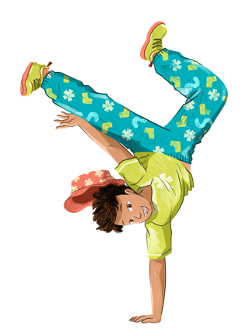

See you at the library!
Marvellous Makers - promotional animation (YouTube)
Notes:
Marvellous Makers Summer Reading Challenge 2024 | The Reading Agency – YouTube TRA SRC animated film.

