Slide 1
#EcoTeach Webinar Waste and Recycling
The webinar will start here soon….

Slide 2
#EcoTeach Webinar Waste and Recycling
Lee Jowett, Environmental Education Coordinator
Amy Peace, Graduate Project Officer

Slide 3
#EcoTeachMeet Webinar Series
Overview of #EcoTeach format and dates/times of webinars
What Environmental Education Leicester is
Eco-Schools – and how it fits into the big picture
Waste and recycling projects
Q & As
Other opportunities coming up

Slide 4
Overview of #EcoTeach Webinar format and dates/times of webinars
Weekly at 10am during term time – lasting up to an hour, Leicester focused but suitable for everyone.
Recording and PowerPoint with links available afterwards at schools.leicester.gov.uk/eco-schools
During the presentation, ask questions in the chat box.
Questions and answers at the end – either directly ask or in chat box depending how many people are attending.

Slide 5
What is Environmental Education Leicester?
Provide free support to all Leicester School.
Communications with schools – social media (Twitter, Facebook, Instagram, YouTube), monthly eBulletins and quarterly newsletter.
TeachMeets, Eco-Schools Roadshow, Eco-Schools & Food for Life Celebration, Sustainable Schools Celebration bi-annual.
Focus on the Eco-Schools Award.
Delivery of energy and litter focused projects.
Project support and partnership working with internal and external organisation.

Slide 6
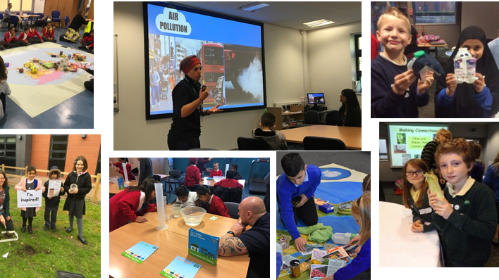
Eco-Schools Roadshow

Slide 7
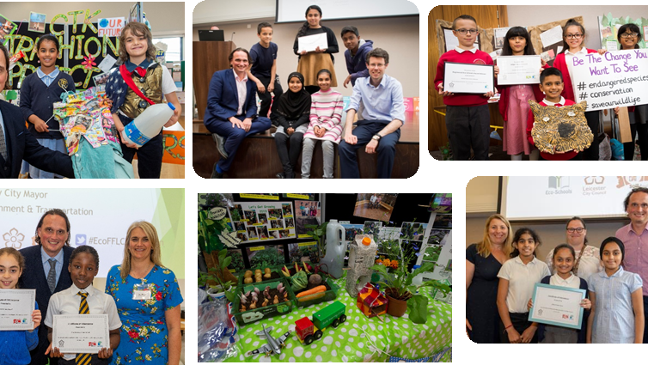
Eco-Schools and Food for Life Celebrations

Slide 8
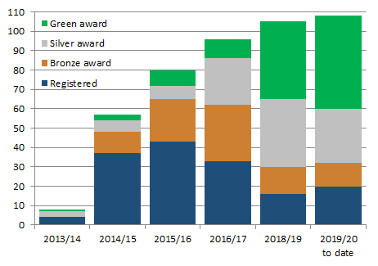
Eco-Schools – Our Work in Leicester
Promoted Eco-Schools as an award since September 2014 (114 schools)
109 registered on the programme
of those, 91 have achieved bronze
of those, 78 have achieved silver
of those 48 have achieved Green Flag

Slide 9
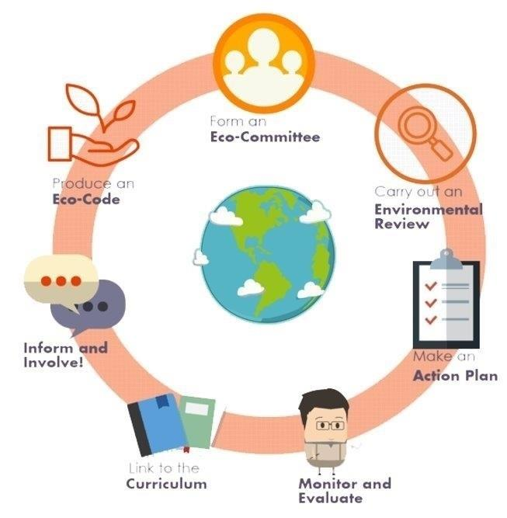
Eco-Schools Programme 7 step model

Slide 10
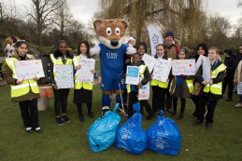
Step 1
Eco-Schools model - 7 steps 1
EYFS resources
Primary resources
Secondary resources
Step 1 – Eco-Committee, the heart of an Eco-Schools action and learning
At least one pupil form each year group
Meet at least once per half term
Share responsibility for running meetings
Records of minutes are kept
Minutes displayed on the Eco-board
Representative from parents, governors or senior leaders

Slide 11
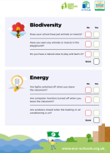
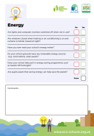
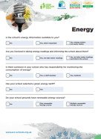
Step 2
Eco-Schools model - 7 steps 1
EYFS resources
Primary resources
Secondary resources
Step 2
EYFS
Primary
Secondary
Step 2 – Environmental Review – investigating the school's environmental performance
Covers all 10 Eco-Schools topics
A copy is displayed on the notice board
It is updated/reviewed at least every 2 years (best practice is annually)

Slide 12
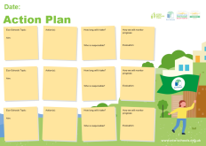
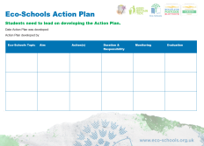
Step 3
Eco-Schools model - 7 steps
EYFS resources
Primary resources
Secondary resources
Step 3
Step 3 – Action Plan – Decide on topic actions, based on the result of the Environmental Review
The action plan is influenced by the review
Pupils take responsibility for learning on the topics
3 for the first green flag
5 for the renewal (changing 2 with each subsequent application)
Contains timescale, who is responsible and how it will be monitored
Shared with the whole school
A copy is displayed on the noticeboard

Slide 13
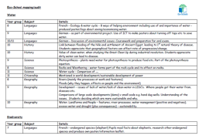
Step 4
Step 4
Eco-Schools model - 7 steps
EYFS resources
Primary resources
Secondary resources
Step 4 – Curriculum Links – making links between the school's environmental activity and the curriculum
Environmental issues are covered in at least three areas in your school curriculum, evident in schemes of work, pupils work and/or lesson plans (for first green flag this can be the same year group)
They do not need to be the same topics as your Action plan

Slide 14
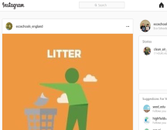
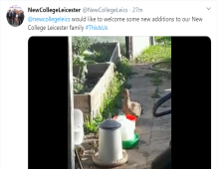
Step 5
Eco-Schools model - 7 steps
EYFS resources
Primary resources
Secondary resources
Step 5
Step 5 – Informing and involving – Let the whole school and wider community know what the Eco-Committee is doing
A prominent noticeboard in school
Covering the 7 steps and 3/5 topics
Members of the committee
Environmental review
Environmental action
Examples of monitoring and evaluation
Eco-code
Variety of mediums to communicate
The whole school and wider community is informed

Slide 15
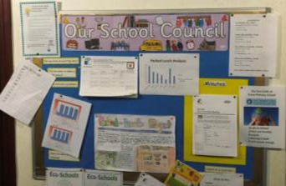
Step 6
Eco-Schools model - 7 steps
EYFS resources
Primary resources
Secondary resources
Step6
Step 6 – Monitoring and Evaluation – Measuring change and finding out what works and what doesn't
The committee monitors the effectiveness of the topics via data collections, surveys, before and after photographs
It is communicated with the whole school
Data has been analysed to help pupils develop further topic actions
Data has been used in the curriculum e.g. graphs and charts in math

Slide 16
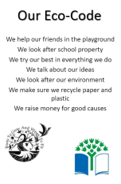
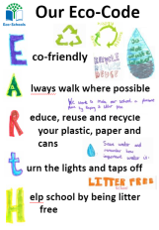
Eco-Schools model - 7 steps
EYFS resources
Primary resources
Secondary resources
Step 7
Step 7 – Eco-Code – Creating a call to action that the whole school can get behind
There is an agreement statement for your school drawn up by pupils
It reflects the topic actions you are working on
It is displayed around school e.g. classrooms, hall and the office
The majority of pupils and students understand is

Slide 17
Eco-Schools model 10 topics

Slide 18
Key things to think about in topics
Whole school opportunities
Informing everyone about the work
Links to curriculum areas e.g. science (materials), DT (construction, materials), English (persuasive writing) and maths (data handling)
Monitor impact of actions – weights and counting items – however photos before and after projects & surveys
Reflected in your Eco-code

Slide 19
Waste and Recycling Projects
General recycling information
Orange bag scheme
Ball Mill
Recycling support from Leicester City Council
(Re)Love Our Stuff
#EcoSchoolsAtHome
COG Youth Services
Clothes recycling
Happy Feet - Africa’s Gift
Battery recycling
Composting
Cool Milk
Plastic reduction – action planning
Wastebuster
Carbon Literacy Project
Plastic Free Schools
Sainsburys Food Waste
Notes:
Why focus on litter?
- bad for the environment, can pollute soil, water and air
- looks horrible
- costs money to clear up
- can attract pests

Slide 20
General recycling advice
Most schools will have 2 bins
General waste (landfill)
Mixed recycling
Paper and cardboard
Glass
Plastic bottles
Metal tins and drink cans
Other recycling around school e.g.
Batteries
Pens
Compost
Toner cartridges and printer inks

Slide 21
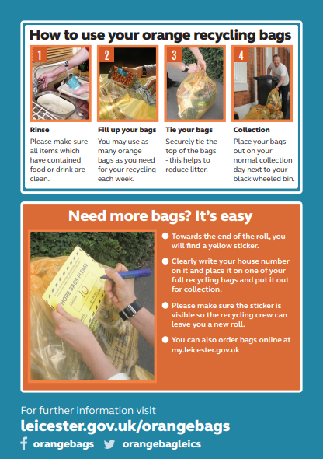
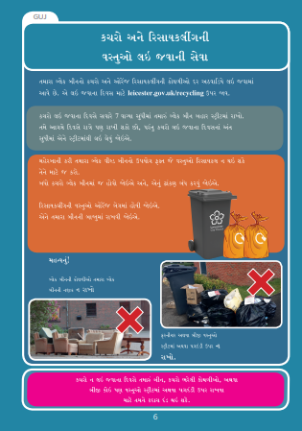
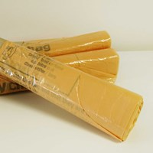
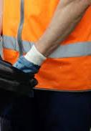
Orange Bag Scheme
www.leicester.gov.uk/recycling

Slide 22
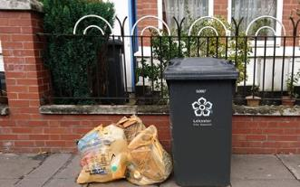
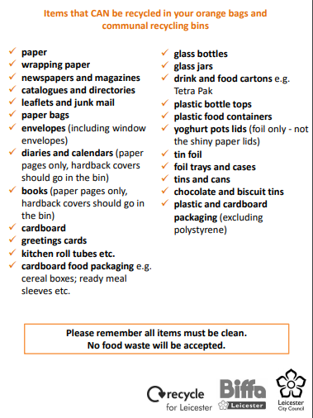
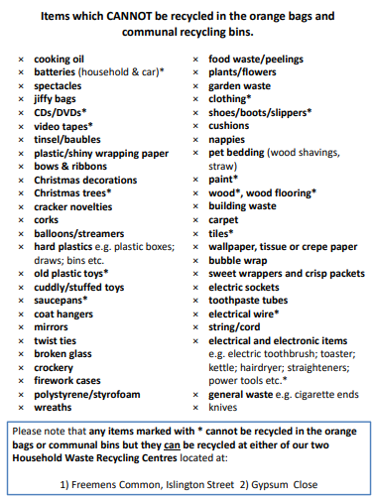
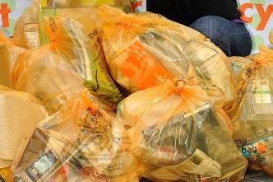
Orange Bag Scheme
Orangebags
@orangebagleics

Slide 23
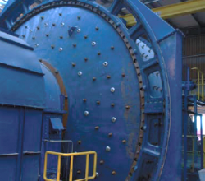
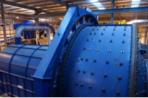
Ball Mill
The Ball Mill is responsible for diverting approximately 70% of wheelie bin waste from landfill and is the only one of its kind in the UK.
The Ball Mill is a huge drum similar to a washing machine. Instead of washing powder contains 42 tonnes of steel balls.
Waste is fed into the drum, which rotates causing the balls to pummel and grind the waste into much smaller pieces.
So, all plastics, cardboard, light materials, metals and food waste can be extracted out of wheelie bins waste and diverted from landfill.
The priority should always be the orange bags as this is cleaner and can be re-used in food grade recycling
View the Ball Mill leaflet, or for a more complex explanation to the Ball Mill and the various extraction processes.
Groups can visit the site. Contact at my.leicester.gov.uk

Slide 24
Ball Mill
For more information please contact Sophie Glover
Sophie.Glover@biffa.co.uk

Slide 25
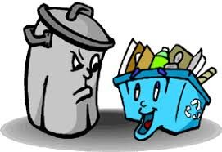
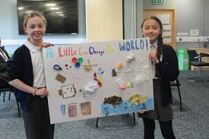
Recycling support from Leicester City Council
Our Waste Management Team offers a range of activities tailored to your school for all things recycling and waste related.
We can offer a range of sessions, including assemblies, workshops and classroom presentations, tailored to your needs and covering a range of topics including:
Reduce – changing habits and behaviours to reduce the amount of waste produced.
Reuse – instead of disposal, think about alternative uses for unwanted items.
Recycle – gain confidence with home or school recycling services.
For further information please contact Kimberley Tilley
Service Development Officer (Waste Management), Leicester City Council
Kimberley.tilley@leicester.gov.uk or 0116 454 6742

Slide 26
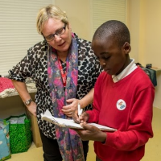
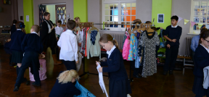
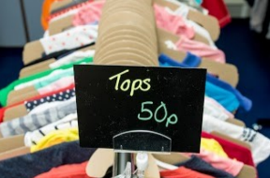
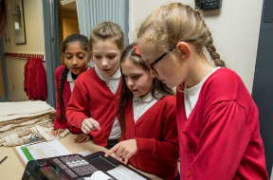
(Re)Love Our Stuff
(Re)Love Our Stuff was developed by Eco-Schools and Keep Britain Tidy’s Centre for Social Innovation.
Gives your pupils the chance to manage a real-life project that delivers measurable environmental savings.
Design, advertise and run a pop-up, second-hand clothes shop.
Can link to Math, English, Science and Art and Design.
Develops enterprise skills including, Leadership, Communication, Teamwork and Presenting.
Raises funds for school or charity.
Prevents clothing from going to landfill.
Reduces energy usage and greenhouse gases.
Re(Love) Our Stuff download

Slide 27
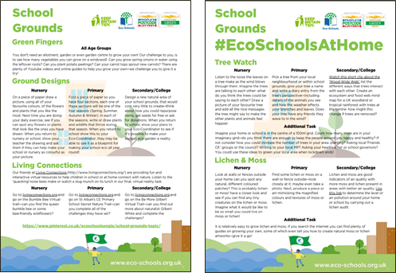
#EcoSchoolsAtHome
Every Tuesday at 8:00pm Eco-Schools England is publishing a new Eco-Schools Topic handout that will include 5 different topic related tasks that can be undertaken both at home and in school.
The topic actions have been designed so that they can be carried out by nursery children and college students alike.
School Grounds
Biodiversity work
Marine work
Litter work
Energy work
Global Citizenship Work
Healthy Living Work
Transport

Slide 28
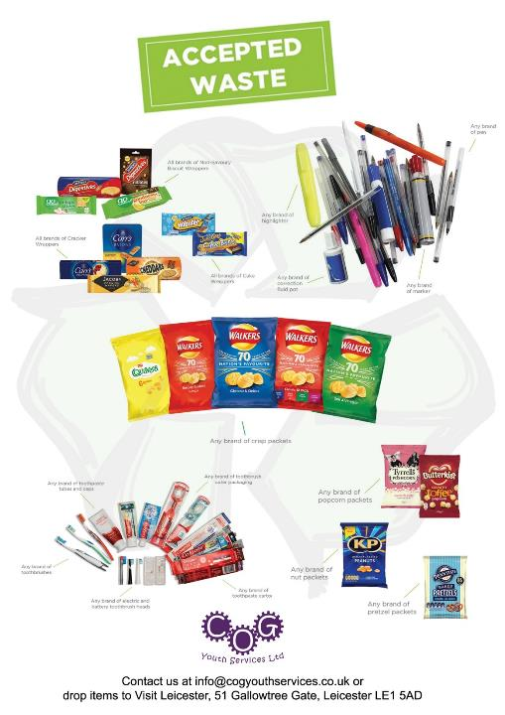
COG Youth Services
COG Youth Services is keen to get schools across Leicester and Leicestershire recycling more. Join us on our epic quest to recycle more plastic then ever!
Collect your pens, collect your crisp packets and collect your toothbrushes as, together, we divert them from landfill and instead, send them to be recycled!
You need to be a school or other educational establishment, based in Leicester or Leicestershire.
You must have a staff member that will act as the liaison for the project.
You must agree to collect at least one of the items listed.
You must be able to ensure only appropriate items are donated.
Register at cogyouthservices.co.uk/service/school-recycling-ambassadors

Slide 29
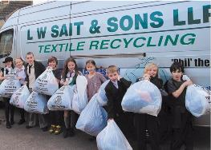
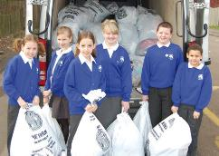
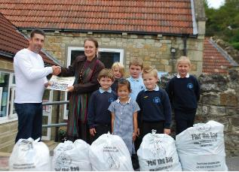
Clothes Recycling
‘Phil’ the Bag is a FREE clothing recycling initiative.
Raises funds from your textile recycling donations.
The setting up of a 'Phil' the Bag collection, the actual clothing collection and all associated administration is totally free.
You can organise as many textiles collections as you wish during the year so there is no limit to how much money you can raise for your school!
How it works:
The students bring in their bags on your Recycle Day, the bags are then weighed and a certificate and cheque land on your doormat before you know it. It's that easy!
Use your parents/families/members own bags (black sacks, bin liners, carrier bags etc.) and we can recycle these for you.
You will find a template letter to parents attached to send home.
'Phil' offers competitions and regular promotions.
Email info@philthebag.co.uk and they will advise you on available dates for collection.

Slide 30
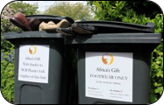
Happy Feet – Africa's Gift
Solve the perennial headache of non-uniform days, raise funds for your school and help support a charity by holding a…​ Happy Feet Day​
a non-uniform day for your feet!​
Students attend school in their choice of footwear, whilst handing over a pair of unwanted shoes that can be used again in rural Africa.​
We pay 40p per kilogram for reusable shoes, and then transport them to Africa, where they are introduced into the communities sensitively.
We collect the shoes from school on the Happy Feet Day, so there are no storage problems. We weigh them and make swift payment.
All we ask is that the shoes are clean, paired, tied and together.​
Book a date to make your feet happy!​
Find out more at www.africasgift.org​

Slide 31
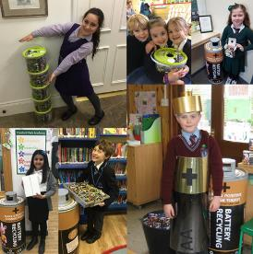
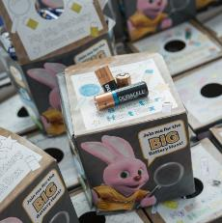
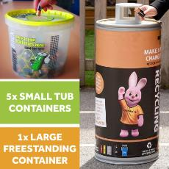
Battery Recycling
The Big Battery Hunt is a nation-wide battery recycling programme for schools.
Its aim is to increase the number of batteries currently being recycling in the UK.
Pupils are challenged to collect as many batteries as they can, encouraging their communities to the same, with the chance to win great prizes.
The Big Battery Hunt 2019 has now closed, but you can register your interest here.
The initiative is currently aimed at Primary aged children and has a pupil activity booklet for Key Stage 2 pupils. But every school in the UK can take part.
Once registrations open, each school will receive a collection box for each pupil and access to the resources. The collection service is only available to schools.
www.bigbatteryhunt.co.uk

Slide 32
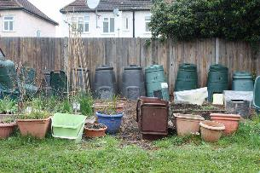
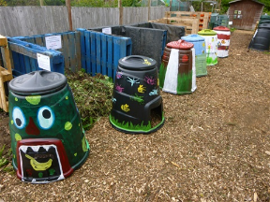
Composting
www.carryoncomposting.com
You can turn garden and kitchen waste into a free, environmentally friendly source of organic matter. It helps reduce the amount of rubbish that can end up in landfill.
Aim for 25-50% of green waste from the garden: Flowers, fresh leaves, grass cuttings, annual weeds, fruit and vegetable waste and plant material.
Aim for 50% plus of brown waste from the garden: Chopped up twigs, dried or old leaves, hedge trimmings, bark, tough plant stems, straw or hay, shredded paper and carboard, eggshells, sawdust, newspapers and brown paper bags shredded.
Potential problems
Avoid allowing any one material to dominate your compost heap such as grass clippings or fruit waste. This can make your compost slimy and smelly.
Flies can be a problem, especially in high summer. Try covering your compost heap with shredded paper.
Vermin include mice, voles and rats. Discourage vermin from your compost heap by only adding garden and vegetable material. Never add cooked food or dairy waste to a compost heap. Call in the professionals if there is a rat problem.
RHS Composting advice

Slide 33
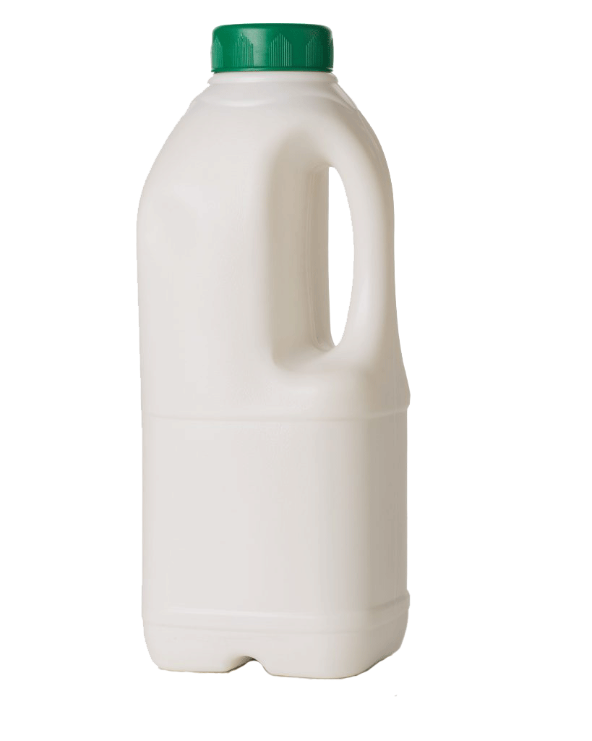
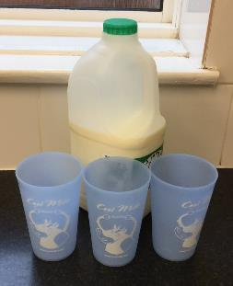
Cool Milk
Cool Milk provide free and subsidised school milk to children in pre-schools, nurseries and primary schools.
In order to reduce single use plastic in schools Cool Milk are able to supply free reusable cups for use in place of the non-recyclable cartons.
Milk will be instead be supplied in large recyclable plastic bottles. Not only does this approach mean that the containers can definitely be recycled it also reduces the amount of material used in the packaging and transport of the milk.
The cups are dishwasher safe and if every school in the city used them significant amounts waste would be prevented each year.
Get in touch with Cool Milk to opt for reusable cups.
https://www.coolmilk.com/environment/

Slide 34
Plastic Reduction Action Plan
The recent wave of awareness about plastic pollution has led many schools to notice how much plastic waste they create.
With plastic, there is no ‘away’ yet we have been treating it as a disposable material for decades.
The most effective way to tackle plastic pollution is to learn to use less plastic in the first place.
To start making a difference to plastic pollution as soon as possible, here are nine practical steps reduce plastic in your school.
www.lessplastic.org.uk/9-ways-to-reduce-plastic-in-your-school

Slide 35
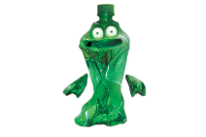
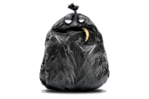
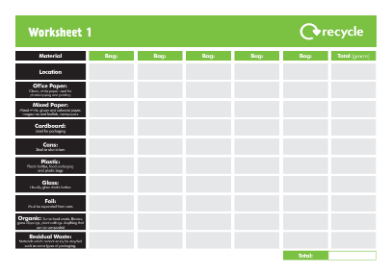
Wastebuster
The Intergalactic Waste Federation has identified Earth as an endangered planet. Captain Busta and his trusty sidekick, Lieutenant Pong, are on a brave mission to protect the planet by reducing waste.
Your mission, should you choose to accept it, is to help children join the mission, by using Wastebuster resources with your pupils and eco-teams. May the eco-force be with you.
Lots of resources, lesson plans and activities.
www.wastebuster.co.uk
Download the resource online

Slide 36
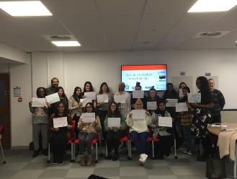
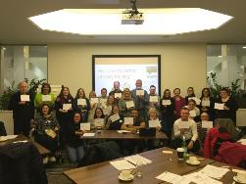
Carbon Literacy
https://carbonliteracy.com
'An awareness of the carbon costs and impacts of everyday activities and the ability and motivation to reduce emissions, on an individual, community and organisational basis.'
Carbon Literacy is a term used to describe an awareness of climate change, and the climate impacts of mankind’s everyday actions.
Enables students to become carbon aware
Gives students a better understanding of how climate change will affect them and others.
Provides knowledge and skills to develop their own responses to lowering their carbon footprint, and the carbon footprint of others.
The project is aimed at Year 5 and Year 8, but other year groups can be considered.
To register your interest email: amy.peace@leicester.gov.uk

Slide 37
Plastic Free Schools
Plastic free schools is a pupil led education programme to reduce plastic in and around school.
Created to hit key curriculum targets from KS1 – KS3, their five ‘objectives’ guide students through the plastic free schools process in an easy to understand, purposeful and fun way!
There are five lesson plans each for KS2 and KS3 which explore how and why we use plastic, what happens to it once we’re done and how it’s affecting our coastlines.
www.sas.org.uk/plastic-free-schools

Slide 38
Plastic Free Schools

Slide 39
Fab Food Resources
Download from their website

Slide 40
Declaring a Climate Emergency in School
On 1 February 2019 Leicester City Council declared a Climate Emergency. The declaration is an acknowledgement that:
Climate change is happening, and threatens the wellbeing of everyone in Leicester and worldwide
The speed and scale of global and local action to tackle the problem needs to be dramatically increased.
In its declaration, the Council committed to developing a new action plan to address the emergency through our own services and projects.
What action you can do:
Discuss your plans with students and staff .
Select actions which you plan to achieve, make them manageable but also remember we are in a Climate Emergency.
Make sure your actions have a duration, responsibilities and an evaluation.
Take your action plan to the Governing Body or Trustees to ensure that you have their support.
You can submit your action plan to the City Council which we will publicise as part of our wider action plan.
Start your action plan!
Review regularly to check and maintain your progress .
schools.leicester.gov.uk/climate-emergency

Slide 41
Climate Emergency Documents
Templates and document available at schools.leicester.gov.uk/climate-emergency

Slide 42
Other opportunities coming up
Education Officer (Eco-Schools) in Leicester – deadline today
15 hours a week, starting at the end of August 2020 (term time working)
UN Climate Change Learn Online
Climate Change: From Learning to Action (8 hours)
Children and Climate Change (6 hours)
Cities and Climate Change (2 hours)
Human Health and Climate Change (2 hours)
Module 1 of Open Online Course on Gender and Environment (6 hours)
Off School website - a free website full of ideas for home learning and fun activities. Head to the Activity Zone for 100s of films, created by teachers, across loads of great topics and themes!

Slide 43
Grant opportunities
British Recycled Plastic grants
eTeach grants link
Grants 4 Schools

Slide 44
Questions and Answers

Slide 45
Future Webinars
20 May | Topic: Transport | Danni Kennell, Air Quality Education, Living Streets
3 June | Topic: Biodiversity | Martha Rose, Leicestershire & Rutland Wildlife Trust
10 June | Topic: Global Citizenship & Fairtrade | Hannah Boydon, Mayflower Primary School
17 June | Topic: Healthy Living | Lisa Didier - Food for Life, Sam Woods - TCV, Daxa Ralhan, Leicester City Council
24 June | Topic: Marine | Daniel Coles, Alex Cameron, Roshni Jose - Leicester City Council Nicola Holt, Environment Engagement, Leicester City Council (and also Refill Leicester)
1 July | Topic: How to submit your Green Flag application

Slide 46
Keeping in Touch
EcoSchoolsLCC
EnvEducationLeicester
EcoSchoolsLCC
EcoSchoolsLCC
schools.leicester.gov.uk/eco-schools
Eco-Schools@leicester.gov.uk
(sign up for newsletter and eBulletins)

