Slide 1
Lichen Identification Game
Match the picture to the lichen

Slide 2
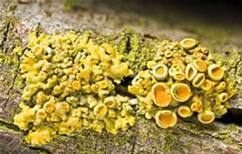
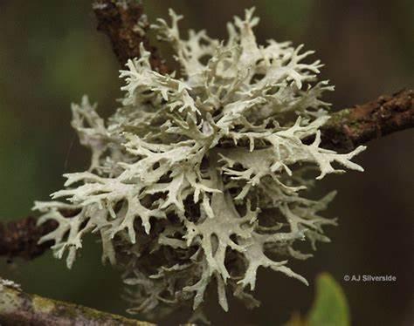
Group A
Group A

Slide 3
Cushion Xanthoria
Evernia

Slide 4
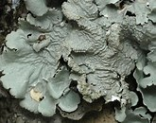
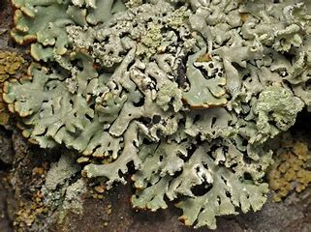
Group A
Group A

Slide 5
Flavoparmelia
Hypogymnia

Slide 6
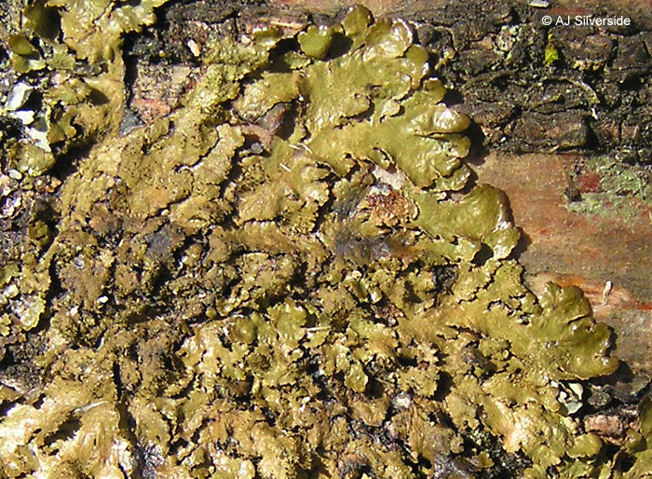
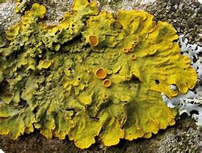
Group A
Group A

Slide 7
Melanelixia
Leafy Xanthoria

Slide 8
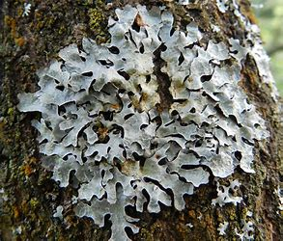
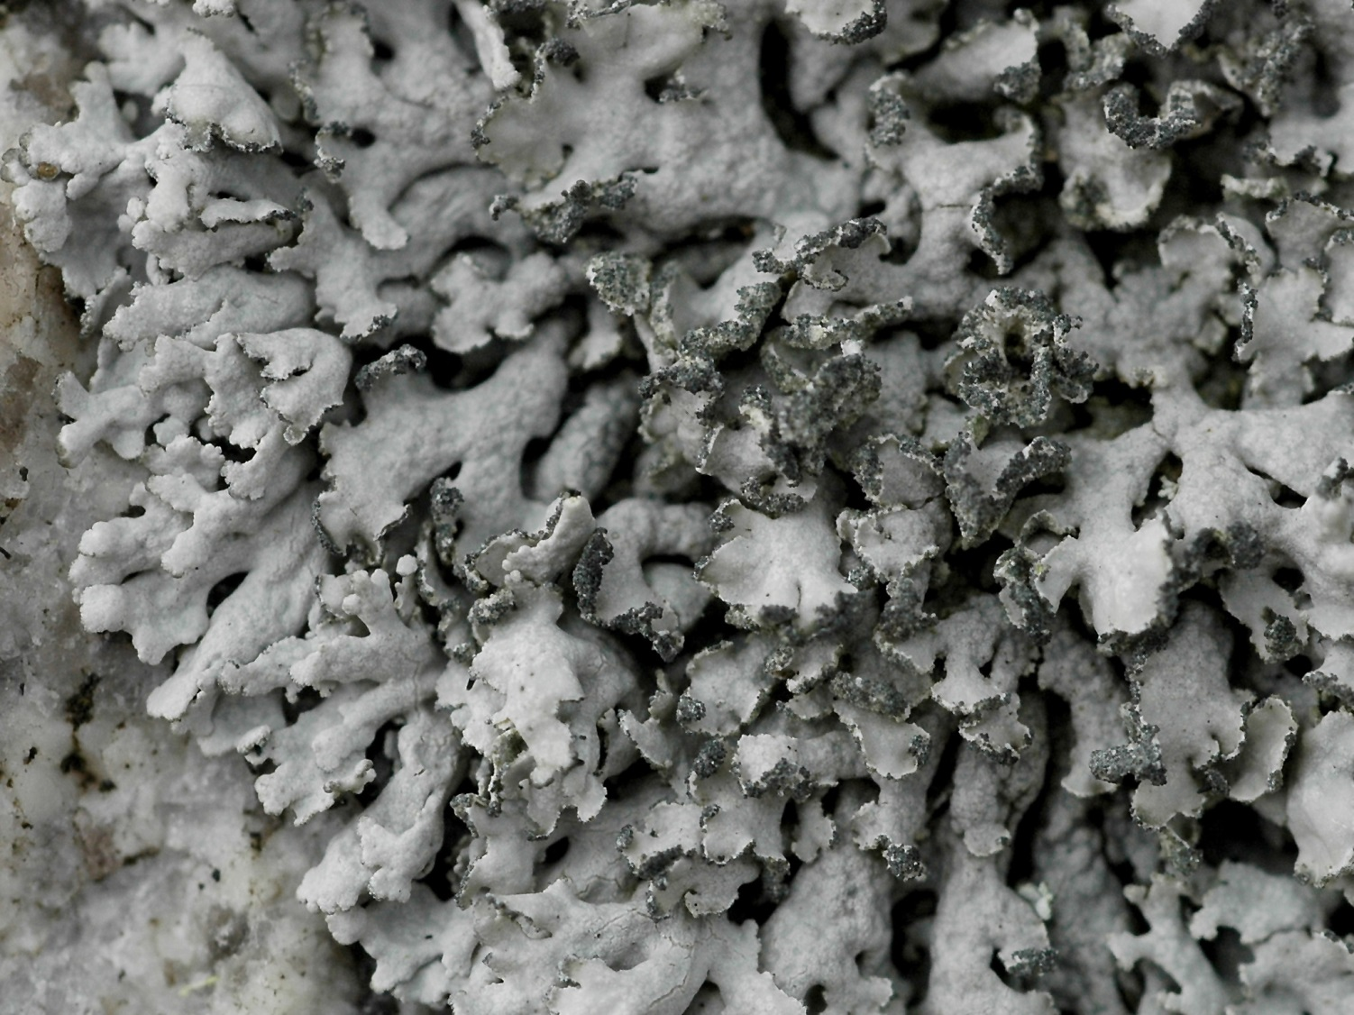
Group A
Group A

Slide 9
Parmelia
Physcia

Slide 10
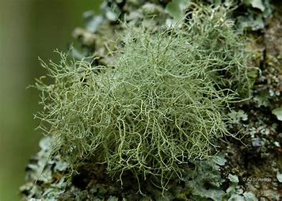
Group A

Slide 11
Usnea

Slide 12
Usnea
Parmelia
Physcia
Evernia
Leafy Xanthoria
Melanelixia
Hypogymnia
Flavoparmelia
Cushion Xanthoria

Slide 13
Nitrogen loving
Intermediate
Nitrogen-sensitive

Slide 14
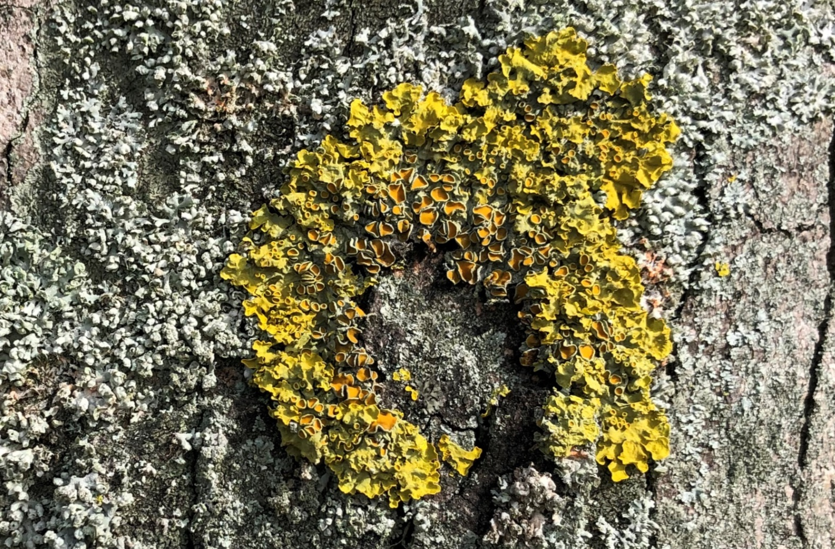
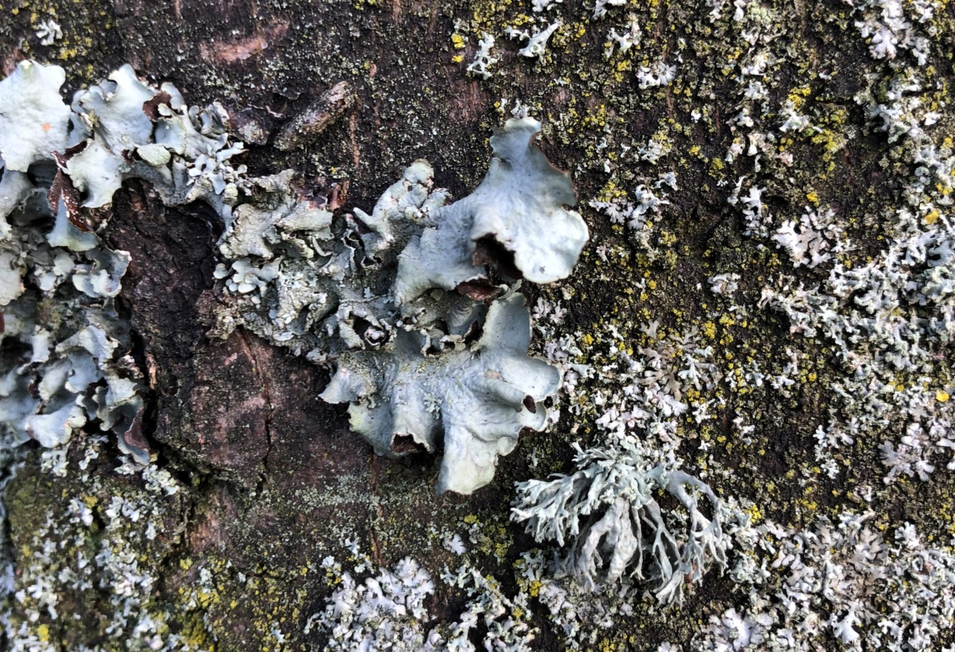
Group B - 8
Group B - 7

Slide 15
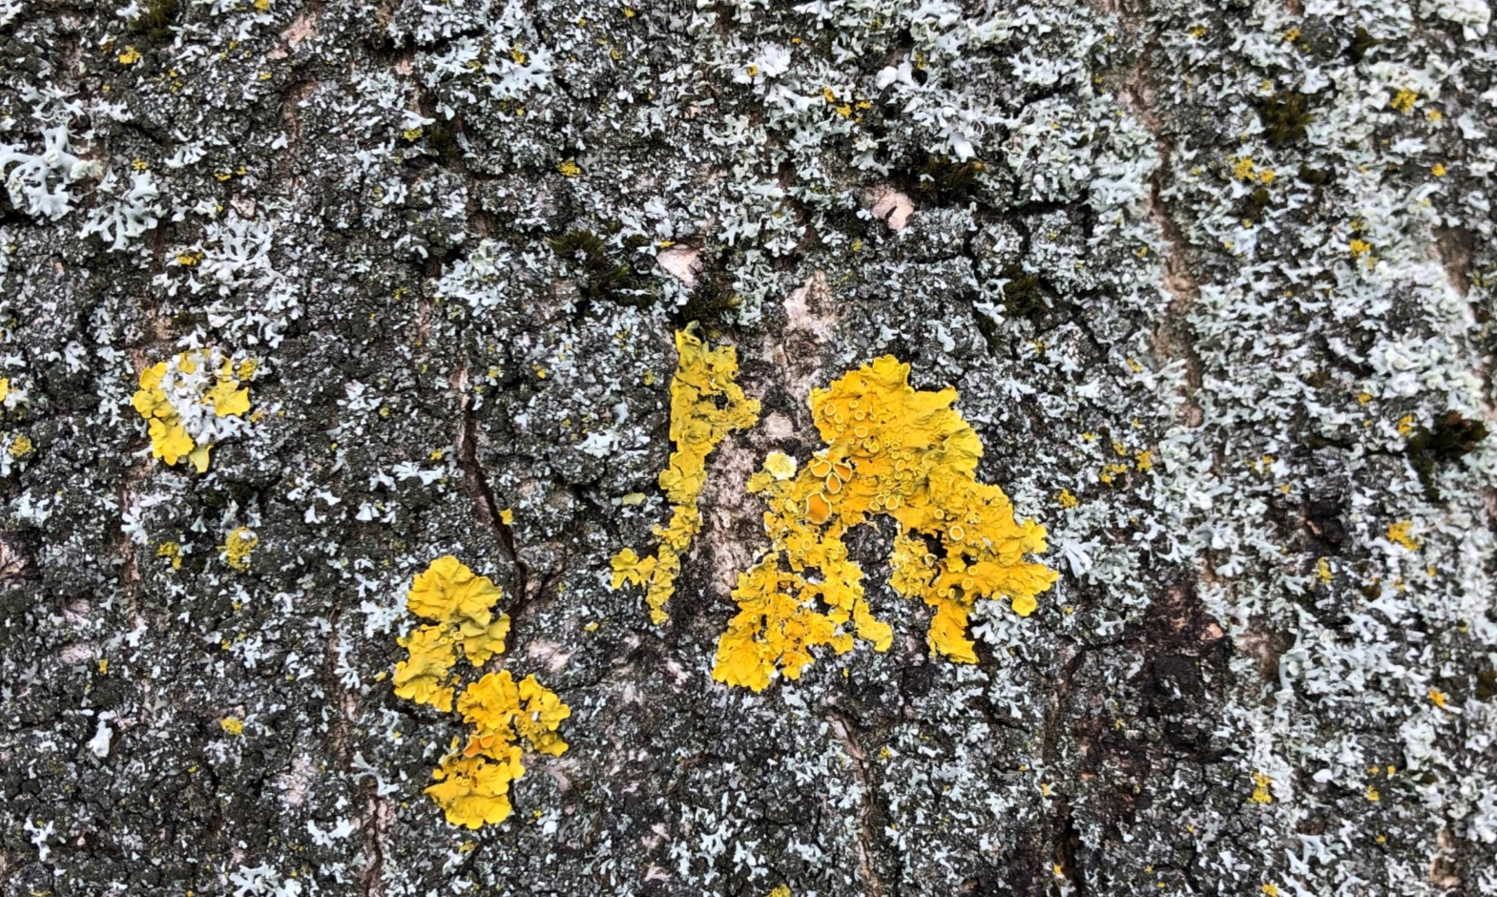
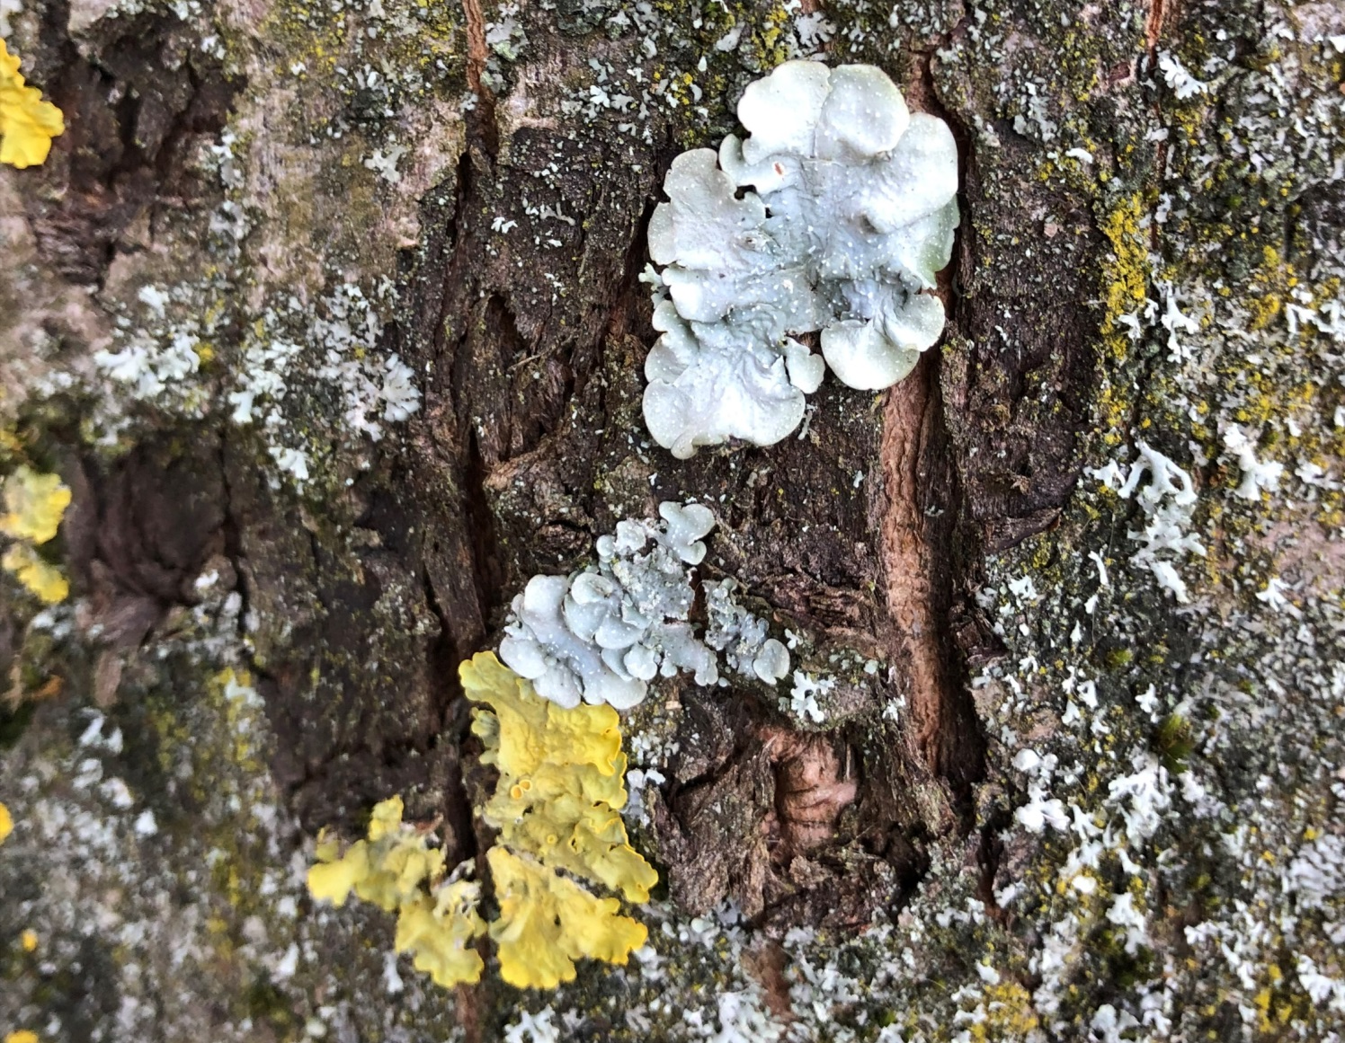
Group B - 6
Group B - 5

Slide 16
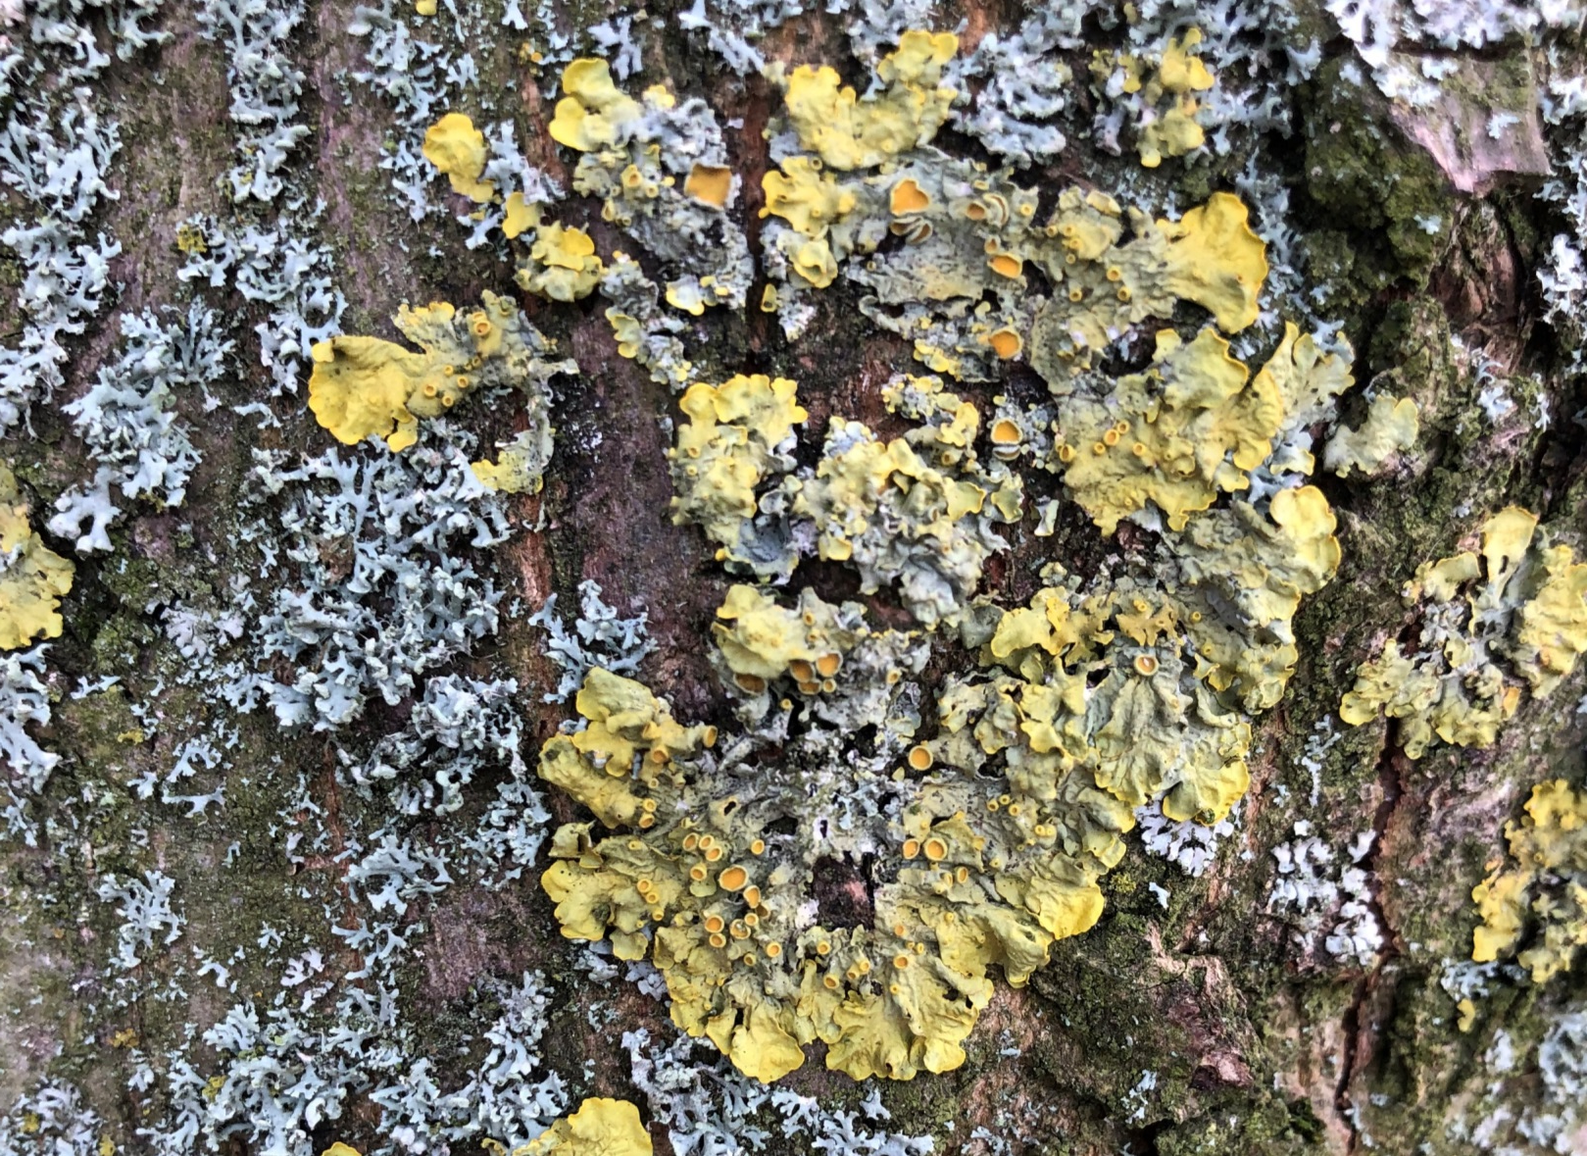
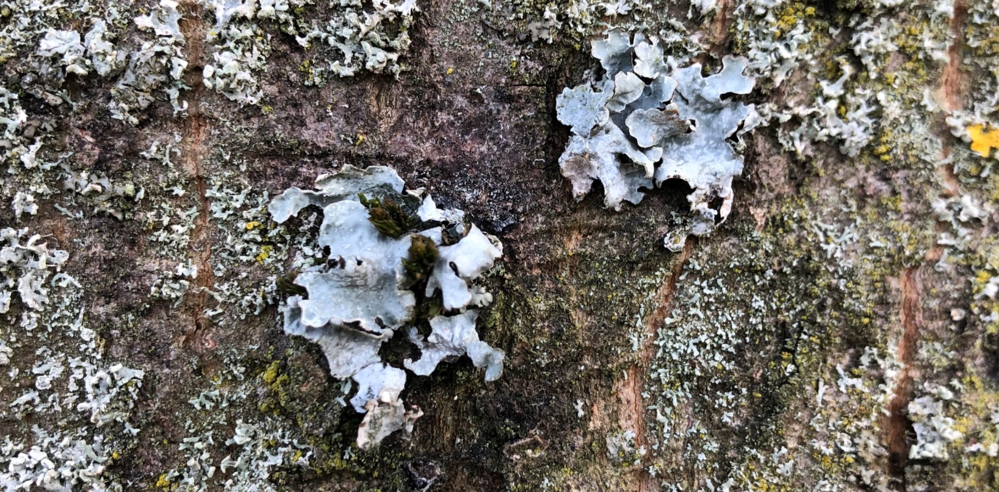
Group B - 4
Group B - 3

Slide 17
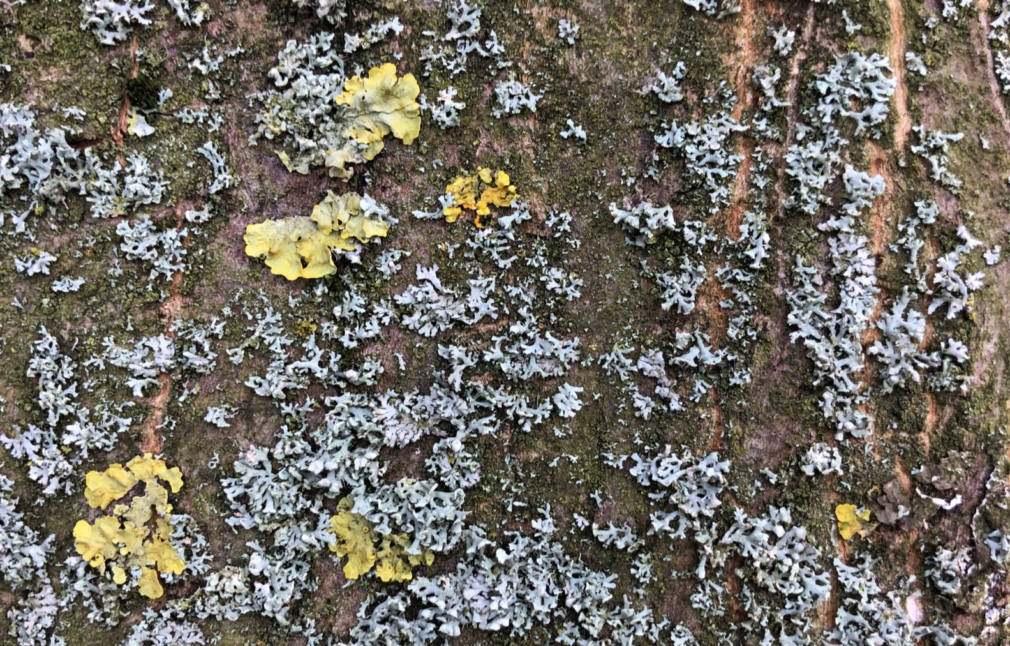
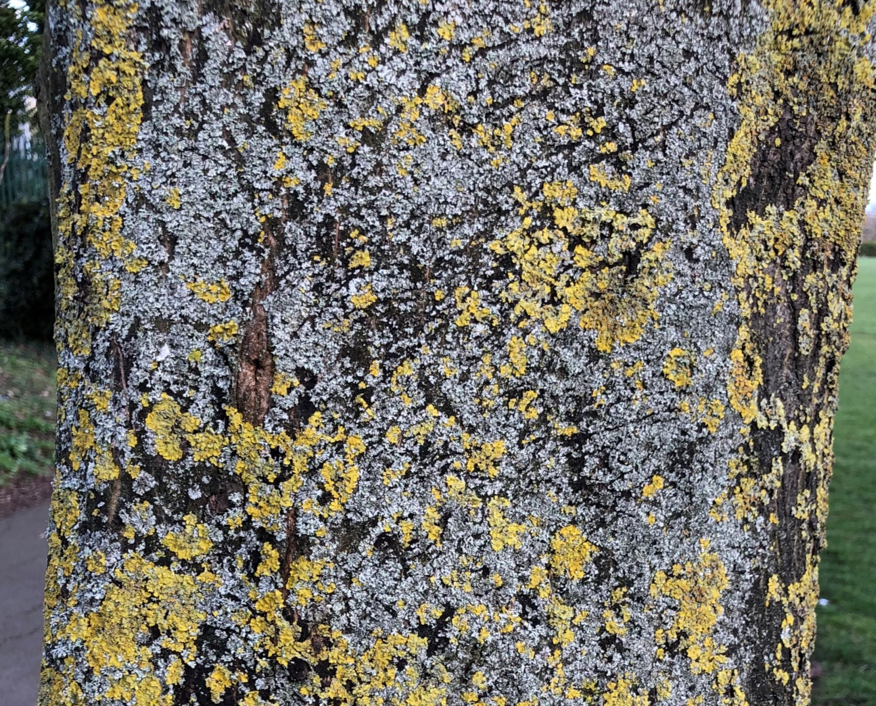
Group B - 1
Group B - 2

