Slide 1
Site Characteristics Game
Match the words to the picture
Street
Playing Field / Park
Farmland
Garden
City
Woodland

Slide 2
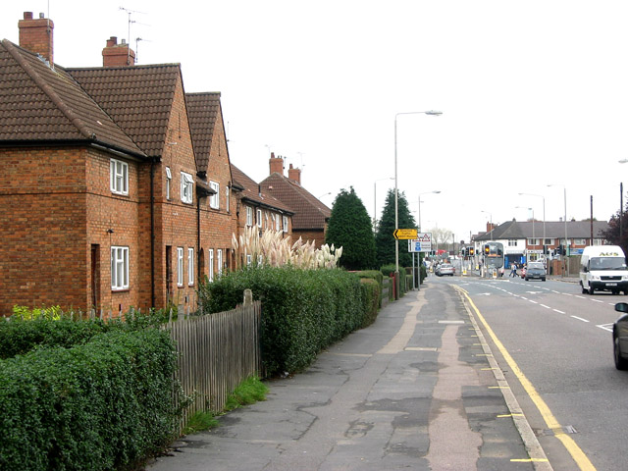

Slide 3
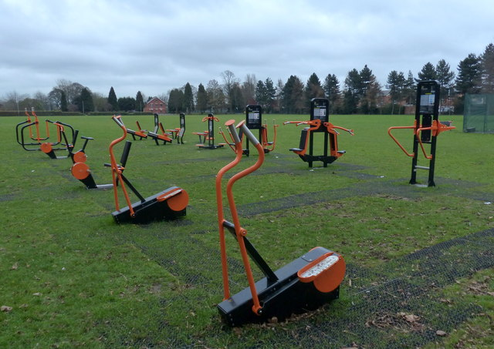

Slide 4
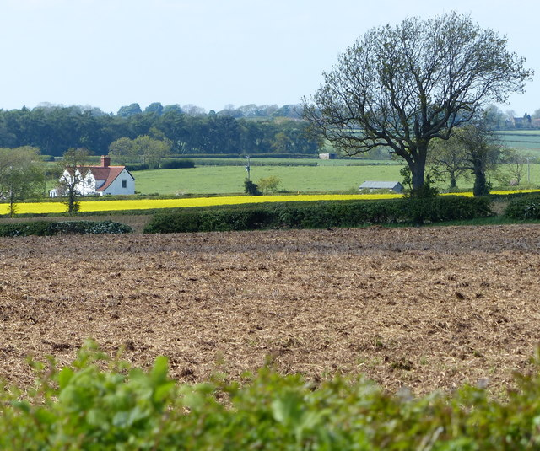

Slide 5
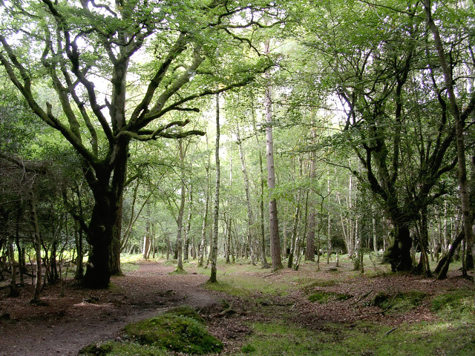

Slide 6
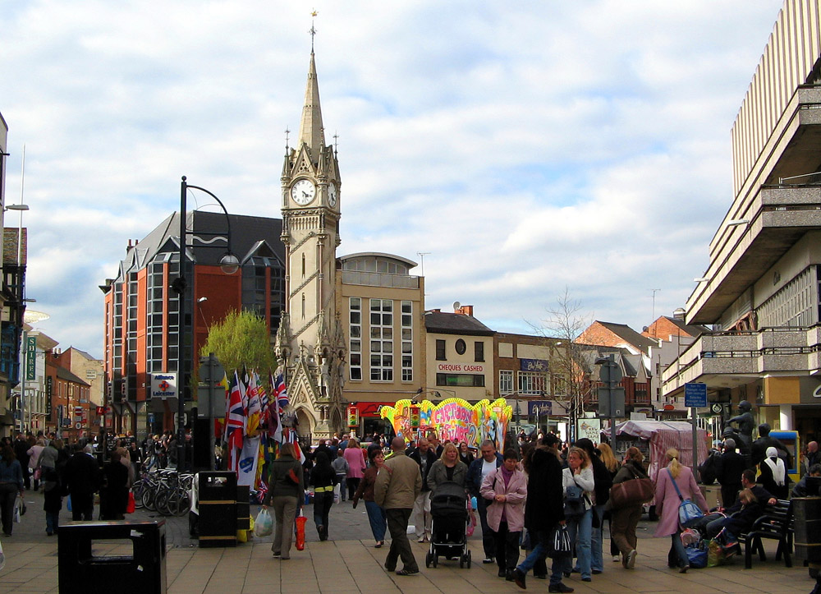

Slide 7
