Slide 1


Slide 2
Why do we need safe clean air?

Slide 3
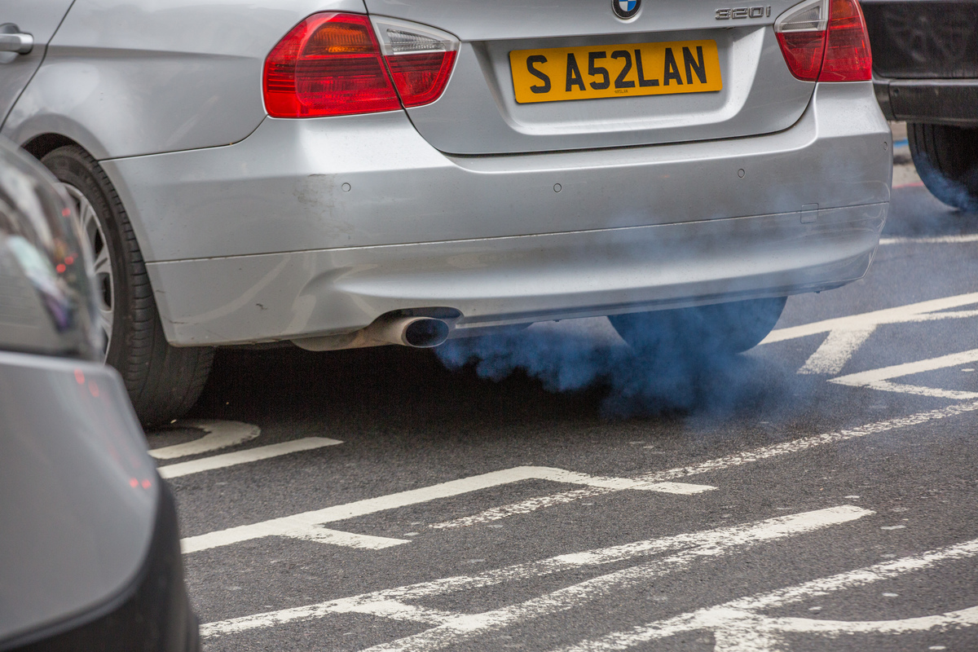
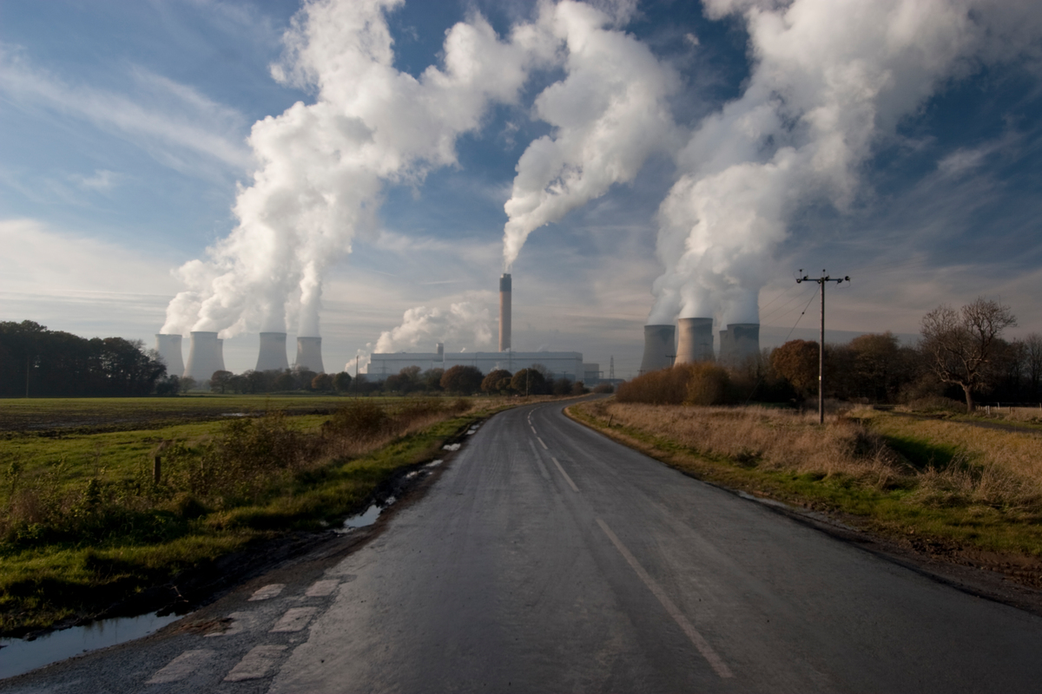
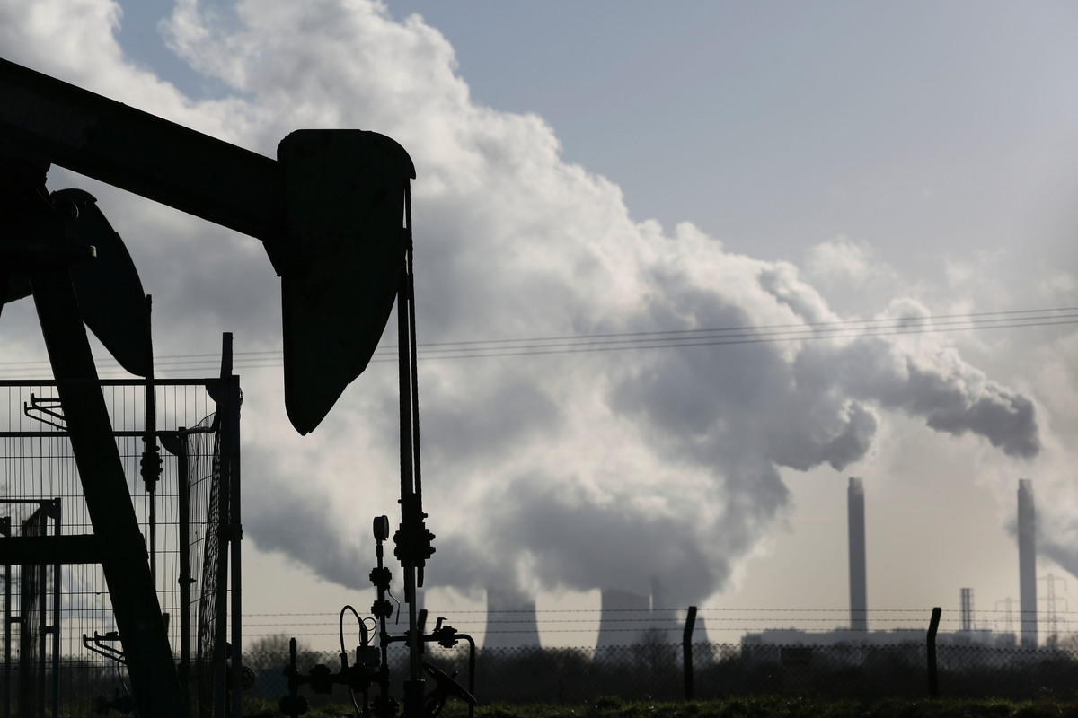
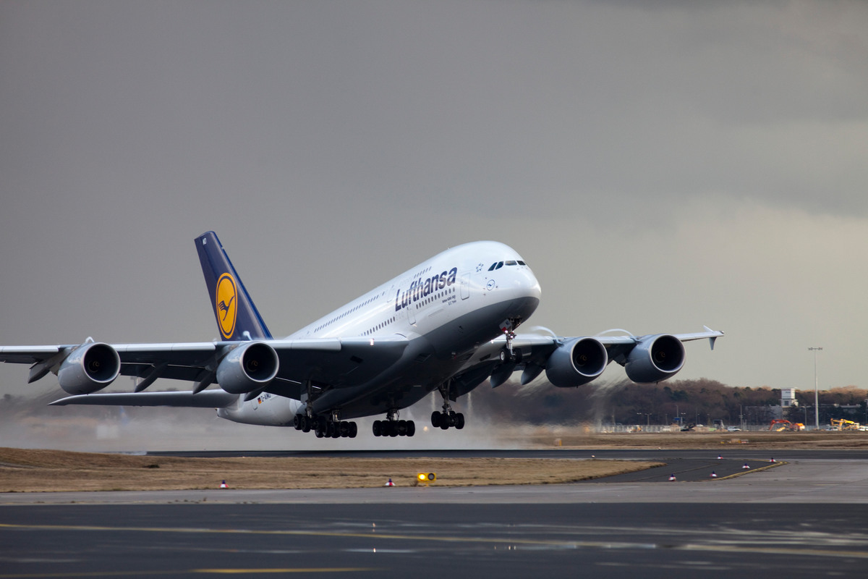
How does our air get polluted?

Slide 4
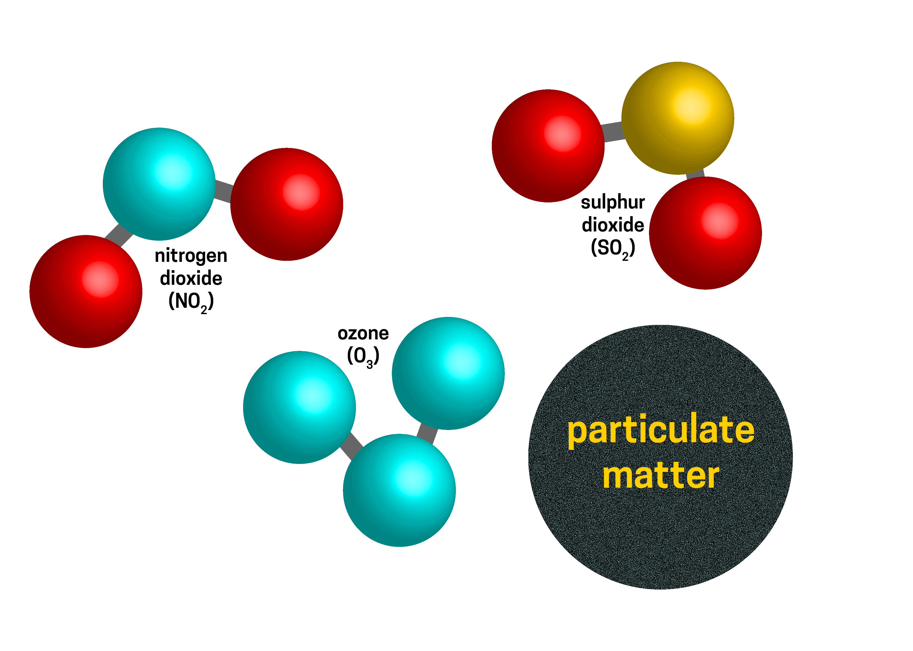
What is pollution?
The main pollutants in London are:
.

Slide 5
“Day in the life of a child”
Video

Slide 6
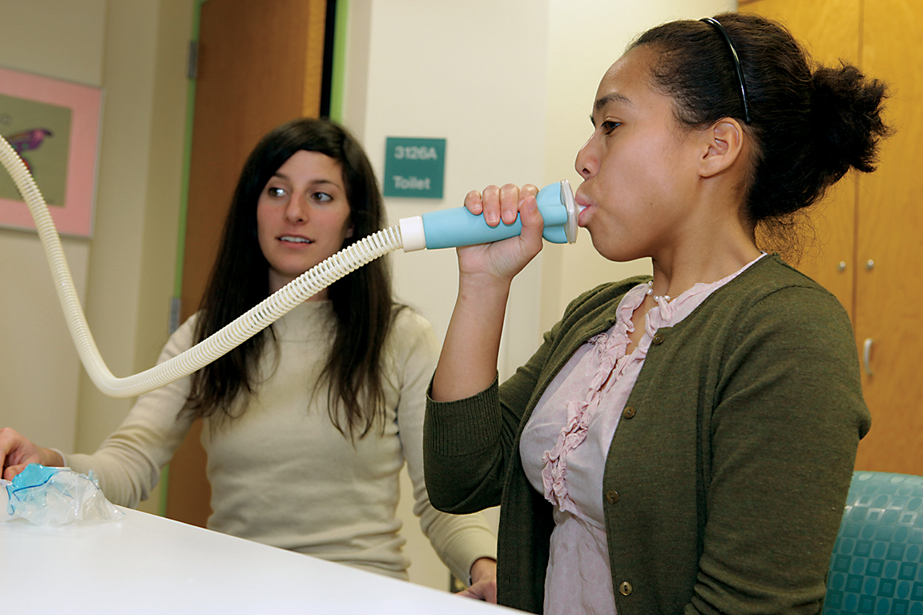
How does pollution affect me and my family?

Slide 7
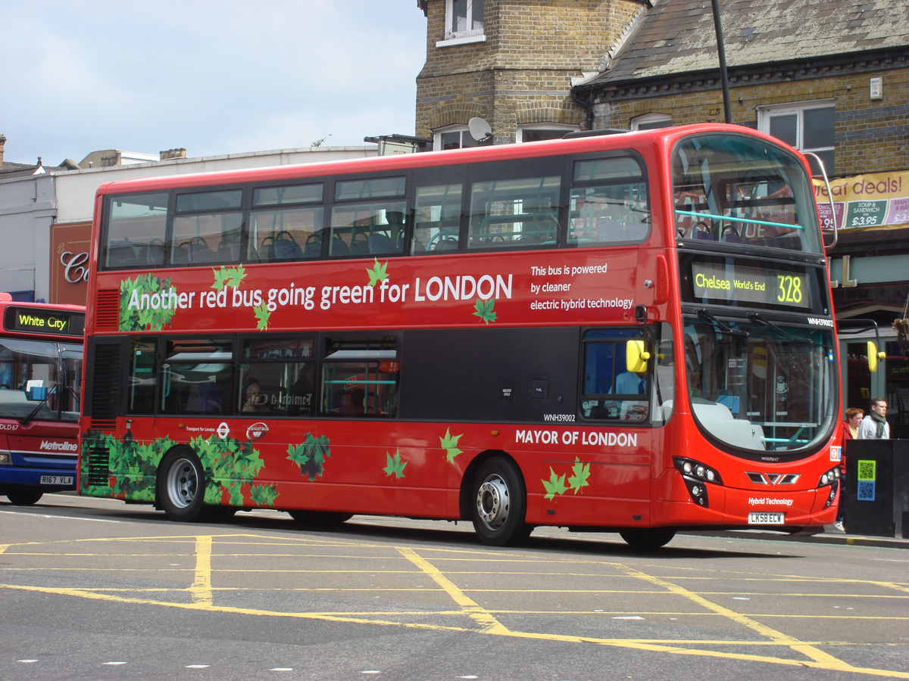
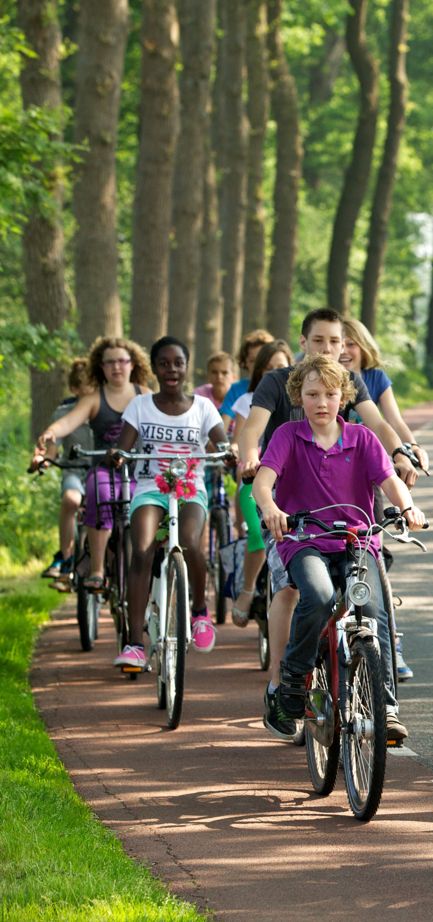
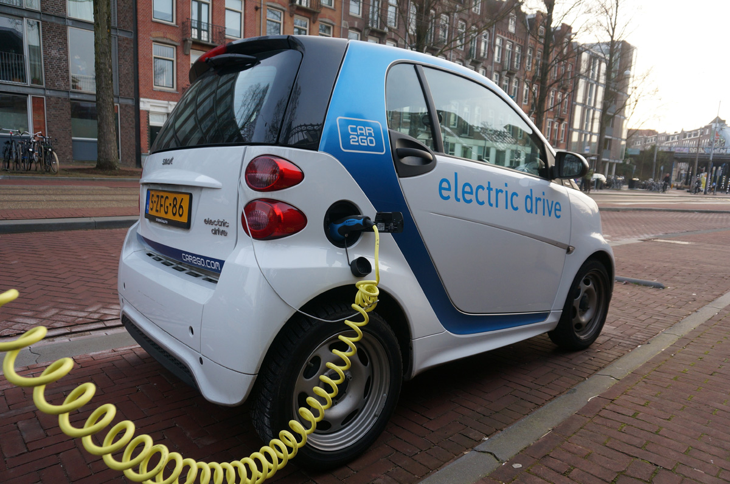
What’s the solution?
Notes:
NO RIGHTS FOR BUS PIC _ NEED TO REPLACE

Slide 8
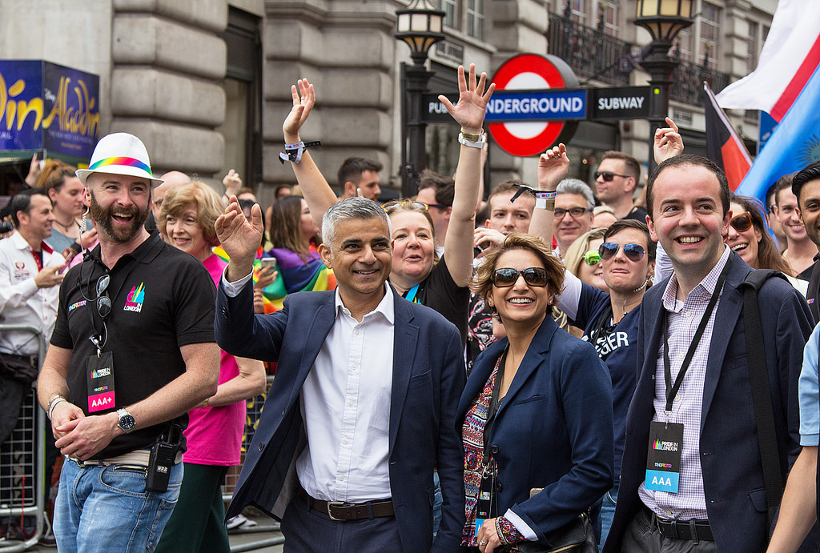
Who can make this happen?

Slide 9
What do you think?
In groups of three, imagine you are:
    the Mayor of London
    a worried London parent
    a car fanatic who thinks pollution is a lot of fuss about nothing
Discuss how you think we should solve the air pollution crisis.

Slide 10
Cause, effect or solution?
Cause | Effect | Solution
Charging points for electric cars
Driving to school
Solar and wind energy
Heart problems
Nitrogen dioxide
Cycle lanes
Breathing problems
Factories
Particulates
Polluting cars pay more to enter the city
Walking to school
Flying on holiday
Asthma
Gas power stations

