Slide 1
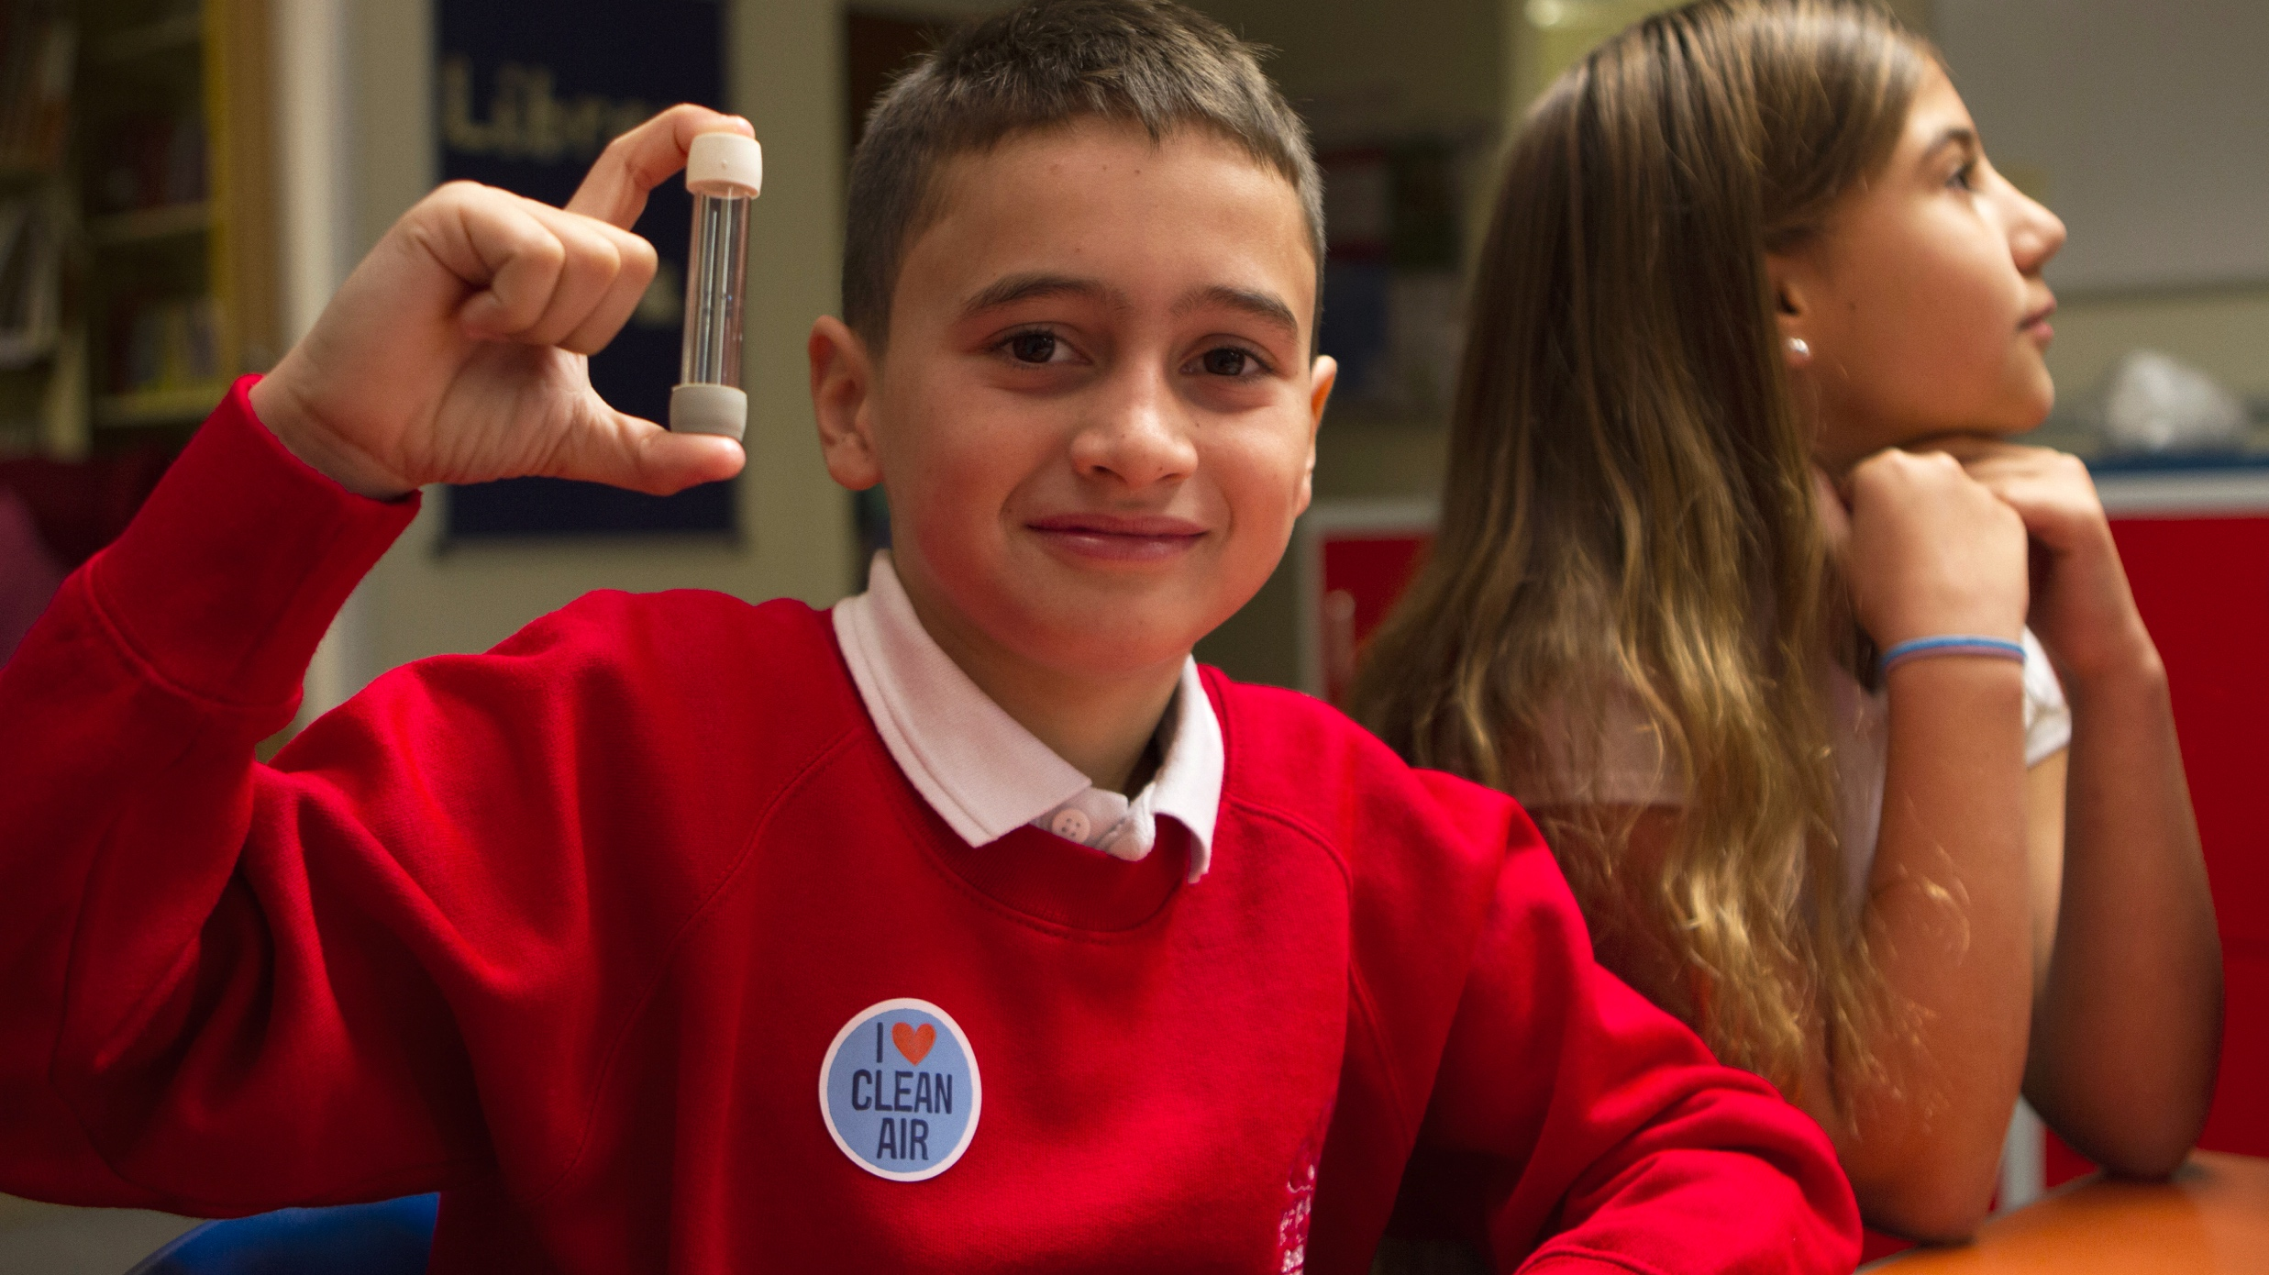
Clean Air Schools Assembly
Friends of the Earth Limited; Company number 1012357. Registered in England and Wales. Our registered office is: 1st Floor, The Printworks, 139 Clapham Road, London SW9 0HP. September 2018.
Notes:
More information on the Clean Air Schools project can be found at: https://friendsoftheearth.uk/clean-air
Friends of the Earth Limited; Company number 1012357. Registered in England and Wales. Our registered office is: 1st Floor, The Printworks, 139 Clapham Road, London SW9 0HP. September 2018.

Slide 2
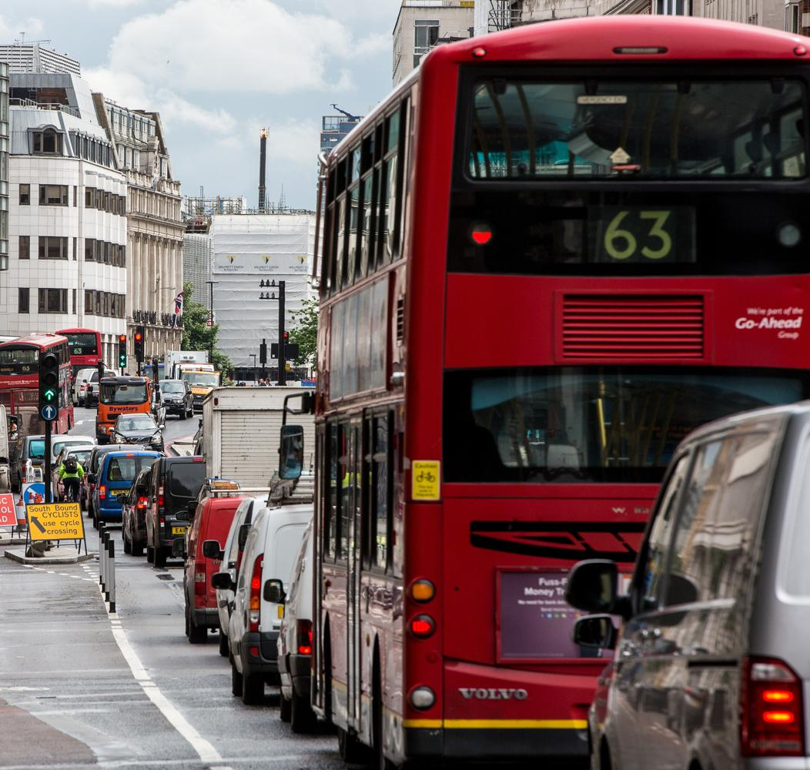
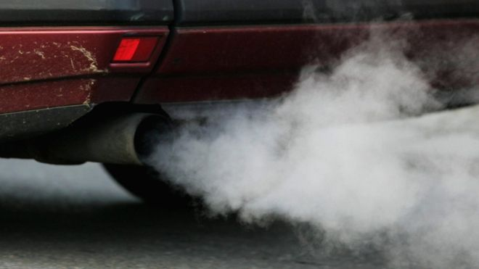
Air pollution
Notes:
Today’s assembly is about air pollution.
Here’s a normal, busy high street. Can you see any pollution?
Then close-up of vehicle exhaust from cars. Nasty stuff coming up from back of cars – fumes.
Then heavily congested from main road highway – what do you think happens - nasty stuff from cars? Where does it go? Show people on the street
Images from BBC and Alamy

Slide 3
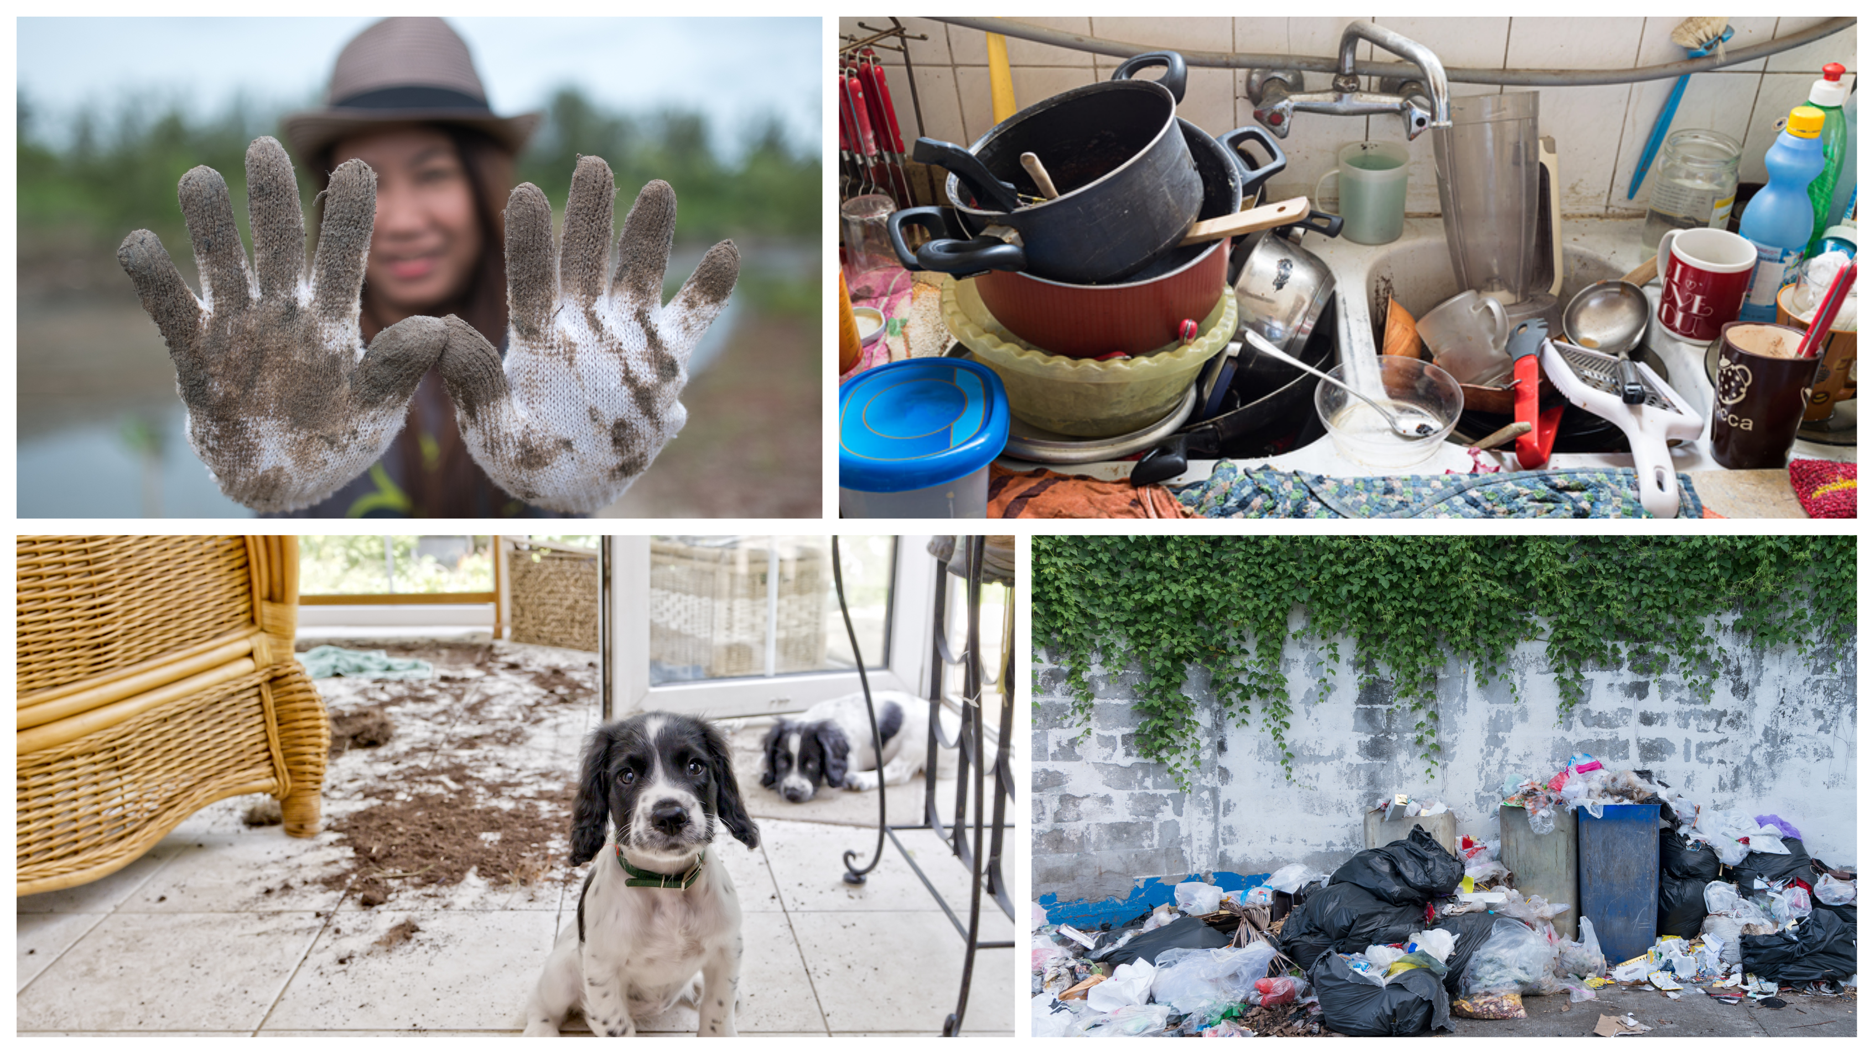
Notes:
Show pupils some pictures of things which are dirty – the more disgusting the better! There are some examples here. You could even bring in some new clean socks and ask them to sniff to see if they’re dirty or not.
What do these pictures all have in common? They’re all things which are dirty, or not clean.
How can we tell if something is dirty? We can see the dirt, and sometimes it smells bad too.
Sometimes it can be a lot of fun to get dirty, helping with the gardening or playing! That’s a good thing and we clean up afterwards.
But some dirty things can affect our health and be bad for the environment.
Today’s assembly is about something which gets dirty, but we can’t always see or smell that it’s happening.
Can pupils guess what it might be? It’s the air around us.

Slide 4
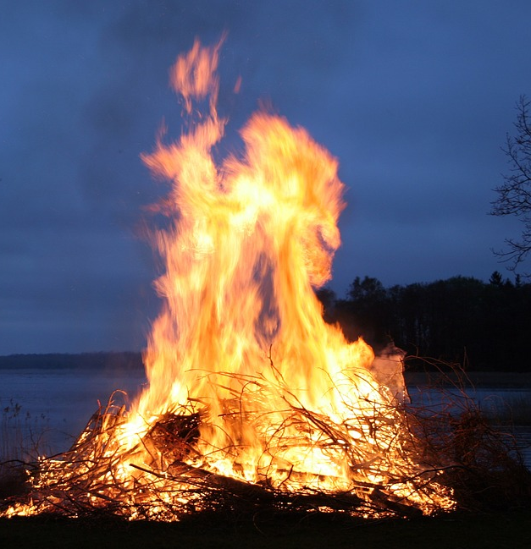
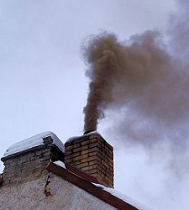
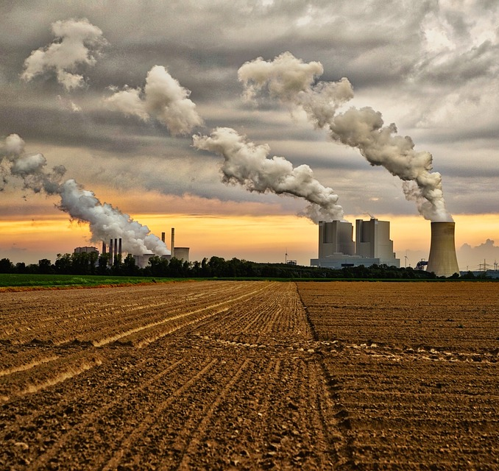
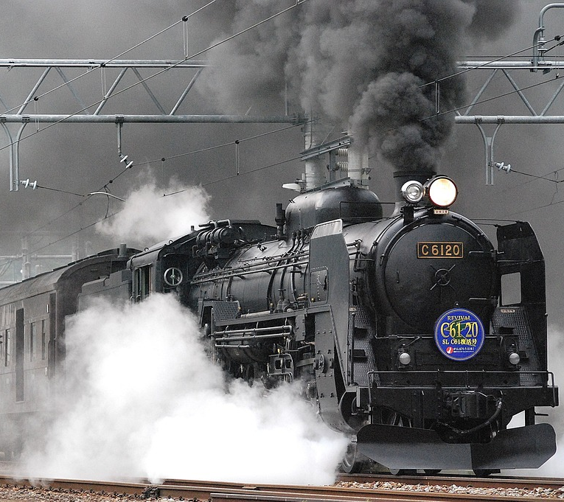
When you burn things…
Notes:
What happens when you burn things?
Bonfire
Chimneys out of houses
Power station
Trains
Buses
Cars
Things that give off smoke can make things dirty.

Slide 5
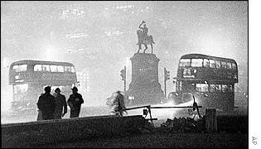
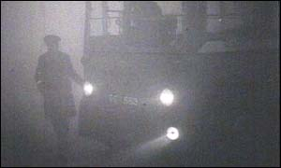
The Great Smog of 1952
Lots of smoke from burning coal in factories and homes
Very bad fog
Smoke + fog = a smog over London
You couldn’t see very far and it made people very unwell
Around 8,000 to 12,000 people died
Rules put in place to stop burning dirty fuels
Images from the Great Smog of 1952
Notes:
The story of The Great Smog of 1952
Talk to pupils about the Great Smog which affected London in 1952. Key facts are on the slide and on the Clean Air Schools factsheet. More information can be found here too:
http://www.metoffice.gov.uk/learning/learn-about-the-weather/weather-phenomena/case-studies/great-smog
London had many factories which made lots of smoke.
There were also lots of power stations that burned coal which is a fossil fuel. Burning coal is very dirty for our air and bad for the planet as it makes climate change.
It was very cold weather and there was a bad fog. You could only see a few metres ahead of you. In one place the fog was so bad you couldn’t even see your own feet!
Almost everybody burned coal in their homes in those days to keep warm. Lots of smoke came from their chimneys.
The smoke from factories, people’s homes and power stations mixed with the fog.
This created smog. Smog makes the air hard to breathe and makes it difficult to see.
Around 8,000 to 12,000 people died from causes related to the amount of pollution in the air.
After this terrible disaster – many rules were put in place to stop people burning dirty fuels. People also stopped burning coal in their homes and got central heating.

Slide 6
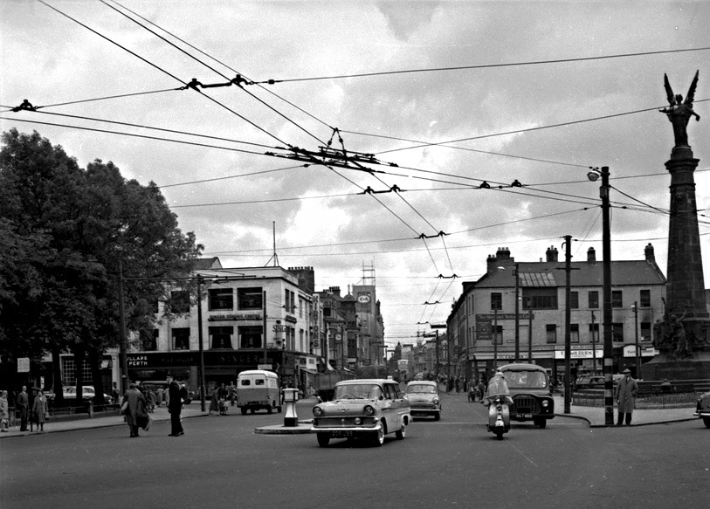
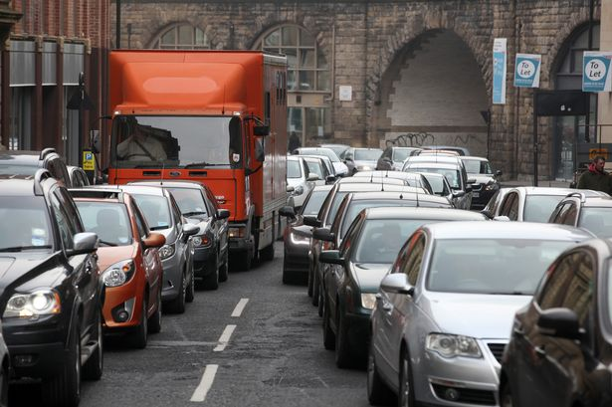
Spot the difference – then & now
Newcastle 1960s
Newcastle today
Notes:
What are the differences between now and 50 years ago?
What can you see a lot more of? (There are many more cars on the road).
There are now over 35 million cars on the roads. There used to be a lot fewer.

Slide 7
The Great Smog of 1952
Notes:
Here are some gifs of the Great Smog of 1952 in London.

Slide 8
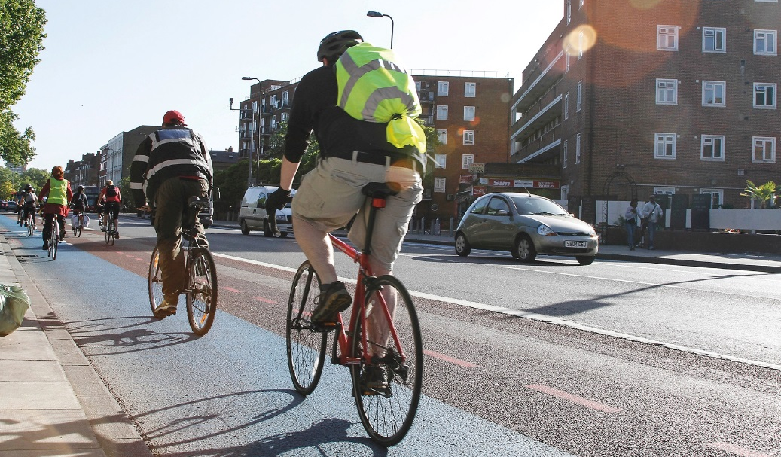
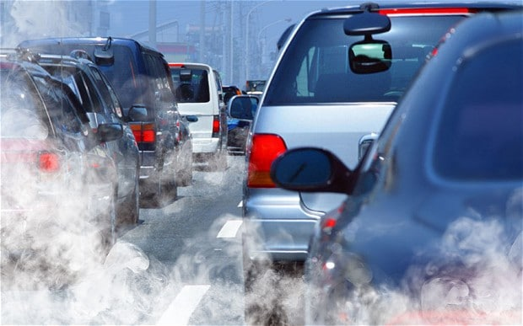
How do you get to school?
Do you… Walk? Cycle? Scooter?
Bus? Train? Tram? Taxi? Drive?
Which of these ways of travelling do they think are worst for making air pollution?
Which of these ways make the least air pollution?
Notes:
Air pollution can be caused when we burn fossil fuels such as coal, natural gas, diesel or petrol.
We use these energy supplies for cooking and washing at home, for turning on our lights, heating our homes and travelling by car.
The most concerning pollutants that can make you unwell:
Nitrogen Dioxide (NO₂): this can irritate the lining of your lungs.
Particulate Matter (PM) – these are tiny particles of dust, soot or liquid which are too small to see. These can sometimes go deep into your lungs.
Nowadays, when it comes to air pollution – road transport is the biggest problem. Cars, lorries and buses on our roads. Diesel vehicles are the worst of all.
What is diesel? Like you can put your petrol in your car to make the engine work, you can put diesel in your car instead.
Take a show of hands from pupils to find out how many of them drive to school, how many walk, ride or scooter, and how many use public transport.
Which of these ways of travelling do they think are worst for making air pollution? Which of these ways make the least air pollution?

Slide 9
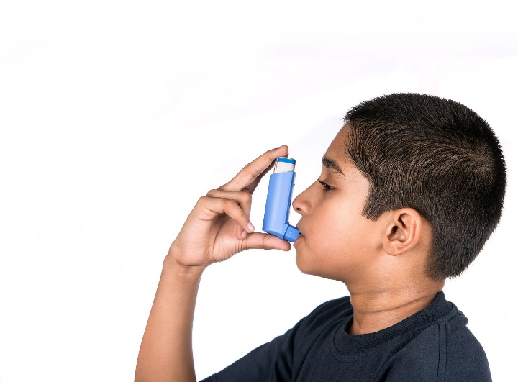
Why is air pollution a problem?
Heart, lung and breathing problems, including asthma
Weakens our immune system
Children are more at risk than adults
It can stop lungs growing properly
Notes:
Talk to pupils about the effect of air pollution on their health.
Air pollution can contribute to breathing problems, the development of asthma, and lung and heart diseases. The risks are greater for children, as your bodies are less resilient and still developing. Because of your height, you are also closer to the exhaust fumes from cars. Studies have also shown that living in very polluted areas can stop your lungs growing properly, which could cause health problems later in life. But if we do something about it and cut pollution, we can reverse some of this damage.
What other impact does air pollution have on the environment? Pupils may also know about how burning fossil fuels also creates global warming. As well as causing acid rain, which can affect plants and trees.
If there is a class in the school who have been using the lesson plans, you may like to invite them to take part in the assembly. They could re-enact the lung simulation to demonstrate the effect of particulate matter coming into the lungs and making it more difficult to breathe. See Lesson Plan 2 for details of this simulation.
Image from Education for Health.

Slide 10
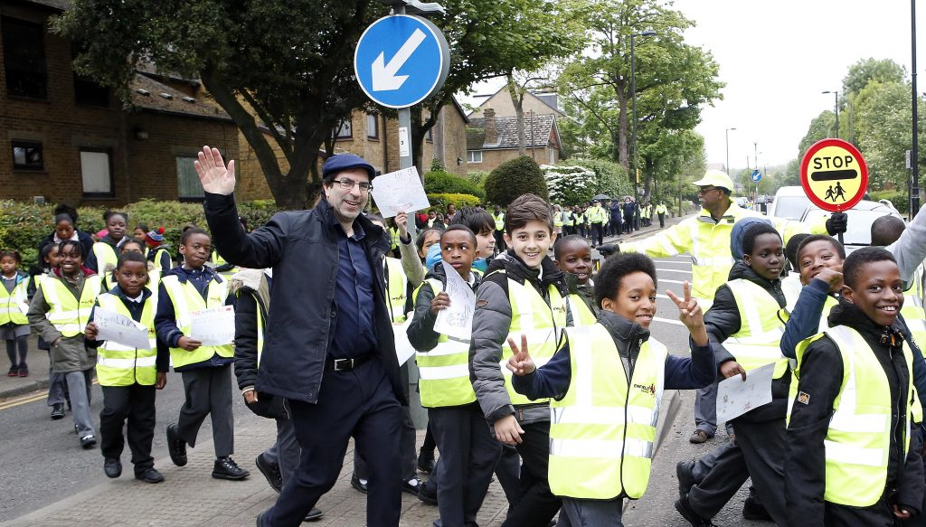
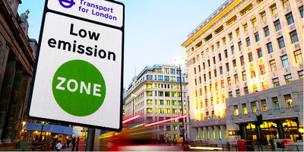
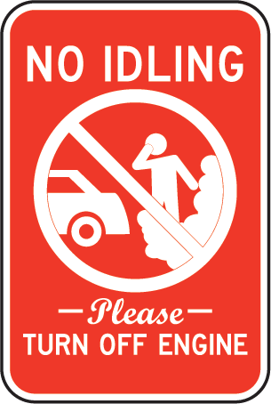
What do you think?
What are some of the things that we do which might contribute to air pollution?
Businesses, governments and parents sometimes take steps to reduce air pollution. What have you noticed them doing?
Notes:
Ask pupils to consider each question, one at a time. They may know about things like
Clean Air Zones
low-emission zones
congestion charges
t-charge
electric vehicles
’no idling’ signs around school
walking buses
Starting to cycle or cycling more
planting trees, green screens and shrubs to absorb pollution.
If pupils have done the lessons - show some examples of posters drawn by pupils to promote clean air.
Image of giant walking bus made up of nearly 300 pupils from Latymer All Saints CE Primary School, Edmonton, London.

Slide 11
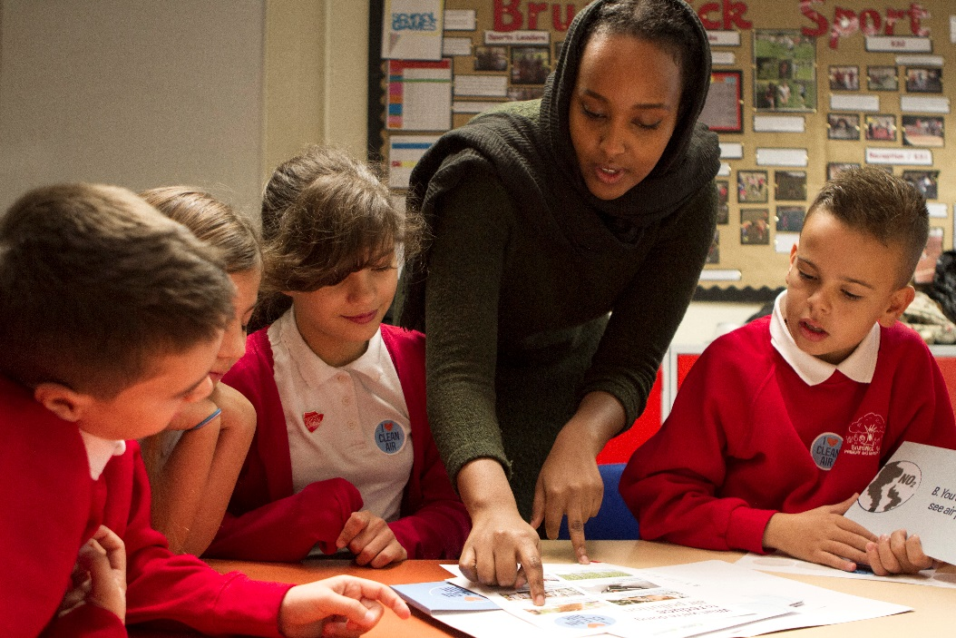
Talk to the person next to you
What are the key messages people need to know about air pollution?
How can we help to spread these messages?
Notes:
A) If there is a class in the school who has been using the lesson plans, they may have come up with key messages and campaigns as part of this work. This would be a good time for them to share, perform and celebrate these.
B) Alternatively, ask pupils to discuss these questions with people sitting near them and share back some of their ideas.
See lesson 3 for suggestions for how to spread the messages – e.g. create a song or jingle, make an internet meme, design a poster or bumper sticker with a catchy slogan.

Slide 12
Muna Suleiman Campaigns Officer Friends of the Earth cleanair@foe.co.uk
We’d love to hear your thoughts and feedback.
Notes:
For more information on Clean Air Schools and the work of Friends of the Earth – visit: https://friendsoftheearth.uk/clean-air
Please also share any positive actions your school is taking to clean up the air around you and we’ll do our best to promote them.
Contact cleanair@foe.co.uk with feedback on this assembly.

