Slide 1





FOOD FOR LIFE
MAKING BRITAIN HEALTHIER THROUGH FOOD
Lisa Didier. Local Programme Manager Leicester City

Slide 2
Food for Life:
is a multiple outcome intervention that uses food to engage young people and their families, and nudge them towards the behaviours that matter for public health, sustainability and education.

Slide 3
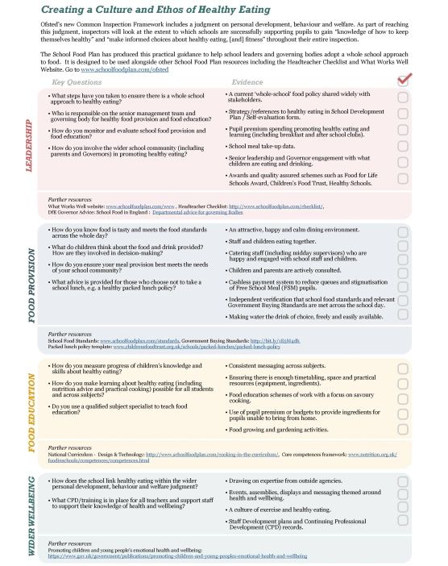
Why do we do it.
Children’s health and wellbeing is rising up the political agenda, with the
launch of the government’s Childhood Obesity Strategy in 2016
There is growing recognition for the role of a good school food culture in supporting pupil health, wellbeing and attainment
Lots has changed in school food over the last few years following the publication of the School Food Plan (summer 2013), including:
Universal Infant Free School Meals (Sept 14)
A new Ofsted Inspection Framework (Sept 2015)
Cooking on the curriculum for KS1-3 (Sept 2015)
Mandatory School Food Standards (Jan 2015)
Notes:
Set the scene and demonstrate the brilliant progress that has been achieved nationally over the last few years to improve the food culture across all schools. Mention that there is a growing political recognition for the importance of school food culture in improving pupil health, wellbeing and attainment – mention the government’s child obesity strategy (due to be launched in 2016).
There is also a focus on food culture as a means of wider character development, e.g. healthy social engagement during lunchtimes as a vital means of developing pupil confidence and resilience.
Highlight some of the key actions from the School Food Plan (refer to supporting documentation, listed below, as required)
Universal Infant Free School Meals (UIFSM)
Provided for all children from reception to year 2, irrespective of free school meal entitlement.
Schools have risen to the challenge magnificently to deliver UIFSM nationally from September 2014 and there was a commitment to sustain the policy in the November 2015 Comprehensive Spending Review
The policy produces a range of benefits (see the links below)
Ofsted Inspection Framework
In the new Ofsted inspection framework inspectors will be looking at the extent to which schools are successfully supporting pupils to gain “knowledge of how to keep themselves healthy” and “make informed choices about healthy eating, [and] fitness” throughout their entire inspection.
Inspectors were made aware of the School Food Plan and associated resources in the December 2015 School Inspection update (pages 9 and 10 – see the link below)
Cooking on the curriculum
All students from 5-14 must be taught practical cooking skills.
Refer any participants who are teaching cooking skills to the ‘additional resources and further reading’ handout for further support.
Food-based Standards – further information is available on slide 17
Supporting documents for this slide:
Head-teacher’s checklist
Ofsted guidance and announcement around new inspection framework
School Food Standards A3 poster and guidance
New guidance for school governors
Sources and further information:
School Food Plan - http://www.schoolfoodplan.com/the-plan/
Universal Infant Free School Meals - http://bit.ly/1TzXxtV and http://bit.ly/1wg5qbs
Ofsted Inspection Guidance - http://www.schoolfoodplan.com/actions/ofsted/ and Ofsted Inspectors Update - http://bit.ly/1UqiPH1
Cooking in the curriculum - http://bit.ly/1QJNfVy
School Food Standards - http://bit.ly/1WbVz0G
Childhood Obesity Strategy – due for launch in 2016

Slide 4








One in five children in Reception is overweight or obese
(boys 23.4%, girls 21.6%)
One in three children in Year 6 is overweight or obese
(boys 35.2%, girls 31.7%)
Adapted from: http://www.noo.org.uk/slide_sets
Notes:
Now move on to review the scale of the problem. The slide shows the high rates of overweight or obese children in both Reception (approx. 1/5th) and Year 6 (approx. 1/3rd)
What is shocking is the increase in the levels of obesity during school years.
The National Child Measurement Programme (2014/15) shows that 19.1% of children in Year 6 (aged 10-11) were obese and a further 14.2% were overweight. Of children in Reception (aged 4-5), 9.1% were obese and another 12.8% were overweight.
These costs are felt nationally - obesity costs the NHS over £5 billion a year.
Importantly, there is also a strong link between deprivation and higher levels of obesity at each age, i.e. those from more deprived backgrounds show higher levels of obesity (on average).
Consumption of sugar and sugar sweetened drinks is particularly high in school age children and also tends to be highest among the most disadvantaged.
So improving the school food culture can have a huge impact on pupil’s health and wellbeing
Sources and further information:
Data on the levels of childhood obesity – http://www.hscic.gov.uk/ncmp and http://www.noo.org.uk/slide_sets (January 2016) and http://www.noo.org.uk/NOO_pub/Key_data (December 2015)
Links between deprivation and levels of obesity http://bit.ly/1PILsiN and http://bit.ly/1UYhLN9 (October 2015)
If asked: the definition used to define overweight vs. obese children is available from the National Obesity Observatory report, available here - http://bit.ly/1QRwhRT (June 2011)

Slide 5
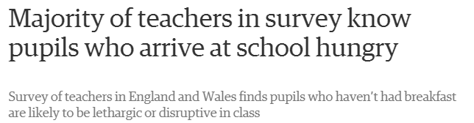
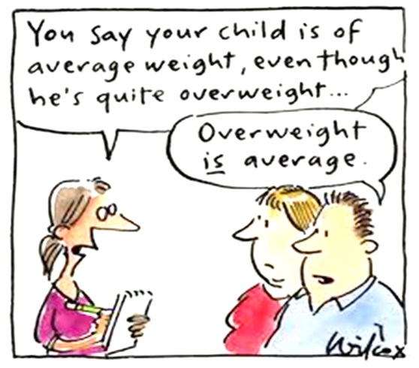
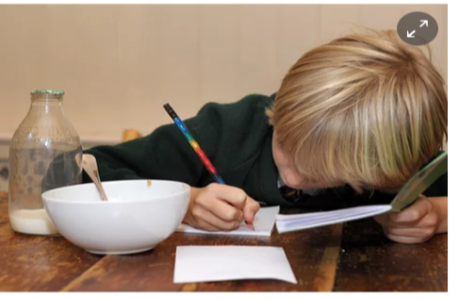
Notes:
Stress the point that 77% of parents of overweight children do not recognise their child as overweight.
There are specific resources from NHS Choices to help parents in these situations broach the subject with their children (link below).
However, reiterate that the issue goes beyond obesity. An unhealthy diet and malnutrition also includes children/pupils who are a normal weight and under-weight.
In a January 2016 survey by YouGov it was found that:
Nearly 50% of teachers said some pupils arrived at school hungry at least three or four times a week.
Around 20% said they had brought in food within the last 12 months for children who had not eaten breakfast
There is also an on-going issue with Holiday Hunger which was highlighted in a report by the All Parliamentary Party Group on School Food (link below). Key facts include:
29% of food bank referrals are for families with children (Jan 2013)
In 2012-13 food banks fed 465,126 people nationwide. Of those helped 36%, (260,282) were children
More than a quarter of parents said they can’t provide food for all of the meals their children need
There are a number of useful articles and tips for parents on dealing with underweight children on the NHS Choices website (see the link below)
Children who are underweight will also be flagged as part of the National Child Measurement Programme (see the link below) and will have specialised care, if this is required, via GPs and dietitians.
Introduce Optional Activity B (5 mins): this is a group discussion to review the information so far. Some wider questions the group may wish to consider include:
Are they surprised by the scale of the problem?
How does it compare with their experiences in their own schools or placements?
Do they think the situation is getting better or worse?
Have they noticed any changes in their school or local area to improve the food culture?
Sources and further information:
Image (left) and YouGov data for taken from - http://bit.ly/1RpcUnN
NHS Choices website - http://bit.ly/1m64S6z
National Child Measurement Programme - http://www.hscic.gov.uk/ncmp
Holiday Hunger report - http://bit.ly/1QqZzqf

Slide 6




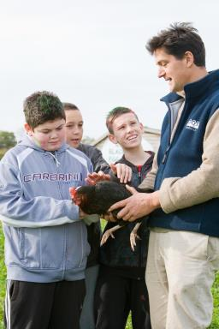
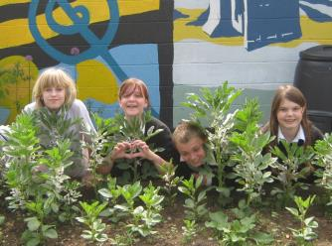
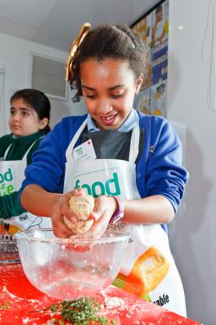

Food for Life
Schools Award
Food Quality (Catering Mark meals)
Food Leadership and Culture
Food Education
Community and Partnerships
Notes:
As well as the work that caterers are doing to meet standards and demonstrate the quality of their food there is also an award for School to achieve. The Schools Award Framework provides a framework for schools to embed a whole school approach to food by taking action in the following areas:
Food Leadership and Culture – involving pupils and parents in food culture, maximising take up of lunches and improving the dining room experience.
Food Quality – i.e serving Catering Mark standard school lunches!
Food Education – making healthy and good food part of the curriculum – having assemblies about good food, visiting local farms, etc.
Community and Partnerships – holding an annual food event for the school and local community, engage parents in the activities

Slide 7
Why?
Encouraging children to be more involved and have a greater understanding about diet and health is key to healthier, longer lives
Pupils with better health and wellbeing are likely to achieve better academically. The culture, ethos and environment of a school influences the health and wellbeing of pupils and their readiness to learn
Schools are a great environment to deliver this message and model a positive, healthy food environment
Schools are also a point of wider engagement and should promote a good food culture to parents and others across the community
Notes:
Make sure you stress the four key points on the slide. Particularly the links between pupil health and wellbeing and academic achievement – also reference the WHO report (see the link below), which mentions the negative impact of obesity on attainment.
Mention the importance of schools as a model of positive behaviour both within the school gates and beyond - i.e. in the wider community.
Make the point that many teachers/caterers will know that just because you present children with healthy food it doesn’t mean they will eat it. This is where the ‘whole school approach’, which is discussed in the next section, really comes in. It’s about more than the dinner the children are served, but about the food culture across the school and beyond, e.g. the culture in the dining room and the investment children have in their health etc…
For example, studies have shown that children are far more likely to eat fruit and vegetables they have grown themselves. Similarly children who learn to cook are more aware of the importance of a healthy diet and a longer lunch time increases fruit and vegetable consumption (see the links below)
Make the point that this is why there have been new ‘School Food Standards’ introduced - to clarify what foods pupils should be eating and in what proportion, but it’s vital we stick to the guidelines.
Re-state the point that food preferences and eating habits can be greatly affected by food exposure during early years, which re-emphasises why the school food culture is so important.
Sources and further information:
Links between health/wellbeing and attainment:
PHE report - http://bit.ly/1plIxST
WHO report – http://bit.ly/1Qvzv0T
Links between pupil fruit and vegetable growing and consumption
Acta Paediatrica: http://bit.ly/1Hlkoy1
Daily Mail: http://dailym.ai/1A7aRx7
Link to demonstrate that food preferences and eating habits form during early years:
Can J Diet Pract Res: http://1.usa.gov/1U6I5Fo
Link to demonstrate that longer lunchtimes increase fruit and vegetable consumption
J Acad Nutr Diet: http://1.usa.gov/1Xi7D0A

Slide 8
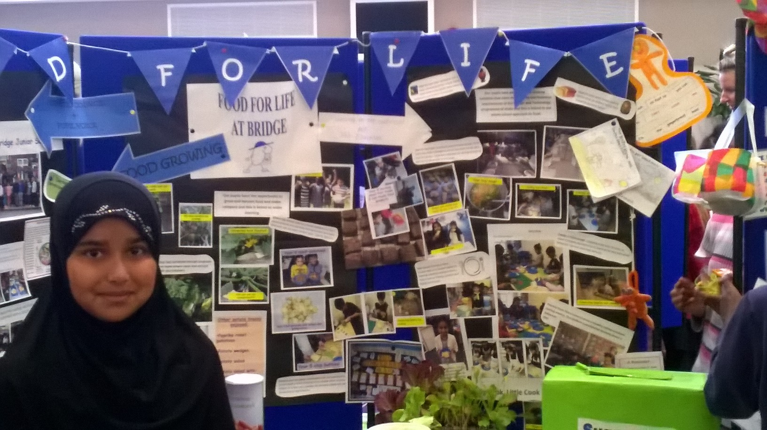

Slide 9
A good school food culture is one in which:
The dining hall is an integral part of the school, where children and teachers eat together
Food is a vital element of school life and the catering team are important and valued members of staff
All children have the practical cooking skills and knowledge to keep themselves healthy; making informed choices about healthy eating.
Children take home learned habits and the school engages with parents and others, so that a good food culture spreads throughout the community
The pupil voice is taken seriously, to encourage a sense of ownership throughout the school

Slide 10
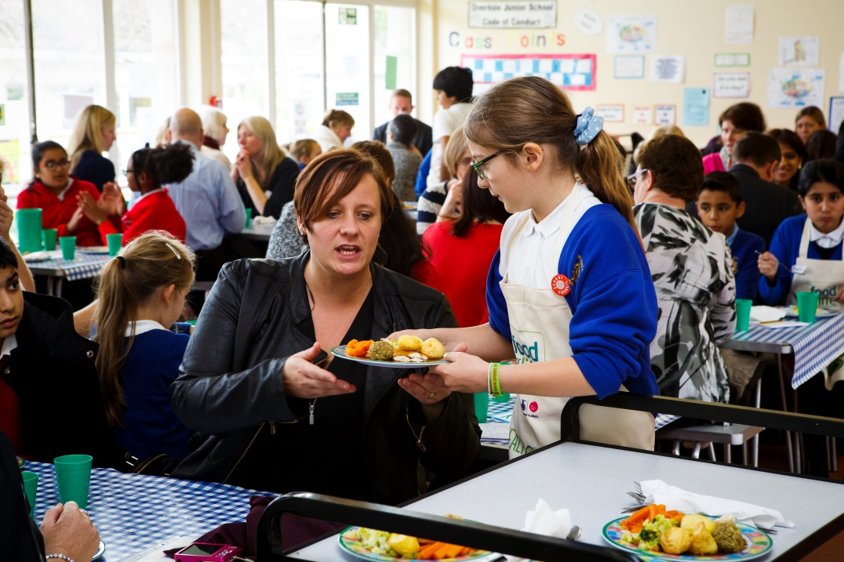
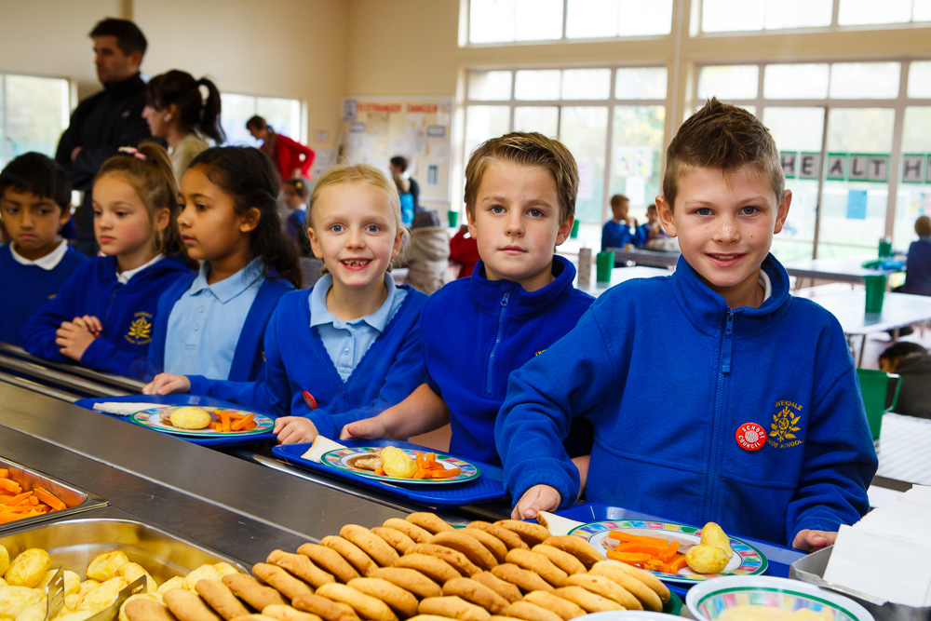
Lunch times are important

Slide 11
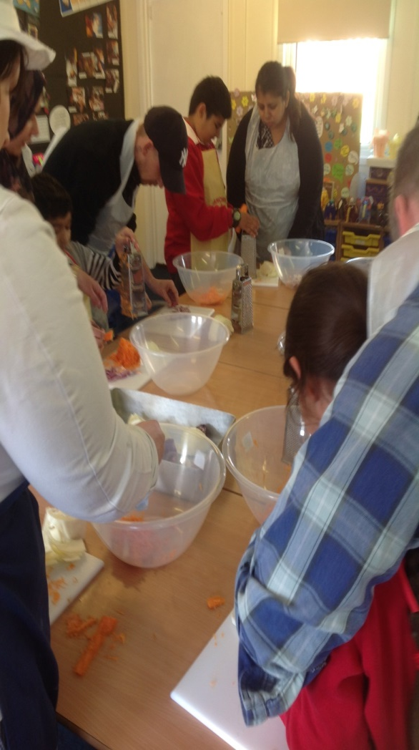
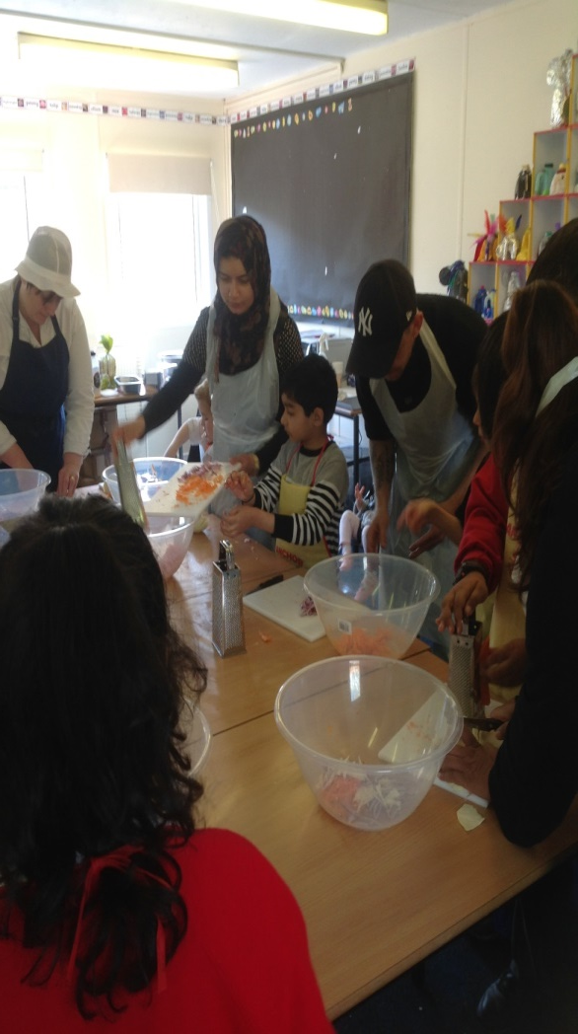
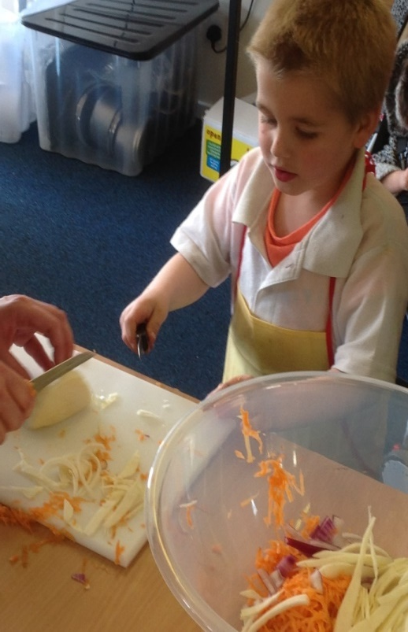
Big Cook Little Cook
Parents and children cooking together.

Slide 12
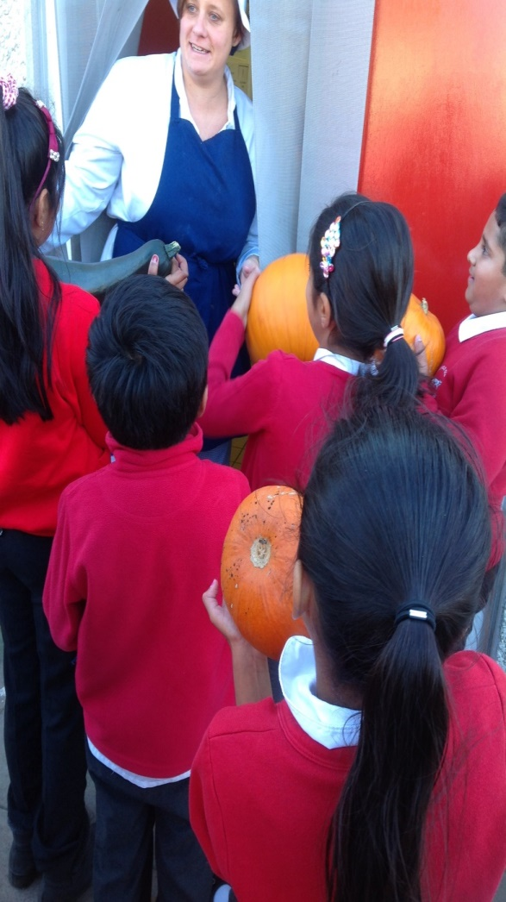
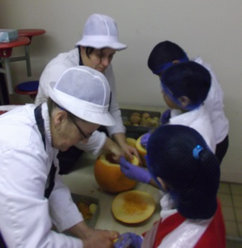
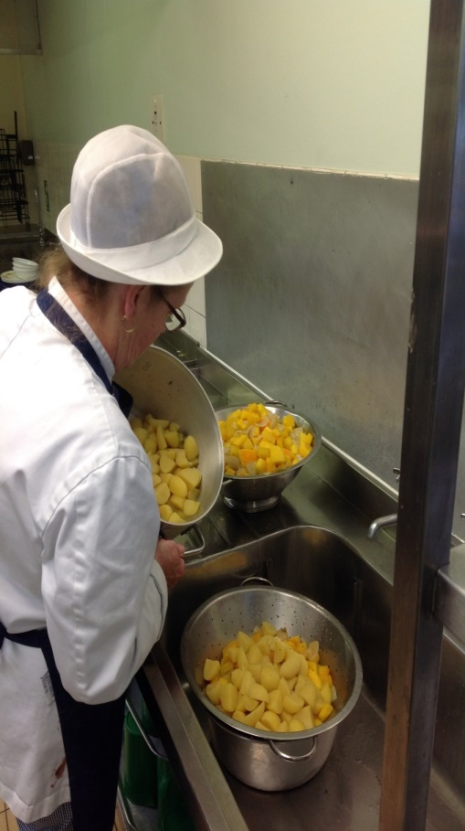
The children grow it……then the team cooks it
Home-grown pumpkin soup.

Slide 13
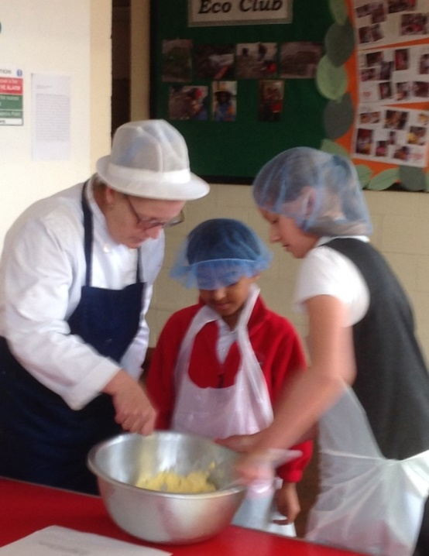
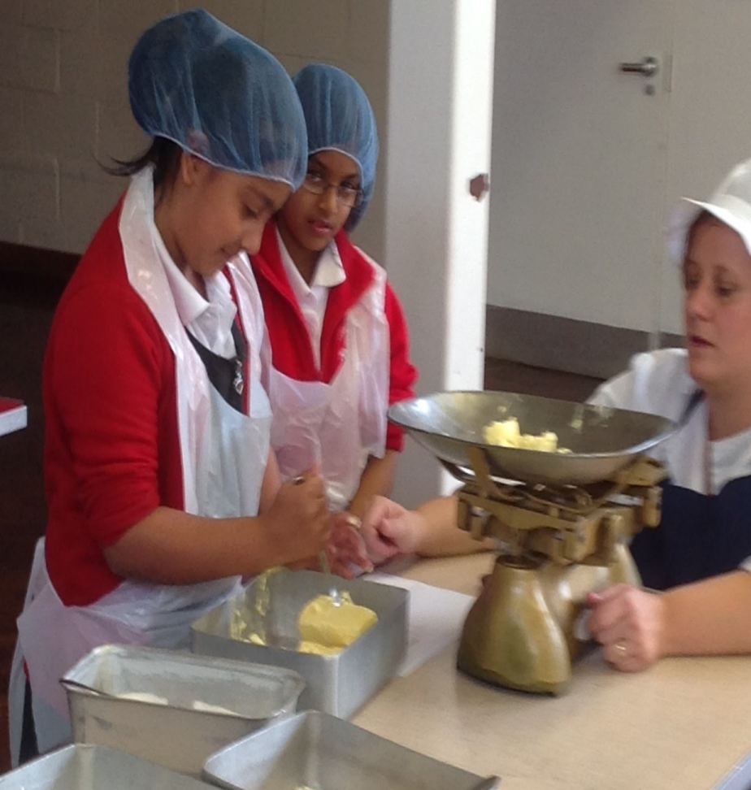
Passing on skills
Passing on skills
Food For Life is an opportunity to share skills and knowledge with children.

