Slide 1
Virtual SENDCo Network
Wednesday 14th October 2026
3.45 pm – 4.45 pm

Slide 2
Agenda
 | Item | SENDSS | Timing
1. | Welcome and dates for your diary | Emma Milton (QIT) | 3.45 pm – 3.50 pm
2. | Updates from the Independent Travel Training Service | Eva Douglas (Transport) | 3.50 pm – 4.00 pm
3. | Physical Disability and Complex Health Needs Support Team | Claire Waterfield (Sensory Team) | 4.00 pm – 4.05 pm
4. | Parent Engagement Officer | Clare Elliott (QIT) | 4.05 pm – 4.10 pm
5. | Annual Review Updates | Hannah Marlow (SES) | 4.10 pm – 4.20 pm
6. | EBSA short term funding forums – New processes from January 2027 | Katie Tyler, Jo Lockley (QIT) | 4.20 pm – 4.30 pm
7. | Specialist Bases – updates and myth busting | Emma Milton (QIT) | 4.30 pm – 4.40 pm
8. | Final Questions and close | Emma Milton (QIT) | 4.40 pm - 4.45 pm

Slide 3
Dates for your diary….
SENDCo Networks
Free Training & Networks » Leicester City Council - SEND
Term | Face to Face | Virtual (3.45pm – 4.45pm)
Autumn | Wednesday 11th November 2026 | Wednesday 14th October 2026
Spring | Thursday 18th March 2027 | Thursday 21st January 2027
Summer | Thursday 1st July 2027 | Thursday 20th May 2027

Slide 4

Monthly bulletin
Are you on the list? Don’t miss out!
QualityInclusion@leicester.gov.uk
School's Extranet

Slide 5
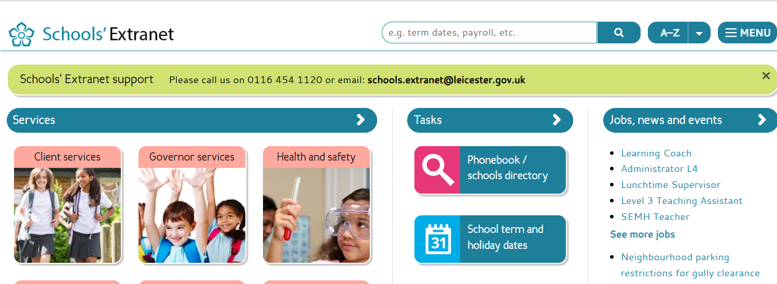
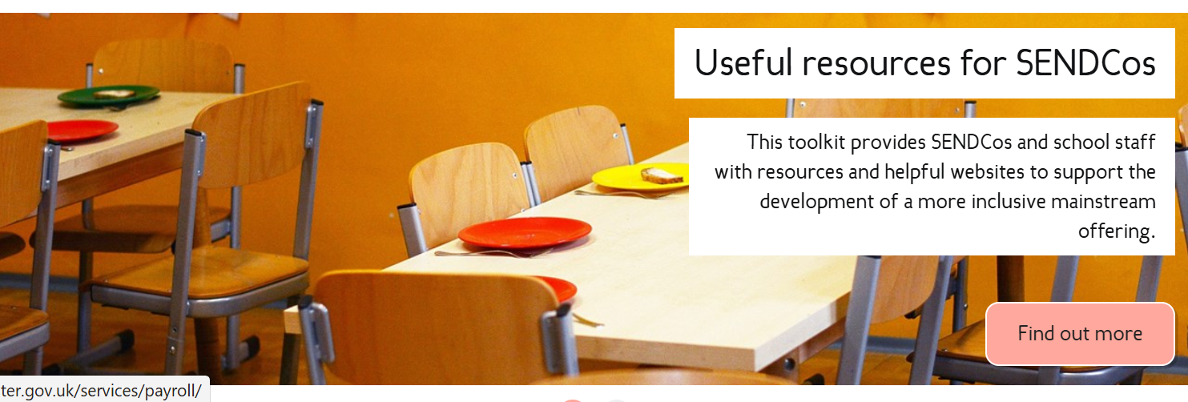
Extranet SENDCo area
What would be helpful for you?

Slide 6
Leicester City Council
Independent Travel Training
Service
EMPATHY + STRATEGY + RELATIONTIONSHIP BUILDING = TRUST
Eva Douglas - Independent Travel Training Manager
Maria Coulson – Strategic SEND Transport Lead

Slide 7
What is Independent Travel Training?
This is a service that has been created in order to support children/young people who have SEND needs build on their independence, self-esteem and empower children and young people to get out into the community. The aim is to open more doors for children/young people with SEND needs getting around the city and providing them with practical life skills that they can use into adulthood.
The aim of the service is to:
Developing safe, confident and independent travel skills
Supports people to travel with increasing independence.
Focuses on confidence, practical skills, safety and problem-solving.
Personalised training sessions to meet the individuals' needs and strengths.

Slide 8
Eligibility and Success Criteria
This course is tailored to each child/young person and their individual needs however, to be eligible for the course the child/ young person must have an EHCP in place alongside the following…
Eligibility:
Be of secondary school age (or transition to adulthood age), although younger pupils may be considered where appropriate.
Have an identified need for travel support (e.g. SEND, social, emotional or learning needs).
Regularly travel to school, college, work placement, supported internship or other agreed destination.
Demonstrate the potential to develop independent travel skills with appropriate support.
Be willing to participate in travel training.
Have parent/carer support where appropriate

Slide 9
Why Independent Travel Training Matters
Promotes independence and confidence.
Improves access to education, employment, leisure and the community.
Reduces reliance on family, carers or specialist transport.
Develops decision-making, resilience and problem-solving skills.
Supports preparation for adulthood and greater participation in everyday life.
Overcoming fears that the child/young person and family network may have
Person-centred training based on individual strengths, needs and goals.
Freedom and social inclusion
Health benefits
Slide 2 of 5

Slide 10
What the course will support children/young people to achieve.
Planning a route and identifying key landmarks in and around the city.
Reading signs, maps and timetables and using travel information.
Using tickets, passes and appropriate travel technology.
Road safety, safe crossings and safe use of public transport.
Knowing how to stay calm, ask for help and respond to delays or getting lost.
Supporting SEND children to reach their goals and ambitions on a day-to-day basis.
Provide SEND children/young people with vital life skills to support them entering their independent adulthood.
Slide 3 of 5

Slide 11
Safety, SEND and Personalised Support
Due to the course being tailored to the child/ young person there are other areas that the service could support with e.g. signposting internally and externally, multi-agency work across the SEND, Social care and Health services and being another supportive addition within the child/young person’s life.
Support during sessions may include visual prompts, repetition, route cards, assistive technology and extra practice. support should gradually reduce as confidence and competence develop which is not time limited by the service but set by the officer and child/young person and how comfortably that child feels travelling in the city alone.
Safety measures in place will consist of regular risk assessments taking place throughout the course ensuring the child/young persons voice being heard and taken into consideration. Contingency plans created by the family/professional's network and child and regular mutli-agency reviews held in order to ensure all professionals are aware of the progress and expectations around the child and their progress within their independence journey.
EMPATHY + STRATEGY + RELATIONTIONSHIP BUILDING = TRUST
Slide 4 of 5

Slide 12
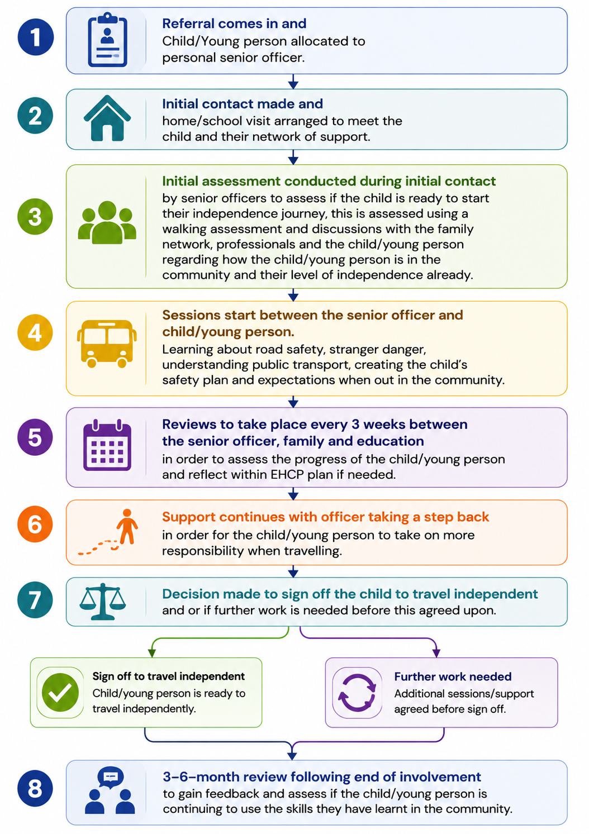

Slide 13
Where to find us and contact us
Location: 37-39 Sulgrave Road, LE5 0HL
Email: IndependentTravelTraining@leicester.gov.uk
If you have any questions or queries our emails are open!!!

Slide 14
Claire Waterfield - Physical Disability and Complex Health Needs Support Team
Create a register
Email any CYP with a physical disability and/or complex medical needs in your school
Name, Student ID, DoB, diagnosis (if known)
What support, if any, school and/or CYP needs
What are you already doing to support? Celebrate!
PD-CHN@leicester.gov.uk

Slide 15
Clare Elliott – Parent Engagement Officer
Supporting Parental Engagement
My role is to support parents and carers across schools, Family Hubs and local communities, helping families to feel informed, listened to and involved, and more confident in accessing and understanding the support their child or young person may need.
How I can help
Offer supportive conversations when parents or carers need someone to talk things through with, particularly if they are unsure, worried or don’t know what to do next.
Help families understand the graduated approach, processes and pathways, including the current situation and what might happen next.
Help parents and carers feel informed on services, advice and guidance, so they can access the right support at the right time.
Support families to feel heard and confident in sharing their views, questions or concerns with schools and services.
Work alongside families and professionals where there may be barriers to communication or engagement, helping to build understanding and positive relationships.
Attend coffee mornings, parents’ evenings and other parent/carer events to build relationships and hear directly from families about what matters to them.
If you identify a family who may benefit from early support to strengthen their understanding,
confidence or engagement, please get in touch
Clare Elliott Parent Engagement Officer Quality Inclusion Team Clare.Elliott@leicester.gov.uk

Slide 16
Hannah Marlow - Annual Review Updates
A review should take place every 12 months
The review should focus on progress towards outcomes and be person-centred
A plan only needs to be amended when:
  There is a significant change to need
  There is a transfer to the next phase
  ehcp.annualreview@leicester.gov.uk

Slide 17

When ‘No Changes’ is Appropriate
Needs are accurately described
Provision is clear and being delivered
Outcomes remain suitable
Any minor adjustments/updates can be managed ordinarily by the setting through SEN Support Plans/Passports

Slide 18
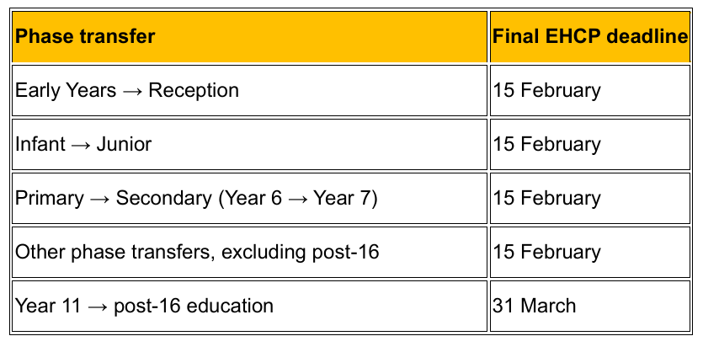
Phase Transfer Annual Reviews
EHCP phase transfer reviews guidance document

Slide 19
EBSA Short Term Funding Forums
Why we are making changes?
  More child and young person focused
  Personalised around individual and school contexts
  Possibility of alternatives to 'funding'
  Advice and support

Slide 20
EBSA Forums
Simplified form to request a time slot at the forum
Range of professionals at the forum
Extension of existing funding
Range of possible forum outcomes (tbc)
  Short term funding
  Signposting to other funding
  Signposting to support (toolkit, professionals)
  AV1 Robots

Slide 21

When this will happen
Every three weeks, Wednesdays, 2:30 till 4:30
Starting 13th Jan
Details of how to access the forum to follow

Slide 22

Inclusion Bases
Currently known as Designated Specialist Provisions (DSPs) and Units in Leicester City
Currently known as Internal Alternative Provisions (IAPs) in Leicester City
Commissioned by the Local Authority (LA)
Funded by the School or Academy Trust
Typically for children and young people who have an Education, Health and Care Plan (EHCP)
Schools can choose to use the provision for children with OR without an EHCP
Commissioned to provide a specialist offer within a mainstream school
Part of a school's mainstream offer – early intervention and targeted support
Specialist staffing and resources
Notes:
Updates and clarification of the terminology following updated guidance from the DofE.
Read definitions for both. Essentially specialist bases are what we are currently terming our DSPs and SEND Units. They are funded by the LA and places are commissioned by the LA rather than by schools themselves. They provide more specialist support and staffing.
A support base is what we are currently calling schools IAP.
IAPs are sometimes used by schools for those awaiting specialist. They are set up differently across the City and have varied designations (some schools use them are targeted intervention bases, to support those waiting for special, mixes of need or a single need. IAP provisions are not future proofed - schools can choose to open or close them as required. Staffing does not follow a consistent model across the City, not always staffed by a teacher and permanently based staff.
While support bases are sometimes modelled on specialist bases, they have often been created for differing needs that meet the schools requirements at the time.
Just to clarify – even if a school has been allocated group funding for their IAP this does not change them from a support base to a specialist base. Group funding is part of the E3 Top Up Funding stream.

Slide 23
Inclusion Base myths
“They are in the schools support base; they must require a specialist base”
FALSE – Schools use their support bases for many purposes to support them to meet their mainstream inclusive offer, the provision does not always mirror that of a specialist base. Statutory Assessment panels will use the panel terms of reference with supporting documents such as banding descriptors to decide on an appropriate provision
“If a support base is group funded, it is commissioned by the LA”
FALSE – The Local Authority (LA) is currently piloting the group funding of provision in some City schools. Schools are responsible for which children access the support base.
The pilot is being used to support schools where they have identified a group of pupils with similar needs and a plan for support, inline with their inclusive mainstream offer
“Specialist bases are better than support bases”
FALSE – Both specialist and support bases come under the umbrella of inclusion bases, the right provision is the model which best meets the needs of the child while promoting belonging, participation and successful inclusion. Both types of base have a place in the continuum of Inclusive provision

Slide 24

Final Questions?

