Slide 1

#EcoTeach Webinar
Healthy Living Holding screen
The webinar will start here soon...

Slide 2
#EcoTeach Webinar
Healthy Living
Daxa Ralhan, Programme Officer, Public Health
Sam Woods, Senior Project Officer, The Conservation Volunteers
Lisa Didier, Local Programme Manager, Soil Association Food for Life
Healthy Schools Network
Lee Jowett, Environmental Education Coordinator
Amy Peace, Graduate Project Officer

Slide 3

#EcoTeachMeet Webinar Series
Overview of #EcoTeach format and dates/times of webinars
What Environmental Education Leicester is
Eco-Schools – and how it fits into the big picture
Healthy Living projects
Q & As
Other opportunities coming up

Slide 4
Overview of #EcoTeach Webinar format and dates/times of webinars
Weekly at 10am during term time – lasting up to an hour, Leicester focused but suitable for everyone.
Recording and PowerPoint with links available afterwards at schools.leicester.gov.uk/eco-schools
During the presentation, ask questions in the chat box.
Questions and answers at the end – either directly ask or in chat box depending how many people are attending.

Slide 5

What is Environmental Education Leicester?
Provide free support to all Leicester School.
Communications with schools – social media (Twitter, Facebook, Instagram, YouTube), monthly eBulletins and quarterly newsletter.
TeachMeets, Eco-Schools Roadshow, Eco-Schools & Food for Life Celebration, Sustainable Schools Celebration bi-annual.
Focus on the Eco-Schools Award.
Delivery of energy and litter focused projects.
Project support and partnership working with internal and external organisation.

Slide 6
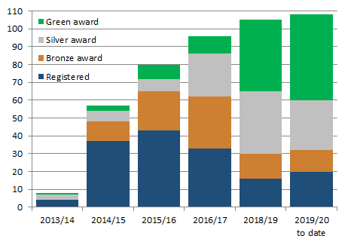

Eco-Schools – Our Work in Leicester
Promoted Eco-Schools as an award since September 2014 (114 schools)
109 registered on the programme
of those, 91 have achieved bronze
of those, 78 have achieved silver
of those 49 have achieved Green Flag

Slide 7
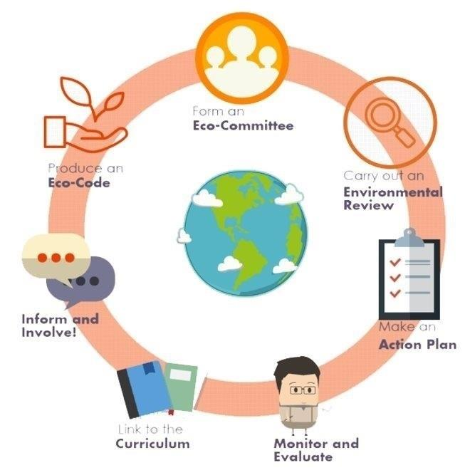

Eco-Schools Programme
7 step model

Slide 8

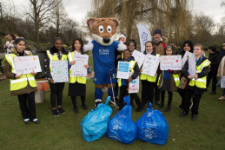
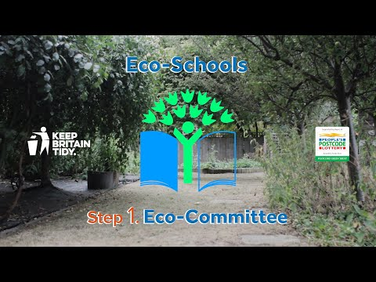
Step 1
Eco-Schools model - 7 steps 1
EYFS resources
Primary resources
Secondary resources
Step 1 – Eco-Committee, the heart of an Eco-Schools action and learning
  At least one pupil form each year group
  Meet at least once per half term
  Share responsibility for running meetings
  Records of minutes are kept
  Minutes displayed on the Eco-board
  Representative from parents, governors or senior leaders

Slide 9
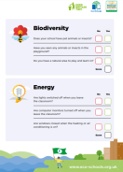
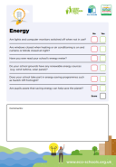

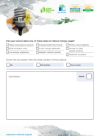
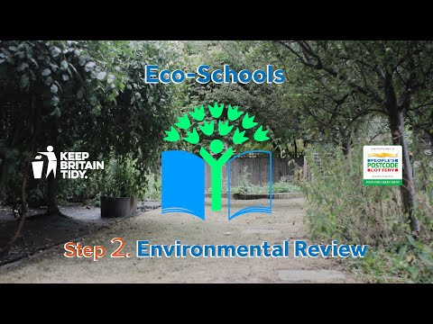
Step 2
Eco-Schools model - 7 steps 1
EYFS resources
Primary resources
Secondary resources
Step 2
EYFS
Primary
Secondary
Step 2 – Environmental Review – investigating the school's environmental performance
  Covers all 10 Eco-Schools topics
  A copy is displayed on the notice board
  It is updated/reviewed at least every 2 years (best practice is annually)

Slide 10
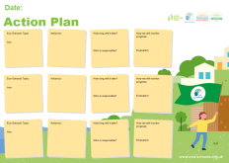
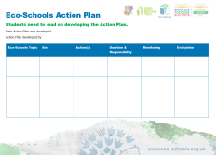
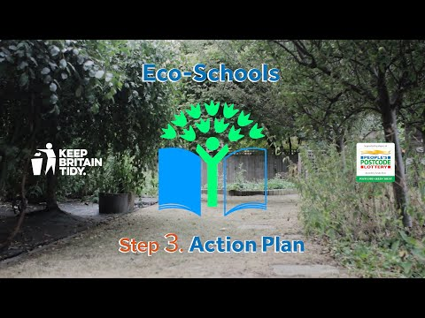
Step 3
Eco-Schools model - 7 steps
EYFS resources
Primary resources
Secondary resources
Step 3
Step 3 – Action Plan – Decide on topic actions, based on the result of the Environmental Review
  The action plan is influenced by the review
  Pupils take responsibility for learning on the topics
    3 for the first green flag
    5 for the renewal (changing 2 with each subsequent application)
  Contains timescale, who is responsible and how it will be monitored
  Shared with the whole school
  A copy is displayed on the noticeboard

Slide 11
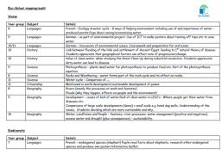


Step 4
Step 4
Eco-Schools model - 7 steps
EYFS resources
Primary resources
Secondary resources
Step 4 – Curriculum Links – making links between the school's environmental activity and the curriculum
  Environmental issues are covered in at least three areas in your school curriculum, evident in schemes of work, pupils work and/or lesson plans (for first green flag this can be the same year group)
  They do not need to be the same topics as your Action plan

Slide 12
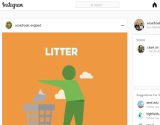
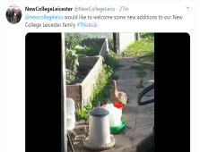
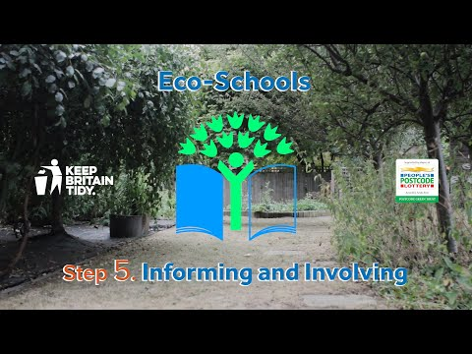
Step 5
Eco-Schools model - 7 steps
EYFS resources
Primary resources
Secondary resources
Step 5
Step 5 – Informing and involving – Let the whole school and wider community know what the Eco-Committee is doing
  A prominent noticeboard in school
    Covering the 7 steps and 3/5 topics
    Members of the committee
    Environmental review
    Environmental action
    Examples of monitoring and evaluation
    Eco-code
  Variety of mediums to communicate
  The whole school and wider community is informed

Slide 13
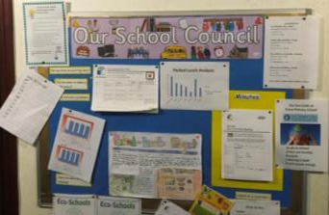

Step 6
Eco-Schools model - 7 steps
EYFS resources
Primary resources
Secondary resources
Step6
Step 6 – Monitoring and Evaluation – Measuring change and finding out what works and what doesn't
  The committee monitors the effectiveness of the topics via data collections, surveys, before and after photographs
  It is communicated with the whole school
  Data has been analysed to help pupils develop further topic actions
  Data has been used in the curriculum e.g. graphs and charts in math

Slide 14

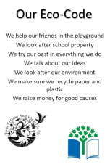
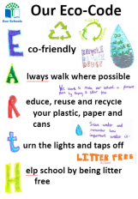
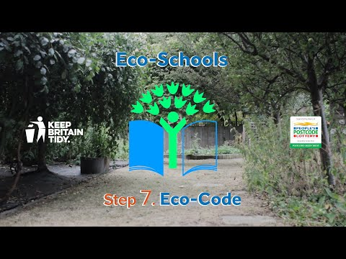
Eco-Schools model - 7 steps
EYFS resources
Primary resources
Secondary resources
Step 7
Step 7 – Eco-Code – Creating a call to action that the whole school can get behind
  There is an agreement statement for your school drawn up by pupils
  It reflects the topic actions you are working on
  It is displayed around school e.g. classrooms, hall and the office
  The majority of pupils and students understand is

Slide 15


Eco-Schools model 10 topics

Slide 16

Key things to think about in topics
Whole school opportunities
Informing everyone about the work
Links to curriculum areas
Monitor impact of actions –photos before and after projects & surveys work really well in healthy living topics
Reflected in your Eco-code

Slide 17

Healthy Living Projects
Daily Mile
Beat the Street
Grow Your Own Grub
Pumpkin Garden
The Conservation Volunteers
Food For Life
Healthy Schools Network
#EcoSchoolsAtHome
Positive and Peaceful Places - Anti-Bullying Award
Oral Health
Air Quality
Meat Free Monday
Mindful Minutes
Young Minds
RHS Big Soup Share
Farmer Time

Slide 18


The Daily Mile
Notes:
The Daily Mile was developed by a headmistress at a Primary School in Scotland who was concerned about the lack of fitness displayed by her pupils in 2012.
It is a simple initiative for schools (for pupils aged approx. 3-11 years) which encourages children to walk, jog or run outside in the fresh air around the school grounds for 15 minutes every day in all types of weather at whatever pace suits the child best.
It gets children active with their friends and teachers, and refreshed for further learning. It is a simple, free and effective initiative; improving children’s fitness, concentration, and social, emotional and mental health and wellbeing.

Slide 19
What is The Daily Mile?
A daily outdoor physical activity which takes 15 minutes
100% inclusive – Boys, Girls, SEN
The children wear their school clothes
Children choose to walk, jog or run
Light touch encouragement to run where appropriate
Slick turnaround from desk-to-desk
Non-competitive (but some do compete)
Free
Notes:
15 minutes – in this time most children average a mile or more.
100% inclusive – every child, every day. No child is left behind in the classroom.
Able bodied children would be expected to run for most of the way, to ensure they feel the full benefits.
The dynamic between teacher and child – teachers know their students and can encourage them to run where appropriate
Slick 15 minute turn around from desk to desk.
The Daily Mile is (and always will be) free – all resources on our website are free to download.
Spread and scale
28 countries
Over 3000 registered schools
= half a million children every day

Slide 20
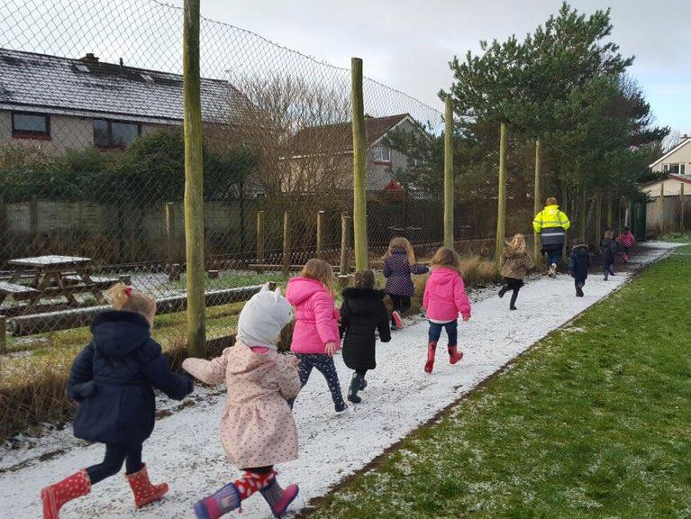
Daily mile slide 3
Notes:
The weather is not a barrier.
Not necessarily great weather, having fun together
This photo is from a Nursery in Scotland
Some Nursery schools in Wigan have taken to doing “The Daily Toddle” for 2 and 3 year olds

Slide 21








Daily mile slide 4
Excess weight* and Physical Activity
in Leicester
Significantly
better than
England
Significantly
worse than
England
Similar to
England
In Reception
…by Year 6
by adulthood it is
estimated that…
1 in 5
children have
excess weight
2 in 5
3 in 5
have excess weight
have excess weight
Only
In a week…
1 in 5
35% of children did no
vigorous exercise
4 in 5
Children participated in physical activity on seven days of the week
45% did vigorous exercise for less than 3 days
children enjoy P.E.
at school:
boys more so than girls
20% did vigorous exercise for more than 3 days
Source: NCMP 2015/2016, Leicester Children and Young People’s Health and Wellbeing Survey 2016 and Active Lives Survey 2015/2016. *overweight or obese
Notes:
Some statistics that I’ve pulled off to show why we are concerned about childrens health.
These figures were taken from the Health & Wellbeing survey conducted in 2015/ 2016 and from the National children measurement programme 2015/2016
we have in Leicester
1 in 5 children in reception classes with excess weight (which is actually significantly better that the rest of England)
However this changes by the children get into Year 6
Where 2 in 5 children have excess weight (this is significantly worse than the rest of England)

Slide 22
Daily mile slide 5
Notes:
In the UK, the Chief Medical Officer’s guidelines state that children should be active for an average of at least 1 hour a day, with an expectation that half of this physical activity time will be provided in-school.
The Daily Mile is a quick, simple, and free way to provide 15 of your 30 active minutes for the children every day.
(It’s good for staff too!)

Slide 23
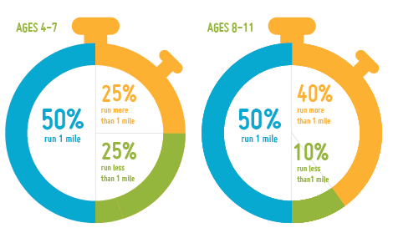
No child has to run a mile…
In 15 minutes this is how far they run
Notes:
75% of the younger children complete 1 mile or more
90% of the older children complete 1 mile or more
Scotland’s Chief Medical Officer has declared The Daily Mile appropriate physical activity for children aged 2 and up.
Children aged 2-12 regularly participate.

Slide 24

The benefits for children
Clear improvement in their health and wellbeing
All children are fit
Obesity and sedentary behaviour is tackled
Self-esteem is raised
Improves body composition for life
They ‘own’ a healthy body and they know it
Reduces stress and anxiety
Builds resilience and determination
Notes:
Health and wellbeing improvements – physical, social, mental and emotional
All children succeed - All children’s fitness improved in 4-6 weeks
Obesity and sedentary behaviour is tackled – regular running becomes normal
Helps to improve relationships (social cohesion and class cohesion)
Some benefits of daily physical activity: good for children’s development, attainment, health and wellbeing, attention, mood, memory, cognition and personal self-efficacy.
There are health and wellbeing improvements for staff, too!

Slide 25
The Daily Mile in the curriculum
Health and wellbeing – social, physical, emotional and mental
Improves access to PE and sport
Improves focus, concentration and behaviour
Daily physical activity raises attainment levels
A bonus, not a burden for teachers – no extra workload
Coppermile Report
BBC’s Terrific Scientific
Notes:
It’s not sport or PE but is physical activity in a social setting
It’s health and wellbeing, and causes improved focus.
When the children return from TDM, they’re ready for learning – benefit of improved cognition that comes directly after exercise
Slick 15 minute transition from desk-to-desk
No special training required for teachers – no extra workload, no data handling, no spreadsheets and no measurements. Unless the teachers and children want to do some child-pleasing measuring of their own.
For those interested in research and results of TDM in schools – The Coppermile Report [University of Essex / Fitmedia Fitness and London Playing Fields Association] and BBC’s Terrific Scientific [Universities of Stirling and Edinburgh] are freely available to view on our website

Slide 26
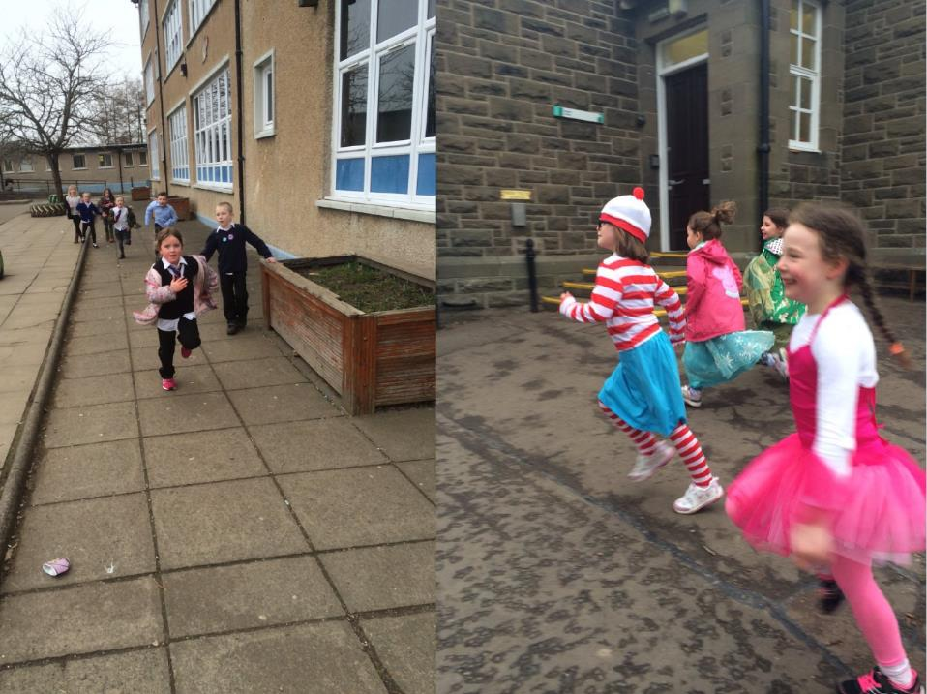
Daily Mile slide 9
Notes:
The children run The Daily Mile in whatever they’re wearing
On the right, you can see if was World Book Day at the time this photo was taken
We’ve also received some photographs recently of schools completing “Laps to Lapland” for their Daily Mile, in Christmas attire

Slide 27
Removing Barriers to Physical Activity
No equipment, no set up and no tidy up
Weather is a benefit, not a barrier
No staff training needed
Risk assessment straightforward
No kit needed, therefore:
  No cool / uncool kit
  No forgetting or losing kit
  No time spent changing
  No body issues or revealing your body
Notes:
Weather as a benefit, not a barrier – children enjoy being outside in nature and connecting with the seasons

Slide 28
Why does The Daily Mile work?
It happens where the children are every day
It’s not complicated – for children or staff
It works for all - keen on sport or not keen on sport
It’s sustainable over years – running is normal
Helps towards a healthy weight
A practical health and wellbeing solution
It meets the needs of childhood:
Fun, Friends, Freedom, Fresh Air
... In 15 golden minutes of childhood
Notes:
It’s sustainable over years – running is normal!
Simple to implement
The founding school, St Ninians in Scotland has been doing The Daily Mile for 6 years in February
It helps towards a healthy weight and create good, daily habits for our younger generation
It’s free – for schools, children, parents, etc.
It meets the needs of childhood – fun, friends, freedom and fresh air …. fitness simply comes with the territory

Slide 29
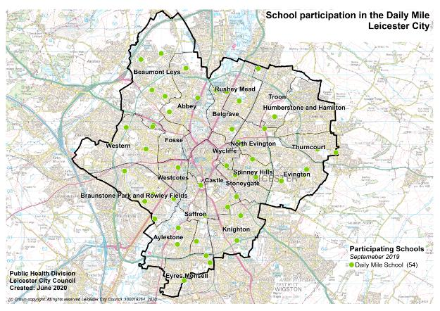
Schools Involved
Notes:
In Leicester we have 54 schools involved with the Daily mile.
When I started on this project at the beginning at the beginning at 2018 we had 4 schools participating we now have approximately 54 schools taking part.
However my task is to get at least 80%of our schools involved so I still have some way to go.

Slide 30
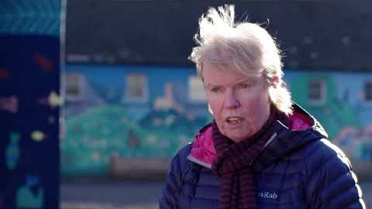


The Daily Mile by Elaine Wyllie
Notes:
A few words form the lady herself Elain Wyllie.

Slide 31
Daily mile slide 14
For further information:
CONTACT
Daxa Ralhan
Daxa.Ralhan@Leicester.gov.uk
Tel: 0116 454 4376
or
Sarah Lansdown
sarah.leicestersspan@gmail.com
Tel:07790 347271
Website: www.thedailymile.co.uk
Notes:
If you would like to sign up to this initiative come and see me afterwards
I also have leaflets at my stall

Slide 32
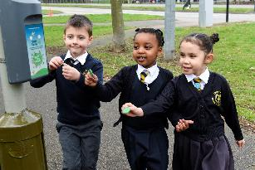
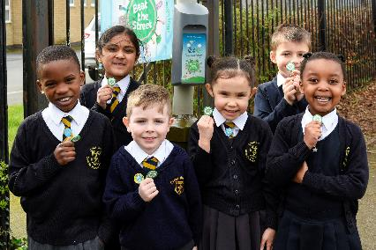

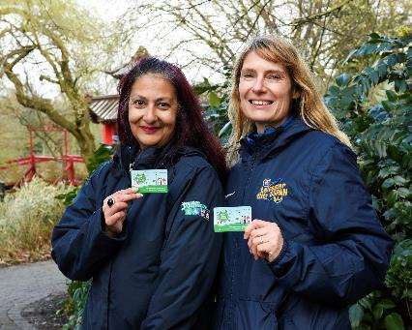
Beat the Street
Beat the Street Leicester is a fun, free game that has seen Leicester transformed into a giant game!
Run over 6 weeks, the game challenges the community to see how far they can walk, cycle or run
There is an element of competition which enables individuals and teams to collect points as they participate to battle it out for the top spots on the leader board and be in with a chance of winning some prizes.
We previously ran with 20 schools and plan to run a further city-wide project in the future

Slide 33





Grow Your Own Grub
The Mealbarrow competition is a great way to involve the wider school community in your growing activities.
Combine creative culinary skills and gardening, your school is challenged to design a three course menu and grow a minimum of 5 ingredients in your Mealbarrow along with your own growing area. Mealbarrows are then showcased for a public vote.
Raise awareness of healthy eating and cooking in your school.
Use as part of your Food for Life and Eco-Schools Awards.
Receive recognition with Bronze, Silver or Gold Grow your Own Grub Award for published criteria on your extended growing area.
Commitments
  Attend free food growing training
  Collect compost and wheelbarrow
  Design and submit a healthy 3 course menu
  Grow at least 5 of your ingredients in the Mealbarrow
  Deliver and collect the Mealbarrow for the celebration day (support is available)
  Host the judging team during your site visit to view your Mealbarrow and extended growing area (where available).
  Advertise the competition and the celebration day to parents & families via school newsletters and the school’s social media channels

Slide 34
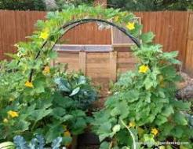
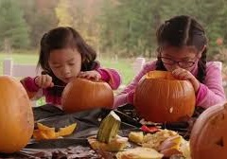
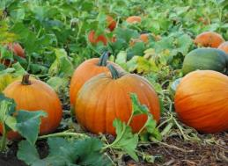
Pumpkin Garden
This year we have launched a brand new competition – the Pumpkin Garden Competition.
Each school participating in the competition received the same selection of pumpkin and squash seeds and a downloadable guide
To be in with a chance of winning you will need to submit a selection of photos and a brief report which includes how you harvested, cooked and composted the pumpkins
As part of the competition you are encouraged to design the garden on a theme of your choice.
There will be prizes for first, second and third place

Slide 35

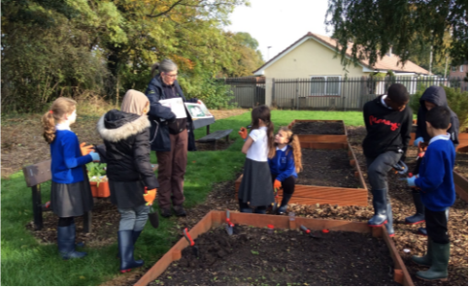



Community Food Support Programme
Bespoke advice (in person and online) to schools on setting up or maintaining a food garden
Sessions for small groups or whole classes in all aspects of food gardening
Inset training for teachers to link food growing to the curriculum
Fundraising advice
How to open your garden to the wider community
Leicester Food Growing
LeicFoodGrowing
Leicester City Council’s Get Growing Grants
www.leicester.gov.uk/your-council/policies-plans-and-strategies/environment-and-sustainability/leicesters-food-plan/get-growing-grant
midlands@tcv.org.uk

Slide 36
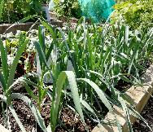
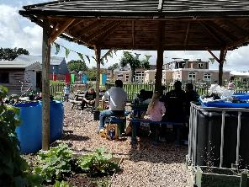
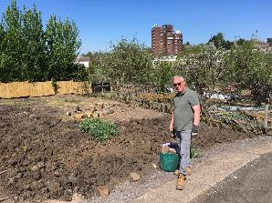

Linking Schools and the Community through Food Growing
TCV’s Green Gym at Rolleston Primary runs an adult only session on Thursdays and a family session on Saturdays, growing healthy food and having fun in the heart of Eyres Monsell.
TCV has been supporting development of two allotment plots in Evington, which will be an outdoor classroom for Mayflower Primary.

Slide 37


Support During the Covid-19 Crisis
Limited stocks of seeds available by post
Lots of advice on the Leicester Food Growing Facebook
Phone line Opening Extended till end of June
Leicester Food Growing YouTube Channel

Slide 38
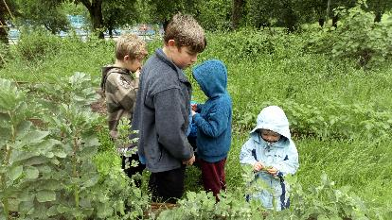


Post Covid Delivery
New risk assessments and health and safety protocols
Phased return
Advice visits
Reduced group sizes for sessions
New sessions ‘Rooting for You’
Nutritious Delicious
Wet Your Plants
Grow Old, Grow Young
Wash and Grow
Green Gym

Slide 39




FOOD FOR LIFE
MAKING BRITAIN HEALTHIER THROUGH FOOD
Lisa Didier - Local Programme Manager Leicester City

Slide 40

Global Goal 3:
Promote Healthy Lifestyles
Preventative measures
Tackling malnutrition.
Overweight and underweight
Healthy food choices
Food in the school environment

Slide 41
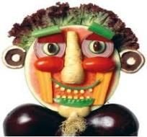
Report by ‘Peas Please’ initiative June 2020
Under lockdown, 25% of households with children are worried about accessing enough fruit and veg
Before covid-19, a third of under 11s were eating none to one portion of fruit or veg a day
There is no food insecurity in the school environment

Slide 42
Food in school
Food growing
Improve school meals
Social dining
Provenance
Food in school
Sustainability
Healthy food choices
School food policy
Cooking
Food waste

Slide 43
UIFSM & FSM
Should be at least 90%
Some schools in Leicester 59-73%
= nutritionally suspicious packed lunches
= food waste

Slide 44

The Ideal for school meals:
Farm to Fork
Farm School Bin

Slide 45
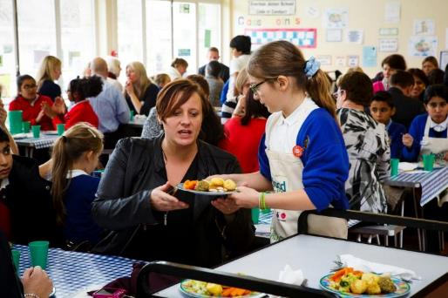
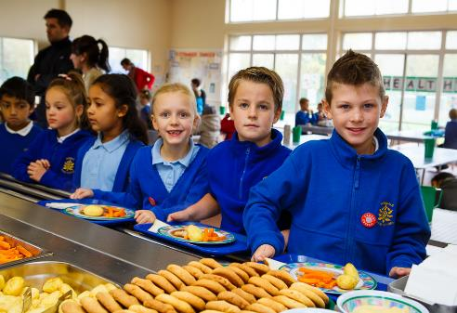
Pupil voice
Pupil Voice = improving lunchtimes

Slide 46


Only milk and water in school

Slide 47
How I can help?
Now and Planning for New Term
Free resources
Free training and support
Gardening resources for outdoor learning
Cooking curriculum support
Websites:
Foodforlife.org.uk
Takeabitecc.org
Autumn term
Lunch box audit
Family Cook and Eat sessions
Lunchtime supervisor training
Contact:
Lisa Didier
Ldidier@soilassociation.org

Slide 48

Healthy Schools Network

Slide 49

Funding cuts / Survey

Slide 50
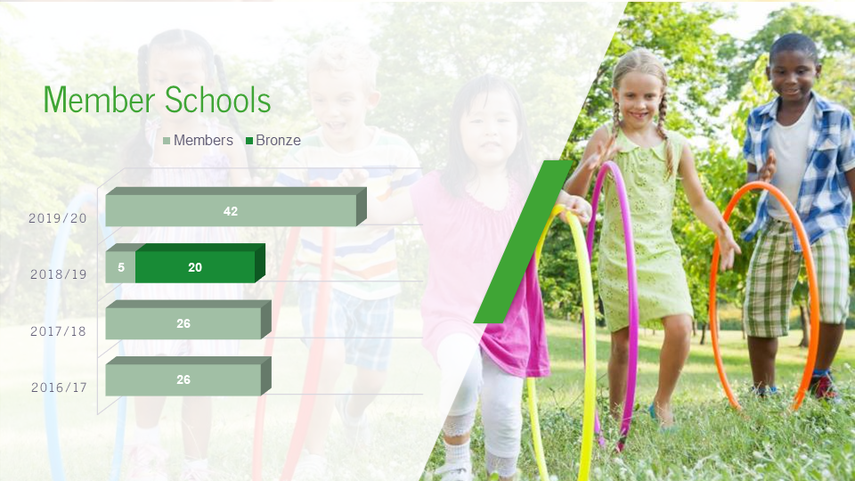
Member schools statistics

Slide 51

Member school statistics 2

Slide 52

The network gives colleagues from all schools the opportunity to come together and share ideas with the help and support of the SDSA and specialist speakers. We would highly recommend being a member of the Network for the opportunities it creates by being a member

Slide 53
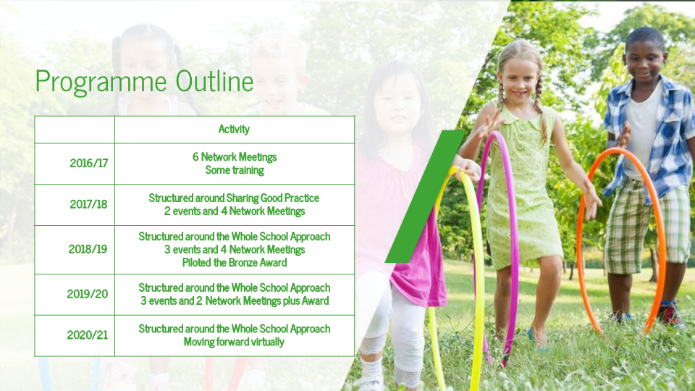
Programme outline

Slide 54
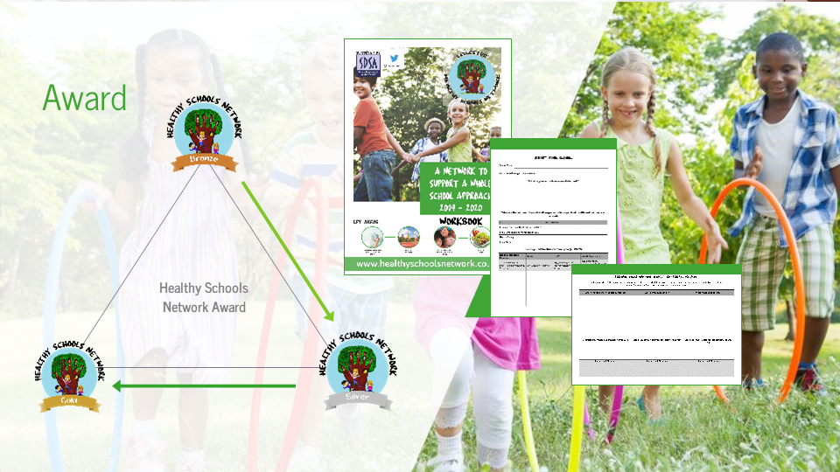
Award format

Slide 55
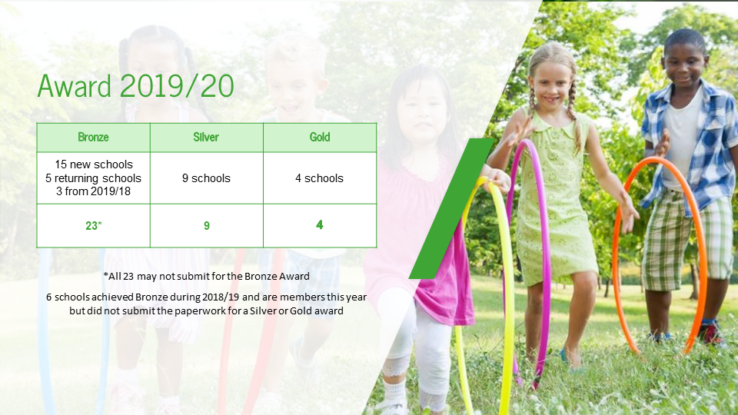
Award statistics

Slide 56

Silver award content

Slide 57
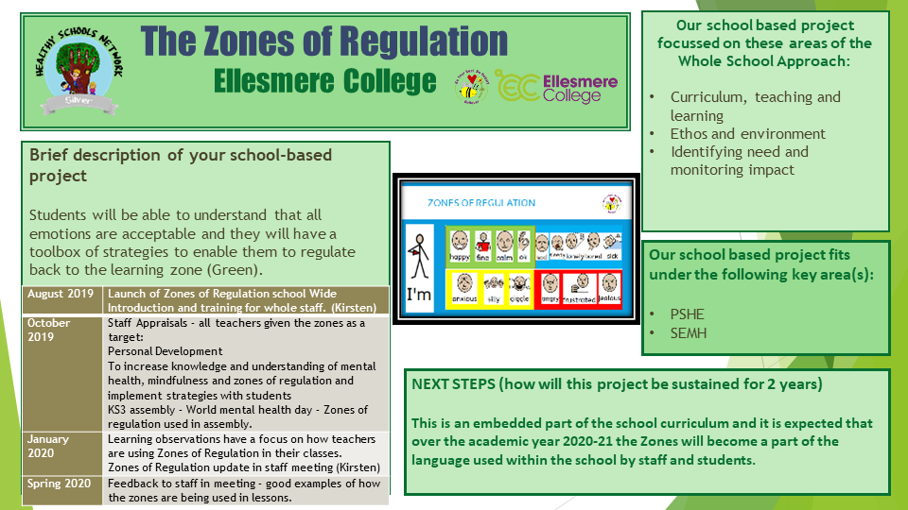
The zones of regulations

Slide 58

Gold award content

Slide 59
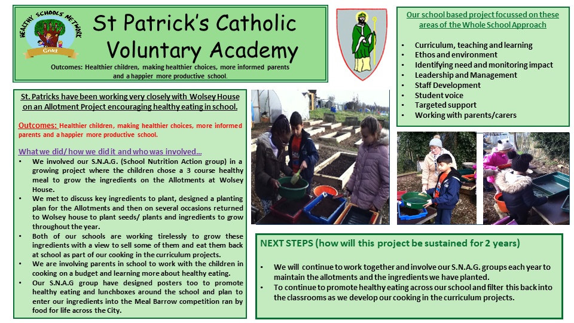
St patricks Catholic Voluntary Academy

Slide 60

Being a part of a wilder network such as the healthy schools network gives us valuable and wide-ranging perspective and support as well as the opportunity to show case and embed out own health and well being work across the whole school

Slide 61
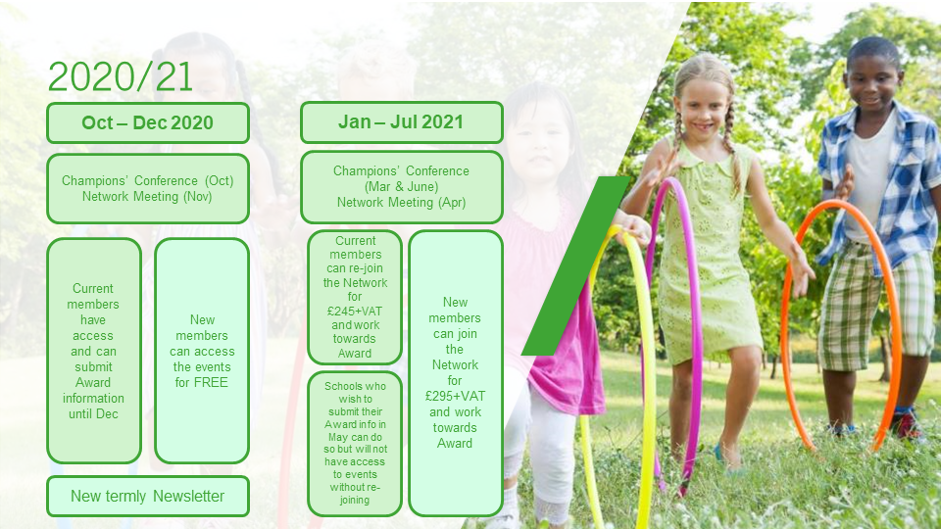
Forward plan

Slide 62

Dates for your diary

Slide 63

How to contact

Slide 64


#EcoSchoolsAtHome
Every Tuesday Eco-Schools England has been publishing a new Eco-Schools Topic handout that will including 5 different topic related tasks that can be undertaken both at home and in school.​
The topic actions have been designed so that they can be carried out by nursery children and college students alike.​
​
School Grounds ​
Biodiversity work​
Marine work ​
Litter work​
Energy work​
Global Citizenship Work​
Healthy Living Work​
Transport​
Waste​
Water​

Slide 65

Positive and Peaceful Places –
Anti-bullying charter
The primary social, emotional and mental health team will now be coordinating the new anti-bullying award under the banner of 'positive and peaceful places for children and young people
This award is open to all settings
The positive and peaceful places award will be awarded to settings who can evidence that they meet the city council's charter statements.
This process will be guided and supported by the SEMH team at a cost, for a 3-year accreditation with a re-accreditation process.
schools.leicester.gov.uk/services/psychology-service/anti-bullying/positive-peaceful-places

Slide 66


Oral Health – Healthy Teeth, Happy Smiles
Healthy Teeth, Happy Smiles aims to provide:
Free toothbrushes and toothpaste for children in oral health packs.
All children in the city will receive five oral health care packs by the time they are five, which contain a toothbrush, fluoride toothpaste and oral health information
Free baby bottle swaps in all of our children, young people and families centres
Supervised toothbrushing. Children
learn how to brush their teeth
properly every day
More information from
healthyteethhappysmiles@leicester.gov.uk

Slide 67
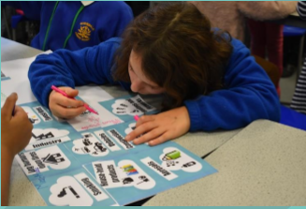
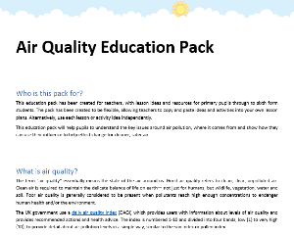
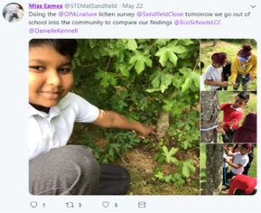




Air Quality Education
FREE
For schools
Suitable
for:
Learn about air quality
Raise awareness throughout the whole school community
Take action, through pupil – led campaigns
Lessons, workshops and assemblies available to download.
Practical activities to help you explore air pollution.

Slide 68

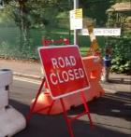
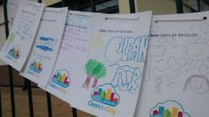



Clean Air Day
SAVE THE DATE
Thursday 8 October 2020
(if Government
Guidance allows)
Tie-in with launch of the LCC School Play Streets, temporary road closure initiative
Currently five schools are on board, £170 application fee - waived for the first 10 schools who apply
You don't need to apply for play streets to get involved – a toolkit of event and activity ideas, is on its way.
Find out more: email danielle.kennell@leicester.gov.uk

Slide 69






Switch off your engine campaign
FREE
for schools
Idling vehicles outside of schools is one of the
biggest contributors to air pollution
around schools.
Campaign developed to discourage vehicles from idling outside of schools
Support to develop pupil-led campaign
Idling monitoring
Free resources: posters, flyers, car stickers
Assemblies available for your school
Suitable
for:
Find out more email: danielle.kennell@leicester.gov.uk

Slide 70






Meat Free Monday
www.meatfreemondays.com/schools
Launched by Paul, Mary and Stella McCartney in 2009, Meat Free Monday is a not-for-profit campaign which aims to raise awareness of the detrimental environmental impact of animal agriculture and industrial fishing
The campaign encourages people to help slow climate change, conserve precious natural resources and improve their health by having at least one plant-based day each week

Slide 71




MINDFULNESS MINUTES
Many of us live our lives rushing through the school day, blink and it’s the end of term. Life is happening, but we may not notice due to everything else that is going on in our school environment.
This weeklong project aims to get pupils and school staff thinking about, and actively promoting, positive mental health and well-being.
Fits in to the Eco-schools 7 steps model
www.eco-schools.org.uk/wp-content/uploads/2019/05/Mindfulness-Minutes.pdf

Slide 72




Young Minds
youngminds.org.uk/
We’re leading the fight for a future where all young minds are supported and empowered, whatever the challenges. We’re here to make sure they get the best possible mental health support and have the resilience to overcome life’s difficulties.
The crisis in children and young people’s mental health is real and it is urgent. More children and young people than ever before are reaching out for help with their mental health. But for those who take that brave step, help is much too hard to find.
Together, we are changing this. We’re fighting for young people’s mental health. Join our fight.
Resources and materials for teachers and school staff to build their skills and make mental health and wellbeing a core, rewarding part of their job.

Slide 73



RHS Big Soup Share
The Big Soup Share is a chance to celebrate the work you do in your garden by harvesting your crops, whizzing them up into a delicious soup and sharing it out with others.
You may wish to share your soup with the rest of your school or group or hold a big event and share the soup with family, friends and other members of your local community.
Any schools, youth groups or community groups based in the UK can take part and apply to receive pack full of resources to help with your event. The premise is simple, and we think it's a great way to engage with young people, whether young people are a part of your group already, or you're looking to engage with them more.
Use the resources to help plan for your event and help you with what to do afterwards
Register for 2020 here
schoolgardening.rhs.org.uk/Competitions/Big-Soup-Share

Slide 74




Facetime a Farmer
Farmer Time is all about harnessing the power of digital communications to inspire, engage and educate young people about not only the journey from farm to fork but also the everchanging, diverse agricultural industry.
Children regularly chat live to their matched farmer from their classrooms through FaceTime or Skype, discuss ideas, ask questions, share knowledge and gain a ‘real-time’ understanding of the issues farmers face every day.
https://leafuk.org/farmertime/home

Slide 75
Curriculum Links 1
Language & Literacy Writing
Create presentations on a Healthy Living theme such as friendship and conflict resolution.
Write a report or article on, for example, healthy minds or the problem of unhealthy breaks and a lack of exercise.
Write in different styles within the Healthy Living topic e.g. journey of a food product or write a food diary or exercise diary.
Talking & Listening
Perform poetry about exercise, foods etc.
Interview locals about health problems in the area. Carry out interviews with staff of organisations such as Public Health Agency.
Participate in group and class discussions. Share, respond to and evaluate ideas, arguments and points of view and use evidence or reason to justify opinions, actions or proposals.
Invite local athletes or sportspeople into assembly to talk to children about the benefits of being active and what it takes to be an athlete.
Reading
Find out about the impacts of a lack of exercise or eating too many fatty foods by gathering articles, searching the web etc.
Follow instructions on food products on how to cook/ store/freeze them.
Consider, interpret and discuss texts, exploring the ways in which language can be manipulated in order to affect the reader or engage attention such as scientific articles and reports.

Slide 76
Curriculum Links 2
Religious Education
​Creation story- what plants and animals humans were meant to eat as outlined in the Bible.
The different foods eaten by other religions and faiths.
Compare our lifestyles to other faiths
Mathematics & Numeracy Number
Apply knowledge of percentage calculations to problem solving e.g. percentage reduction or increase in healthy school meals consumed.
Discuss and be able to assess “value for money” in relation to shopping, e.g. when purchasing fruit and vegetables. Solve numerical problems relating to money and purchasing food.
Undertake counts of food waste/hours of exercise etc. Measures n Undertake monitoring of healthy breaks etc.
Record measurements of length when for example, measuring a plot of the school ground for creating a vegetable patch or for exercise/climbing equipment.
Read and interpret simple graphs and apply knowledge to solve related problems e.g. obesity statistics or pie charts on food groups.
Shape & Space
Pupils walk 2d shape outlines placing cones at the corners using their knowledge of the properties of squares, larger rectangles and triangles.
Discuss shape of food packaging etc. Handling Data
Apply findings through graphs, diagrams, charts etc. Insert data into a prepared relevant computer database and interrogate.
Discuss examples of data represented in newspapers, magazines and multimedia sources.
Carry out a simple class/school food survey.

Slide 77
Curriculum Links 3
  Geography
  Use maps to calculate journeys of pupils and of products and use an online map to work out the mileage.
  Categorise different fruits and vegetables and discover their country of origin.
  Discuss real walks the pupils take (e.g. walking to or around school) and model how to describe a journey referencing landmarks, directions etc.
  Investigate foods from around the world. Have a tasting session.
  History
  Research how lifestyles differed in the past through topics such as the Victorians.
  Create a report/presentation on how eating habits have changed over time.
Science & Technology
  Keep a food diary.
  Set up a smoothie and juice bar.
  Run a children-parent cookery club to find out how easy it is to cook healthy and tasty meals. Create a healthy meal recipe book.
  Categorise different types of food under the “Eat Well Plate”.
  Recognise and identify parts of the human body and investigate the senses.
  Create a report on a Healthy Living issue e.g. effects of drugs.

Slide 78
Curriculum Links 4
    Personal Development & Mutual Understanding
    Understand health and safety on site.
    Actively taking care of self and others.
    Apply findings to the wider community.
    Encourage healthy habits.
    Engage in healthy food cookery classes.
    The Arts Art & Design
    Look at and talk about the work of local artists who paint pictures of food etc.
    Design Healthy Living posters and leaflets e.g. the perfect sandwich.
    Have a school poster competition with the aim of designing posters to promote active and sustainable methods of travel to school.
    Make 3d models of parts of the human body.
    Make maps of pupil journeys to school in the style of an artist e.g. Hundertwasser.
    Music
    Create musical sound story e.g. on a journey.
    Perform/compose a sound picture e.g. sounds we hear in the supermarket.
    Compose a Healthy Living rap.
    Drama
    Use drama to begin to explore their own and others’ feelings about issues, and by negotiating situations both in and out of role e.g. a proposed change to school meals.
    Make a class fruit (or other foodstuffs) shop and engage in shop role play as part of structured play.
    Physical Education
    Prepare for outdoor work.
    Take part in physical tasks.
    Keep an exercise diary.
    Before-school exercise classes.
    Encourage parents and pupils to walk, cycle or scooter to school. n Create a physical activity alphabet focusing on the first letter of each word.
    Have a morning/afternoon/day of action e.g

Slide 79


Water fountain competition
Leicester Water Fountain
Competition​

Slide 80


BESS Energy offer
BESS ​
Energy​
schools.leicester.gov.uk/BESS-Energy​

Slide 81

Declaring a Climate Emergency in School
On 1 February 2019 Leicester City Council declared a Climate Emergency. The declaration is an acknowledgement that:
  Climate change is happening, and threatens the wellbeing of everyone in Leicester and worldwide
  The speed and scale of global and local action to tackle the problem needs to be dramatically increased.
In its declaration, the Council committed to developing a new action plan to address the emergency through our own services and projects .
What action you can do:
Discuss your plans with students and staff .
Select actions which you plan to achieve, make them manageable but also remember we are in a Climate Emergency.
Make sure your actions have a duration, responsibilities and an evaluation.
Take your action plan to the Governing Body or Trustees to ensure that you have their support.
You can submit your action plan to the City Council which we will publicise as part of our wider action plan.
Start your action plan!
Review regularly to check and maintain your progress .
schools.leicester.gov.uk/climate-emergency

Slide 82


Climate Emergency Documents
Templates and document available at schools.leicester.gov.uk/climate-emergency

Slide 83
Other opportunities coming up
UN Climate Change Learn Online
  Climate Change: From Learning to Action (8 hours)
  Children and Climate Change (6 hours)
  Cities and Climate Change (2 hours)
  Human Health and Climate Change (2 hours)
  Module 1 of Open Online Course on Gender and Environment (6 hours)
Off School website - a free website full of ideas for home learning and fun activities. Head to the Activity Zone for 100s of films, created by teachers, across loads of great topics and themes!

Slide 84
Grant opportunities
Get Growing Grants
eTeach link
Grants 4 Schools

Slide 85

Questions and Answers

Slide 86

Future Webinars
24 June | Topic: Marine | Daniel Coles, Alex Cameron, Roshni Jose - Leicester City Council Nicola Holt, Environment Engagement, Leicester City Council (and also Refill Leicester)
1 July | Topic: How to submit your Green Flag application

Slide 87





Keeping in Touch
EcoSchoolsLCC
EnvEducationLeicester
EcoSchoolsLCC
EcoSchoolsLCC
schools.leicester.gov.uk/eco-schools
Eco-Schools@leicester.gov.uk
(sign up for newsletter and eBulletins)

