Slide 1
#EcoTeach Webinar School Grounds
Lee Jowett, Environmental Education Coordinator
Amy Peace, Graduate Project Officer

Slide 2
#EcoTeachMeet Webinar Series
Overview of #EcoTeach format and dates/times of webinars
What Environmental Education Leicester is
Eco-Schools – and how it fits into the big picture
School Grounds projects
Q & As
Other opportunities coming up

Slide 3
Overview of #EcoTeach Webinar format and dates/times of webinars
Weekly at 10am during term time – lasting up to an hour, Leicester focused but suitable for everyone.
Recording and PowerPoint with links available afterwards at schools.leicester.gov.uk/eco-schools
During the presentation, ask questions in the chat box.
Questions and answers at the end – either directly ask or in chat box depending how many people are attending.

Slide 4
What is Environmental Education Leicester?
Provide free support to all Leicester School.
Communications with schools – social media (Twitter, Facebook, Instagram, YouTube), monthly eBulletins and quarterly newsletter.
TeachMeets, Eco-Schools Roadshow, Eco-Schools & Food for Life Celebration, Sustainable Schools Celebration bi-annual.
Focus on the Eco-Schools Award.
Delivery of energy and litter focused projects.
Project support and partnership working with internal and external organisation.

Slide 5
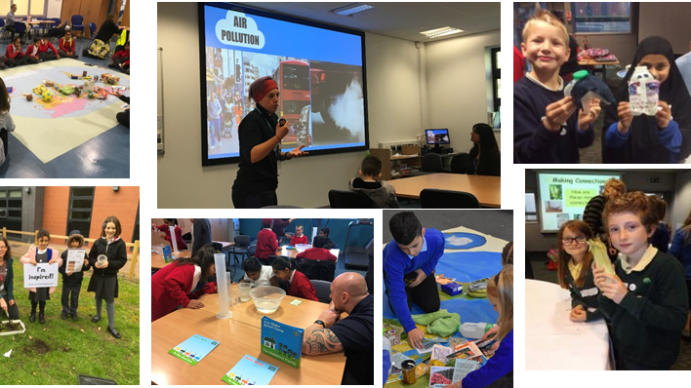
Eco-Schools Roadshow

Slide 6
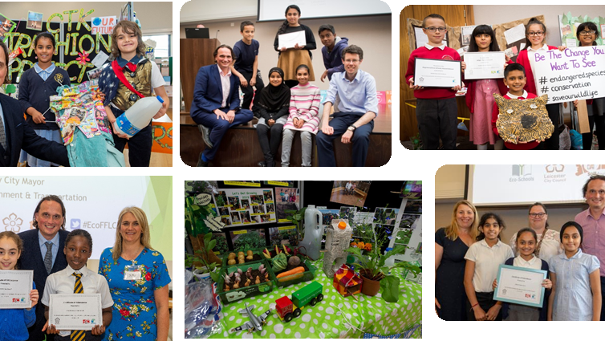
Eco-Schools and Food for Life Celebrations

Slide 7
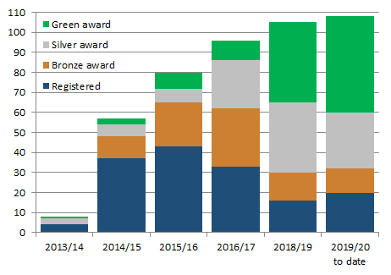
Eco-Schools – Our Work in Leicester
Promoted Eco-Schools as an award since September 2014 (114 schools)
109 registered on the programme
of those, 91 have achieved bronze
of those, 78 have achieved silver
of those 48 have achieved Green Flag

Slide 8
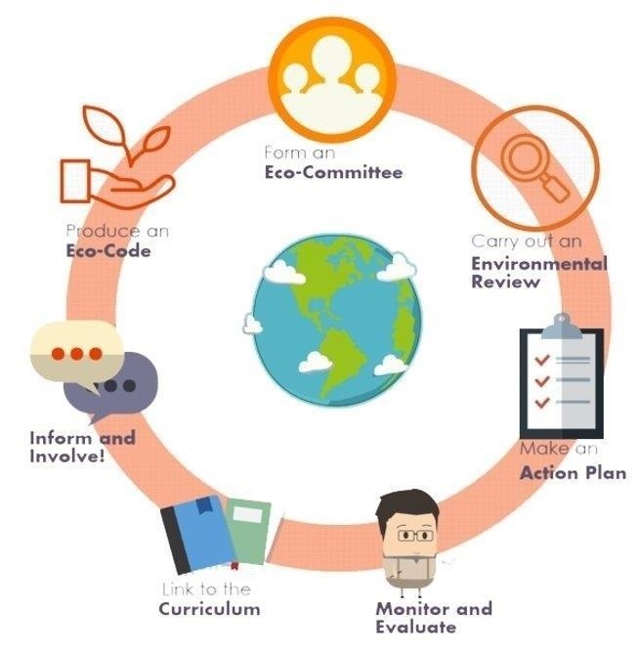
Eco-Schools Programme 7 step model

Slide 9
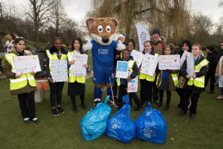
Step 1
Eco-Schools model - 7 steps 1
EYFS resources
Primary resources
Secondary resources
Step 1 – Eco-Committee, the heart of an Eco-Schools action and learning
At least one pupil form each year group
Meet at least once per half term
Share responsibility for running meetings
Records of minutes are kept
Minutes displayed on the Eco-board
Representative from parents, governors or senior leaders

Slide 10
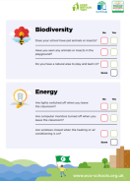
Step 2
Eco-Schools model - 7 steps 1
EYFS resources
Primary resources
Secondary resources
Step 2
EYFS
Primary
Secondary
Step 2 – Environmental Review – investigating the school's environmental performance
Covers all 10 Eco-Schools topics
A copy is displayed on the notice board
It is updated/reviewed at least every 2 years (best practice is annually)

Slide 11
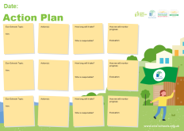
Step 3
Eco-Schools model - 7 steps
EYFS resources
Primary resources
Secondary resources
Step 3
Step 3 – Action Plan – Decide on topic actions, based on the result of the Environmental Review
The action plan is influenced by the review
Pupils take responsibility for learning on the topics
3 for the first green flag
5 for the renewal (changing 2 with each subsequent application)
Contains timescale, who is responsible and how it will be monitored
Shared with the whole school
A copy is displayed on the noticeboard

Slide 12
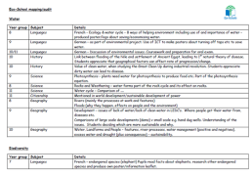
Step 4
Step 4
Eco-Schools model - 7 steps
EYFS resources
Primary resources
Secondary resources
Step 4 – Curriculum Links – making links between the school's environmental activity and the curriculum
Environmental issues are covered in at least three areas in your school curriculum, evident in schemes of work, pupils work and/or lesson plans (for first green flag this can be the same year group)
They do not need to be the same topics as your Action plan

Slide 13
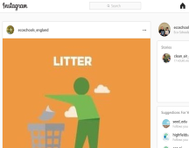
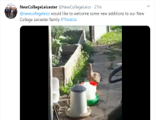
Step 5
Eco-Schools model - 7 steps
EYFS resources
Primary resources
Secondary resources
Step 5
Step 5 – Informing and involving – Let the whole school and wider community know what the Eco-Committee is doing
A prominent noticeboard in school
Covering the 7 steps and 3/5 topics
Members of the committee
Environmental review
Environmental action
Examples of monitoring and evaluation
Eco-code
Variety of mediums to communicate
The whole school and wider community is informed

Slide 14
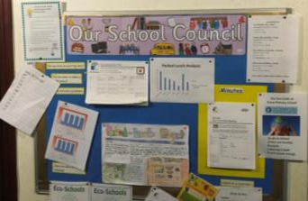
Step 6
Eco-Schools model - 7 steps
EYFS resources
Primary resources
Secondary resources
Step6
Step 6 – Monitoring and Evaluation – Measuring change and finding out what works and what doesn't
The committee monitors the effectiveness of the topics via data collections, surveys, before and after photographs
It is communicated with the whole school
Data has been analysed to help pupils develop further topic actions
Data has been used in the curriculum e.g. graphs and charts in math

Slide 15
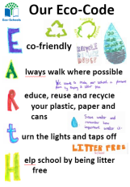
Eco-Schools model - 7 steps
EYFS resources
Primary resources
Secondary resources
Step 7
Step 7 – Eco-Code – Creating a call to action that the whole school can get behind
There is an agreement statement for your school drawn up by pupils
It reflects the topic actions you are working on
It is displayed around school e.g. classrooms, hall and the office
The majority of pupils and students understand is

Slide 16
Eco-Schools model 10 topics

Slide 17
Key things to think about in topics
Whole school opportunities
Informing everyone about the work
Links to curriculum areas e.g. science (biodiversity), geography, English and maths (creative writing and data handling)
Monitor impact of actions – more difficult to do in school grounds – however photos before and after projects & surveys
Reflected in your Eco-code

Slide 18
School Grounds Projects
Edible Playgrounds
Woodland Trust
Outdoor Classroom Day
Wild Forest Schools
#EcoSchoolsAtHome
Eco-Schools Pinterest
Grow Wild
RHS Campaign for School
Learning through Landscapes
Learning Through Landscapes international conference
Forest School Network
Wilko Projects
Grow Your Own Grub and Pumpkin Growing
TCV
Enstruct
Countryside Classroom
Curriculum Links - Wild about Learning
Notes:
Why focus on litter?
- bad for the environment, can pollute soil, water and air
- looks horrible
- costs money to clear up
- can attract pests

Slide 19
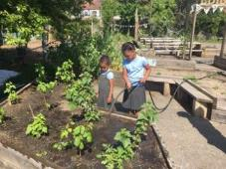
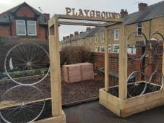
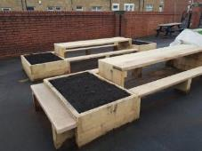
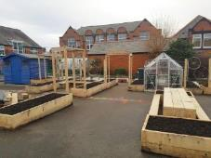
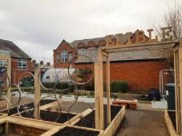
Edible Playgrounds
Edible Playgrounds offer a lively, engaging, multi-sensory way to teach children about growing and eating healthy food
Aside from the physical health benefits that eating well brings, learning in an outdoor environment combats Nature Deficit Disorder and has been shown to increase mental health by boosting mood, confidence and self-esteem
Furthermore, allowing the children to connect with nature develops attentiveness and self-reliance in the pupils, leading to more sustainable behaviours in the long term
They are currently working with 3 schools this academic year in Leicester City and 3 next academic year
www.treesforcities.org/our-work/schools-programme/edible-playgrounds

Slide 20
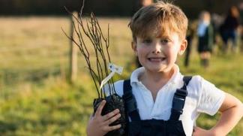
Woodland Trust Trees for Schools
Free trees for schools and communities.
Two delivery periods per year (March and November). Currently taking applications for trees to be delivered in November 2020.
You can buy packs in the shop all year round.
Open to schools across the UK, plus nurseries, colleges, universities and outdoor learning centres.
If you’re applying as a school your trees should be planted on either the school grounds, land the school has arranged regular access to or in an area that is publicly accessible.
The trees can be planted as copses, groves, avenues, shelter belts, hedgerows and many other ways.
You can request up to four separate tree packs as long as the total does not exceed 420 trees in each application cycle.
All the trees they supply are sourced and grown in the UK and Ireland.
www.woodlandtrust.org.uk/plant-trees/schools-and-communities

Slide 21
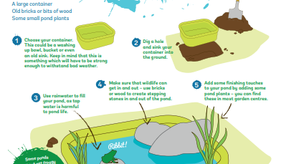
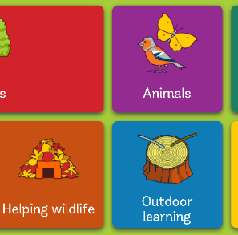
Woodland Trust Resources
treetoolsforschools.org.uk/categorymenu

Slide 22
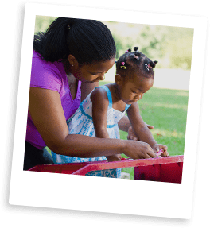
Outdoor Classroom Days
Outdoor Classroom Day is a global campaign to celebrate and inspire outdoor learning and play. On the day, thousands of schools around the world take lessons outdoors and prioritise playtime. In 2019, over 3 million children in over 100 countries took part.
Outdoor learning improves children’s health, engages them with learning and leads to a greater connection with nature. Play not only teaches critical life skills such as resilience, teamwork and creativity, but is central to children’s enjoyment of childhood.
It’s easy to get involved and there is something everyone can do!
If you’re a teacher and new to outdoor learning, why not use Outdoor Classroom Day to try it out? If you already get outdoors regularly, use the day to celebrate what you’re doing and inspire other teachers around the world to join in.
If you’re a parent, talk to your child’s school about the importance of outdoor learning and play and encourage them to get involved. Think about how you can spend more time outdoors as a family too and inspire other parents to do the same.
If you work for an organisation that cares about children, nature, education or the environment, speak to us about how you can get involved. We’re always looking for partners to help spread the message far and wide.
So that schools can participate on a day that fits with their climate and term times, the global campaign has two dates each year. The next Outdoor Classroom Days are on Thursday 21 May and Thursday 5 November 2020. Sign up below for one or both and help build a movement that gets children outdoors to play and learn every day!
outdoorclassroomday.com

Slide 23
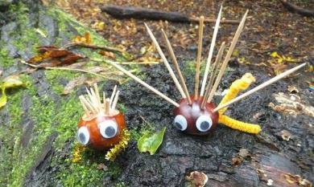
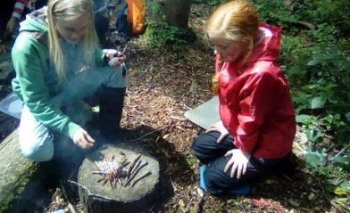
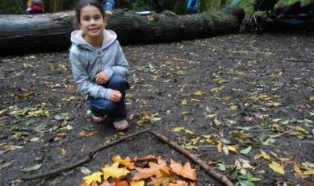
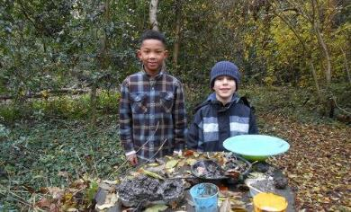
Wild Forest School
Since 2015, Leicestershire and Rutland Wildlife Trust has worked with over 1,000 children in Leicester, thanks to the support of players of People’s Postcode Lottery
Home Education Groups – wild in nature activities
Wild Tots – stay and play style sessions
Wild activities – home learning opportunities

Slide 24
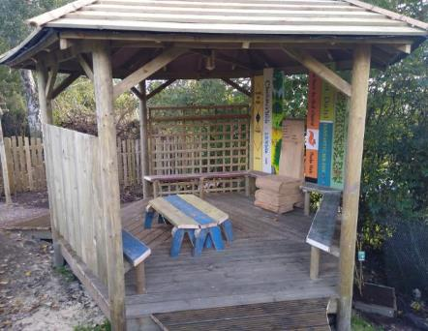
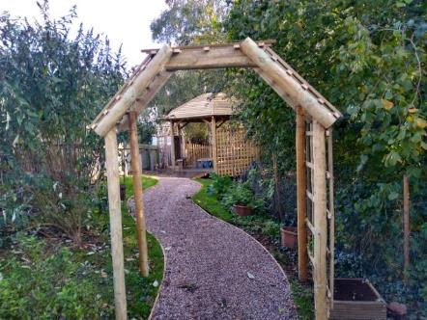
Wild Forest School
Competitions including:
Wild Stories,
Wild Areas
and a future competition called Wild Art

Slide 25
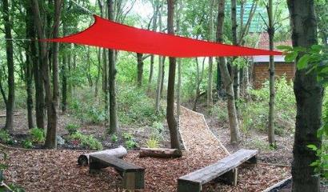
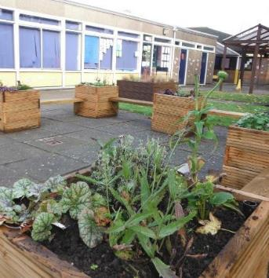
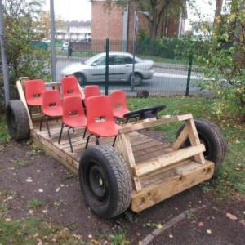
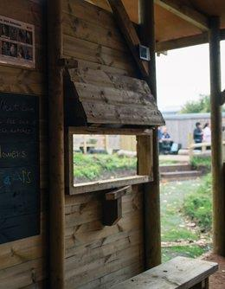
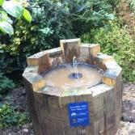
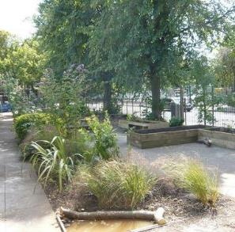
Wild Areas
Outdoor learning and exploring areas created by the Leicestershire and Rutland Wildlife Trust

Slide 26
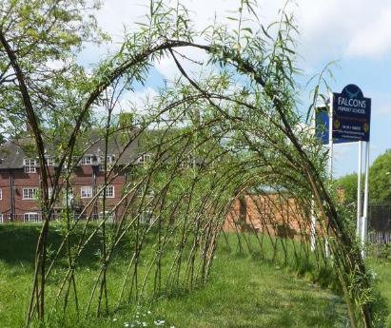
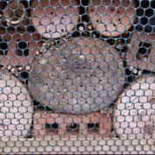
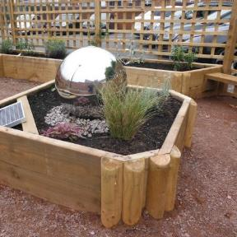
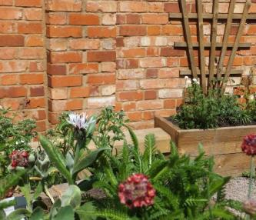
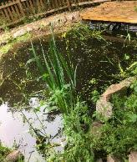
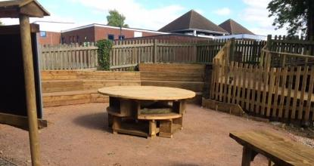
Wild Areas
Wildlife areas, Sensory gardens, Barefoot sensory trails, Outdoor classrooms, Forest School areas, Mindfulness gardens, Living Willow, Wildlife Ponds, Minibeast trails, Wildlife Hedges, Green roofs, Raised beds

Slide 27
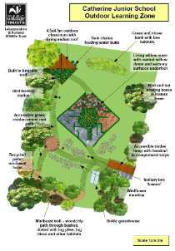
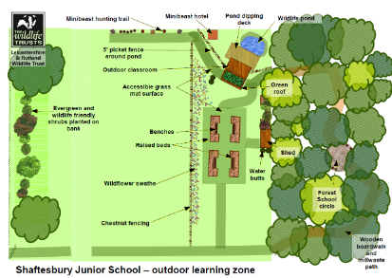
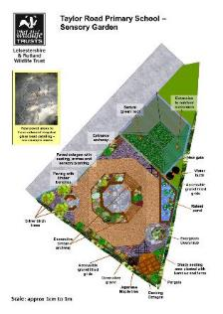
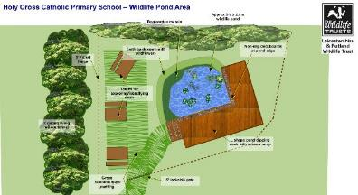
Wild Areas

Slide 28
Wild Areas video

Slide 29
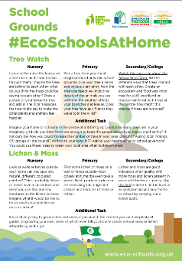
#EcoSchoolsAtHome
Every Tuesday at 8:00pm Eco-Schools England is publishing a new Eco-Schools Topic handout that will include 5 different topic related tasks that can be undertaken both at home and in school.
The topic actions have been designed so that they can be carried out by nursery children and college students alike.
School Grounds
Previous:
Biodiversity work
Marine work
Litter work
Energy work
Global Citizenship Work
Healthy Living Work

Slide 30
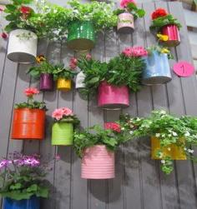
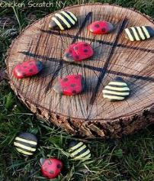
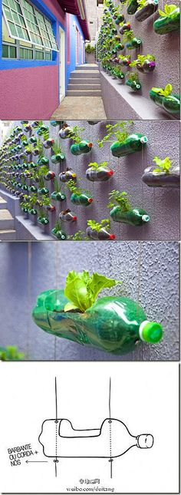
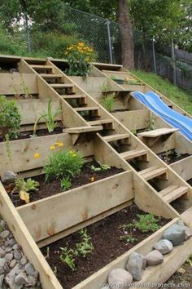
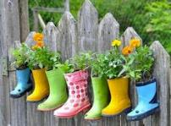
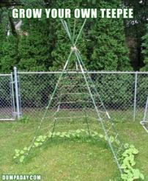
EcoSchools Pinterest
https://www.pinterest.co.uk/ecoschoolsengla/school-grounds-topic/

Slide 31
Grow Wild
National outreach learning initiative of the Royal Botanical Gardens, Kew
Funded by the National Lottery Community Fund and Royal Botanical Gardens, Kew
Grants of £500 for creative projects
They’ve funded and supported 258 young people to run their own creative project since 2014
Eco-brick wildflower planter
Childrens corner in a community café
Photography exhibition
Funding deadline has passed this year, but you can sign up online to be notified when applications open
www.growwilduk.com/visit-volunteer/youth-projects/are-you-aged-14-25-and-buzzing-project-ideas

Slide 32
Royal Horticultural Society
The RHS run several schools specific projects and those that schools can use
Big Soup Share
Grow Social
Green Plan It
School Gardeners of the Year
School Gardening Awards – 5 levels
Lots of online resources about growing
Training courses
schoolgardening.rhs.org.uk/home

Slide 33
Learning through Landscapes
They help children and young people to connect with nature, become more active, learn outdoors and have fun. Lots of free Resources on their website
Local school grants of £500
Catalogue of equipment (£30 all the way up to full £500)
Training course run in school (2 hours)
Need to involve the students in selecting equipment and course
www.ltl.org.uk

Slide 34
Learning through Landscapes International Conference 2021
Learning through Landscapes are organising the International School Grounds Alliance (ISGA) conference in Stirling, Scotland
This event will bring together the best in outdoor learning and play in school grounds and beyond. Learn from the best practitioners, researchers and professionals in the outdoor learning and play world.
Ideal for educators, teachers and design professionals, you can join for one day or all three days.
Full programme and booking details online www.ltl.org.uk/projects/isga2021
This has been postponed a full year and will now be held on the 23 - 25th September 2021

Slide 35
Forest School Network
A group of teachers, nursery practitioners and people working in an outdoor environment formed the network in 2007 to raise awareness of the benefits of Outdoor Learning and Forest School could bring to children's well-being.
They wanted to support teachers and Forest School trainees by offering relevant CPD free or at a reasonable price to encourage maximum participation.
It is a totally voluntary local organisation and operate as a regional group that's part of the national body known as Forest Education Network - FEN (which is itself part of Learning Outside the Classroom - LotC )
Notts and Leics FEN is a constituted group that's free to join and run by it's members
www.facebook.com/forestschooleastmidlands

Slide 36
Wilko Project (2018-19)
Barley Croft Primary School Braunstone Primary School
Ellesmere School
Mowmacre Hill Primary
Woodstock Primary Academy
Year-long project using bespoke outdoor learning education packs
Use strategies and activities to engage your staff and students, using your outdoor learning areas​
Receive regular one to one support from a dedicated project officer​
Use unique and bespoke resources being piloted in the project
Feedback on the development of the resources for primary and SEN schools​
Develop big community engagement and impact work​
Receive funding for the prestigious ​Eco-Schools Green Flag Award and use project evidence to support submitting their application during the academic year

Slide 37
Wilko Project

Slide 38
Grow Your Own Grub
The Mealbarrow competition is a great way to involve the wider school community in your growing activities.
Combine creative culinary skills and gardening, your school is challenged to design a three course menu and grow a minimum of 5 ingredients in your Mealbarrow along with your own growing area. Mealbarrows are then showcased for a public vote.
Raise awareness of healthy eating and cooking in your school.
Use as part of your Food for Life and Eco-Schools Awards.
Receive recognition with Bronze, Silver or Gold Grow your Own Grub Award for published criteria on your extended growing area.
Commitments
Attend free food growing training
Collect compost and wheelbarrow
Design and submit a healthy 3 course menu
Grow at least 5 of your ingredients in the Mealbarrow
Deliver and collect the Mealbarrow for the celebration day (support is available)
Host the judging team during your site visit to view your Mealbarrow and extended growing area (where available).
Advertise the competition and the celebration day to parents & families via school newsletters and the school’s social media channels

Slide 39
Pumpkin Garden
This year we have launched a brand new competition – the Pumpkin Garden Competition.
Each school participating in the competition received the same selection of pumpkin and squash seeds and a downloadable guide
To be in with a chance of winning you will need to submit a selection of photos and a brief report which includes how you harvested, cooked and composted the pumpkins
As part of the competition you are encouraged to design the garden on a theme of your choice.
There will be prizes for first, second and third place

Slide 40
Community Food Support Programme
Bespoke advice (in person and online) to schools on setting up or maintaining a food garden
Sessions for small groups or whole classes in all aspects of food gardening
Inset training for teachers to link food growing to the curriculum
Fundraising advice
How to open your garden to the wider community
Leicester Food Growing
LeicFoodGrowing
Leicester City Council’s Get Growing Grants
www.leicester.gov.uk/your-council/policies-plans-and-strategies/environment-and-sustainability/leicesters-food-plan/get-growing-grant
midlands@tcv.org.uk

Slide 41
Linking Schools and the Community through Food Growing
TCV’s Green Gym at Rolleston Primary runs an adult only session on Thursdays and a family session on Saturdays, growing healthy food and having fun in the heart of Eyres Monsell.
TCV has been supporting development of two allotment plots in Evington, which will be an outdoor classroom for Mayflower Primary.

Slide 42
Support During the Covid-19 Crisis
Limited stocks of seeds available by post
Lots of advice on the Leicester Food Growing Facebook Group

Slide 43
Enstruct
At Enstruct Training we strive to enrich the lives of young people by offering fun, engaging and accessible alternative learning programmes in areas they would otherwise not have the opportunity to explore.
Our flexible approach allows us to create programmes of learning to reflect the individual needs of our learners, encouraging the development of their self-esteem, confidence and their physical and mental well-being.
Our skilled and dedicated team provides our learners with programmes which encourage the development of valuable life skills such as resilience and risk management, whilst increasing their knowledge and practical skills in the environmental and construction sectors. We aim to increase their desire to learn and opportunities for employment and further training.
Having traded as two separate companies for more than 5 years, Environmental Studies Ltd and VTEC have joined forces to create a learning establishment with a focus towards both environmental and construction skills and forest school and outdoor learning.
www.enstructtraining.co.uk

Slide 44
Countryside Classroom
Countryside Classroom helps teachers to find resources, places to visit and school support relating to the themes of food, farming and the natural environment
We aim to inspire and enable teachers to use food, farming and the natural environment more often, in and out of the classroom, because we want all children to have the opportunity to learn about and experience these essential topics
Countryside Classroom is a managed by a partnership of organisations that represent the very best in food, farming and environment education
They are committed to working together to increase the quality of our services and reduce duplication in the sector
www.countrysideclassroom.org.uk

Slide 45
Curriculum Links – Wild about Learning
The curriculum-linked teacher’s pack is designed to support and encourage teachers to take their lessons outdoors. Wild About Learning consists of 2 hour numeracy and literacy lesson plans for each KS1 and KS2 year group, plus links to other packs and resources
Lesson plans have been designed to:
Work in any school grounds
Use commonly found natural materials
Need minimum preparation time
http://www.wildforestschool.org.uk/wild-about-learning

Slide 46
Wild about learning video

Slide 47
Additional Links for
OPAL's national citizen science surveys
The surveys explore the health of our soils and trees, the quality of our air and water, the distribution of native and invasive invertebrates, and the importance of habitats for wildlife. We provide easy-to-follow survey instructions, straightforward ID guides and a variety of other resources to help you explore your local environment.
https://www.opalexplorenature.org/surveys
Urban science
An EU publicly funded free at source project - modules all have an outdoor learning element. For example, our physical science Energy module – ‘Living walls’ has a focus on a GCSE enquiry-based learning approach to green walls – do they work? What are the advantages?
https://urbanscience.eu/uk/learning-modulesxplorenature.org/surveys
The Association for Science Education (ASE)
ASE is committed to promoting fieldwork as an effective and inspirational way to teach science. The 'outdoor classroom' provides a meaningful way to engage learners in practical science, giving them experience of collecting and analysing data, and making predictions in the real world, beyond the limitations of the classroom or laboratory.
https://www.ase.org.uk/outdoor-science

Slide 48
Declaring a Climate Emergency in School
On 1 February 2019 Leicester City Council declared a Climate Emergency. The declaration is an acknowledgement that:
Climate change is happening, and threatens the wellbeing of everyone in Leicester and worldwide
The speed and scale of global and local action to tackle the problem needs to be dramatically increased.
In its declaration, the Council committed to developing a new action plan to address the emergency through our own services and projects .
What action you can do:
Discuss your plans with students and staff .
Select actions which you plan to achieve, make them manageable but also remember we are in a Climate Emergency.
Make sure your actions have a duration, responsibilities and an evaluation.
Take your action plan to the Governing Body or Trustees to ensure that you have their support.
You can submit your action plan to the City Council which we will publicise as part of our wider action plan.
Start your action plan!
Review regularly to check and maintain your progress .
schools.leicester.gov.uk/climate-emergency

Slide 49
Climate Emergency Documents
Templates and document available at schools.leicester.gov.uk/climate-emergency

Slide 50
Other opportunities coming up
Education Officer (Eco-Schools) in Leicester – deadline 13 May 2020
15 hours a week, starting at the end of August 2020 (term time working)
UN Climate Change Learn Online
Climate Change: From Learning to Action (8 hours)
Children and Climate Change (6 hours)
Cities and Climate Change (2 hours)
Human Health and Climate Change (2 hours)
Module 1 of Open Online Course on Gender and Environment (6 hours)
Off School website - a free website full of ideas for home learning and fun activities. Head to the Activity Zone for 100s of films, created by teachers, across loads of great topics and themes!

Slide 51
Grant opportunities
Get Growing Grants
eTeach link
Grants 4 Schools

Slide 52
Questions and Answers

Slide 53
Future Webinars
13 May | Topic: Waste and recycling
20 May | Topic: Transport | Danni Kennell, Air Quality Education, Living Streets
3 June | Topic: Biodiversity | Martha Rose, Leicestershire & Rutland Wildlife Trust
10 June | Topic: Global Citizenship & Fairtrade | Hannah Boydon, Mayflower Primary School
17 June | Topic: Healthy Living | Lisa Didier - Food for Life, Sam Woods - TCV, Daxa Ralhan, Leicester City Council
24 June | Topic: Marine | Daniel Coles, Alex Cameron, Roshni Jose - Leicester City Council Nicola Holt, Environment Engagement, Leicester City Council (and also Refill Leicester)
1 July | Topic: Catch up on all Eco-topics

Slide 54
Keeping in Touch
EcoSchoolsLCC
EnvEducationLeicester
EcoSchoolsLCC
EcoSchoolsLCC
schools.leicester.gov.uk/eco-schools
Eco-Schools@leicester.gov.uk
(sign up for newsletter and eBulletins)

