Slide 1
How do we improve air quality in Leicester?

Slide 2
Aim of the session
Evaluating the effectiveness of different ways of improving air quality
Lesson objectives
To evaluate current methods of improving air quality
To compare current methods
To rank the effectiveness of methods improving air quality

Slide 3
Improving air quality in Leicester 1
All local authorities are required to undertake a review and assessment of local air quality
The Environment Act 1995 requires all local authorities to regularly review and assess local air quality
Where exceeding air quality targets is considered likely, the local authority must prepare an Air Quality Action Plan (AQAP) setting out the measures it intends to put in place to improve air quality.

Slide 4
Improving air quality in Leicester 2
Leicester has developed an air quality action plan (AQAP) which runs from 2015-2026.
It contains far reaching actions over the period to 2026 intended to significantly reduce air pollution to a level lower than we are required to achieve by law.
The consequences of this plan will be more than just reaching EU targets, it will mean better health for the people of Leicester

Slide 5
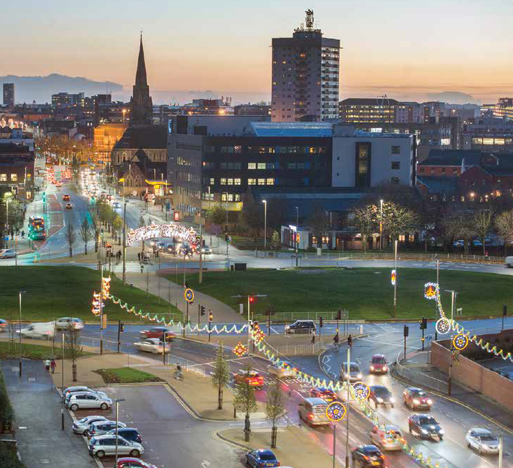
Improving air quality in Leicester - Themes
There are 4 themes:
Reducing Transport Emissions
Promoting Sustainable Transport
Improving Traffic Management
Enhancing Planning and the Environment
In this activity we have identified 4 actions within the themes

Slide 6
Theme 1 – reducing transport emissions
(2) Introduce a low emission zone focussing on buses (using Haymarket Bus Station and St Margaret’s Bus Station) and work towards an ultra-low emission zone (ULEZ) for all vehicles over the period to 2026
Air quality impact - HIGH

Slide 7
Theme 1 – continued
(4) Increase the uptake of ultra-low emission vehicles (ULEV) by residents and business
Air quality impact - HIGH

Slide 8
Theme 2 – promoting sustainable transport
(8) Increase the uptake of more sustainable transport options
Air quality impact - LOW initially, but would increase over time

Slide 9
Theme 2 – continued
(10) Deliver our Leicester cycle action plan and integrate walking initiatives
Air quality impact - LOW initially, but would increase over time

Slide 10
Theme 3 – improving traffic management
(12) Deliver a programme of 20 mph zones
Air quality impact – LOW, but can bring improved localised air quality and encourage walking and cycling

Slide 11
For each action identify:
The benefits of the scheme (air quality and others)
The potential problems (and how you would mitigate them)
You might have to carry out your own research to find out more

Slide 12
Which would give the biggest benefit?
(2) Introduce a low emission zone
(4) Increase the uptake of ultra-low emission vehicles
(8) Increase the uptake of more sustainable transport options
(10) Deliver our Leicester cycle action plan and integrate walking initiatives
(12) Deliver a programme of 20 mph zones

Slide 13
Extension/homework activity
Would free public transport for all improve air quality? Give reasons for and against implementing this scheme
Describe how you would tackle air quality in Leicester – one of the current methods or something completely different?
Write to your local MPs and/or councillors asking them about air quality in the city their plans to improve air quality

